Slide 1


CalAIM Statewide Dementia Care Learning Collaborative
June 12, 2024
California Health Policy Strategies, LLC
Notes:
David

Slide 2
Agenda
Welcome and Introductions
CBAS – ECM Enrollment Discussion with New Sunrise ADHC
Workgroup Update
Technical Assistance Review
Next Steps
California Health Policy Strategies, LLC

Slide 3
CBAS – ECM Enrollment Discussion with New Sunrise ADHC
Lena Haroutunian and Stephanie Gomez
California Health Policy Strategies, LLC
Notes:
Lena Haroutunian and Stephanie Gomez

Slide 4
Workgroup Update
California Health Policy Strategies, LLC
Notes:
Darren

Slide 5
Primary Care
Looking for opportunities to engage primary care physicians that provide care to patients with dementia and/or at risk of institutionalization
California Academy of Family Physicians (CAFP) may be interested in exploring potential collaboration with our collaborative
Northern CA Alzheimer's Association is presenting at CAFP conference in August
More discussions needed about training on dementia care issues and CalAIM opportunities
California Health Policy Strategies, LLC
Notes:
David

Slide 6
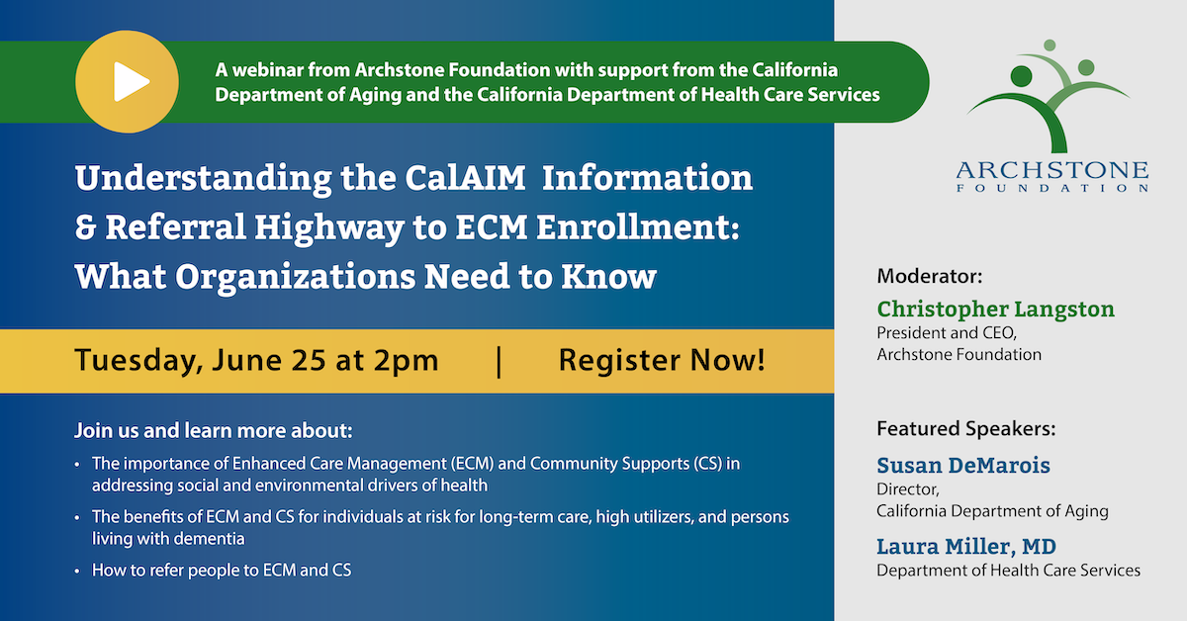
Area Agencies on Aging, Caregiver Resource Centers, Aging and Disability Resource Connection
California Health Policy Strategies, LLC
Notes:
Jasmine

Slide 7
Managed Care Plans
ECM Managers and Supervisor Learning Collaborative
Managed Care Plans ONLY
Wednesday, July 10, 2 PM
Join Zoom Meeting https://us02web.zoom.us/j/87271253064
Meeting ID: 872 7125 3064
California Health Policy Strategies, LLC
Notes:
Jane

Slide 8
In Home Supportive Services (IHSS)
Partnering with managed care plans, counties, and unions to establish referral pathways
Alameda County
Riverside and San Bernardino Counties
Looking for other counties where we can expand our efforts
California Health Policy Strategies, LLC
Notes:
Brooke

Slide 9
Home and Community Based Alternatives (HCBA) Waiver
ECM Referrals via HCBA Applications
Referral Sources:
Member Information Files
Traditional Providers
Personal Referrals
Similar proportions of HCBA applicants who are:
Referred to ECM (~10%)
Enrolled in ECM (~5%)
Overlap of patients eligible for both ECM & HCBA includes:
Adults at risk of institutionalization in skilled nursing facilities, who do not need acute, subacute, or intermediate care
California Health Policy Strategies, LLC
Notes:
Spencer

Slide 10
Technical Assistance Review
Carleena Bhaduri, Alzheimer’s Orange County
California Health Policy Strategies, LLC
Notes:
Lena Haroutunian and Stephanie Gomez

Slide 11
Technical Assistance Review
California Health Policy Strategies, LLC
Notes:
Spencer

Slide 12


Why we needed support – the struggle is real
What to consider
What help did we receive?
Where we are now
Notes:
Carleena Bhaduri, LCSW
Program Services Manager
Initial struggles – When we started to talk about working with CalOptima to provide limited case management to their most vulnerable members, it was daunting, to say the least, and the challenges many. We had to get key staff on board, visualize a plan and appropriate client referral demographics, areas we would serve, and the application process itself was overwhelming. The key though, in being a CalAim provider is really in ensuring that you first look at your own expertise in terms of what services you already excel at providing and who your client base already is, and envisioning how that can translate into meeting Medi-Cal client needs. For example, we already have a robust referral and community partner base, and we can utilize that to help connect clients with as needs arise; we just take that a step further by assisting the clients with that connection and following up on it more in-depth than we might do otherwise.
Once we were approved and had hired a staff member, the real work began. We started getting referrals from CalOptima, but also from our day centers and community partners. Turning those referrals into clients was the next challenge, and understanding the process behind it was where this support came in.
We worked with Darren from Xhealth Solutions who has been extremely helpful over the past few months. Darren really helped us to visualize our process and build a formal standard process flow-chart with steps and protocols that is helpful now and as new employees become involved. He has helped us develop workflows for things including referrals, outreach, treatment/case management, billing and discharge. We were able to make changes to our CRM based on his guidance that will help us with tracking clients for management and billing purposes.
During the time we have worked with Darren, we have seen steady growth in our client base, starting with our first clients in February, and now we are approaching 20 clients whom we provide a minimum of 2 hours of billable service to through CalOptima. Our future goals are to bring on additional staff to support the program as it grows.

Slide 13
Next Steps
Upcoming Collaborative Meetings
Wednesday, August 14, 12:00 – 1:00PM
Wednesday, September 11, 12:00 – 1:00PM
Wednesday, October 9, 12:00 – 1:00PM
Wednesday, November 13, 12:00 – 1:00PM
Tuesday, December 3, 12:00 – 1:00PM
CalAIM Information and Referral Highway to ECM Enrollment – Webinar
Tuesday, June 25th from 2:00 – 3:00PM
Register here: https://tinyurl.com/6xnz2csb
California Health Policy Strategies, LLC
Notes:
Brooke and/or Jasmine

