Slide 1


CalAIM Enhanced Care Management (ECM) and Community Supports (CS)
Nancy Wongvipat Kalev, MPH
Sr. Director, Systems of Care
Notes:
Presentation on Health Net’s Approach for Sustainability and CBO Partnerships (Nancy Wongvipat Kalev) (10 mins)
CalAIM background
Strategy to support CBOs through training, technical assistance, funding, etc. to help CBOs partner and contract more easily with payers for sustainability
Lessons learned from this work
Examples of CBO partnerships
Sustainability strategy by layering benefits and resource connections
Lessons learned on offering food interventions as ILOS through CalAIM

Slide 2
Background
The Department of Health Care Services (DHCS)’s CalAIM (California Advancing and Innovating Medi-Cal) leverages Medicaid as a tool to help address many of the complex challenges facing California’s most vulnerable residents, such as homelessness, insufficient behavioral health care access, children with complex medical conditions, the growing number of justice-involved populations who have significant clinical needs, and the growing aging population.
CalAIM also recognizes the opportunity to provide for non-clinical interventions focused on a whole-person care approach through Medi-Cal that target social drivers of health (SDOH) and reduce health disparities and inequities.
CalAIM has three primary goals:
• Identify and manage member risk and need through Whole Person Care Approaches and addressing SDOH;
• Move Medi-Cal to a more consistent and seamless system by reducing complexity and increasing flexibility; and
• Improve quality outcomes and drive delivery system transformation through value-based initiatives, modernization of systems and payment reform.

Slide 3
Enhanced Care Management (ECM) and Community Supports– Where did it come from?
WPC
HHP
CCI
CalAIM
Health Homes Program (HHP) – Targets members with complex care needs with in-person intensive care mgmt. intervention provided by CBOs
Whole Person Care (WPC) – Targets high utilizers, homeless, re-entry & high risk populations to address health, behavioral health, and social needs of high-cost beneficiaries through multiple county systems
Coordinated Care Initiative (CCI) – Integrated MLTSS & mandatory enrollment of Duals in Medi-Cal
Notes:
Where did CalAIM come from?
DHCS took the lessons learned and the things that worked from current waiver programs: HHP, WPC, and CCI.
HHP and WPC are scheduled to sunset at the end of 2021, and the CCI winding down at the end of 2022 or transitioning to the DSNP 1/1/2023

Slide 4
CalAIM’s Enhanced Care Management (ECM)
ECM is a benefit, and is intended to be rendered in person
The role of the ECM provider is to coordinate all primary, acute, behavioral, developmental, oral, and long-term services and supports for the member, including participating in the care planning process, regardless of setting.
ECM Core Service Components:
Comprehensive Assessment & Care Management Plan – Assess & develop a person-centered care plan incorporating the members clinical & non-clinical needs
Enhanced Coordination of Care – Organize patient care activities according to the care plan, be continuous and integrated among all service providers, and regular contact with the patient
Health Promotion – Identify & build on potential family or community supports, encourage and support patients to make lifestyle choices based on healthy behavior; and supporting the patient in strengthening their skills to enable them to identify and access resources to assist managing the patient’s condition
Comprehensive Transitional Care – Engagement activities that seek to reduce avoidable admissions, and support care transition plan activities
Member & Family Supports – Serve as the primary point of contact for the Member and their chosen family/support persons, identify supports for the patient and their chosen family/support persons
Coordination of Referral to Community and Social Support Services

Slide 5
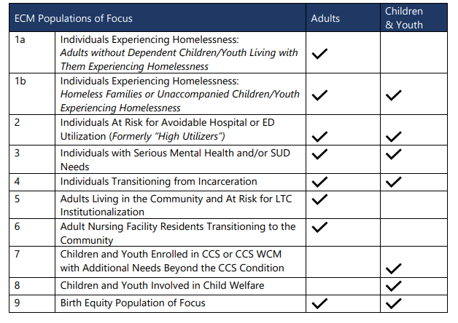
ECM Populations of Focus
Notes:
Wise and Healthy Aging; ADHCs
provider_nameAmpla Health Colusa Medical and DentalAmpla Health Hamilton City MedicalAmpla Health Richland MedicalDaCare Inc*WOOF*Ampla Health Los MolinosVista Community ClinicOnegeneration Adult Day Healthcare ProgramSunnyday Adult Day Health CareLos Angeles County DepartmentDhs-Martin L King Jr - Peds HubChinatown Service Center Community Center - ChinatownKaweah Delta Dinuba Health ClinicVista Community Clinic - Durian - FfsVista Community Clinic - Horne - FfsComprehensive Community Health Centers IncNorwalk Regional Health CenterDIDI Hirsch Psychiatric ServiceTarzana Treatment Centers - Long Beach Outpatient FacilityHill-Elica Health Center - FranklinTulare County Health & HumanKaweah Delta Tulare Health CliElica Health Centers - Mack RoadElica Health Centers - Cadillac DriveElica Health Centers - MarysvilleHill-Elica Health Center - Watt AveElica Health Centers - Health on Wheels 4Hill-Elica Health Center - V StreetHill-ELICA Health Center - West SacramentoElica Health Centers - Revere Medical CenterElica Health Centers - Health on Wheels 2Hill-Elica Health Center - Arden ArcadeElica Health Centers - Health on Wheels 3Elica Health Centers - Health on WheelsSterling Hospitalist Medical Group, Inc. - Titanium Healthcare PlacerVia Care Community Health Center - Via Care Tweedy Health CenterTarzana Treatment Centers, Inc. - Woodland HillsVista Community Clinic-DurianVietnam Veterans of San DiegoHeritage Clinic and the Community Assistance Program for Seniors - LancasterHeritage Clinic and the Community Assistance Program for Seniors - Los AngelesSan Fernando Valley Community Mental Health Center, Inc.Fred Brown's Recovery Services, Inc.Harbor Community Clinic, Inc.Venice Family Clinic-Robert Levine Family Health CenterKern County Hospital AuthorityMaclay Wellness CenterExodus Recovery IncWhole Care SolutionsCare Matters Healthcare Inc Dba Concise Care GroupSacramento County Behavioral Health ServicesBakersfield American Indian Health ProjectWISE and Healthy AgingTri Counties Community Action PartnershipPresidium Health

Slide 6
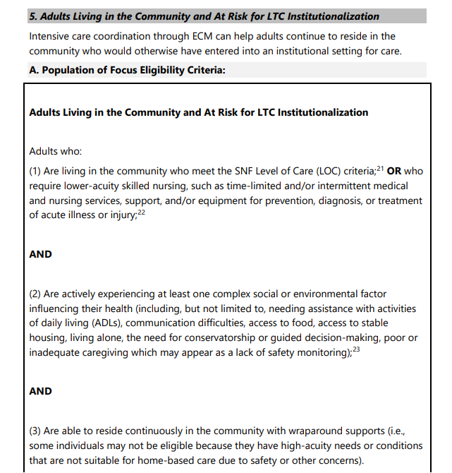
Eligibility Criteria

Slide 7
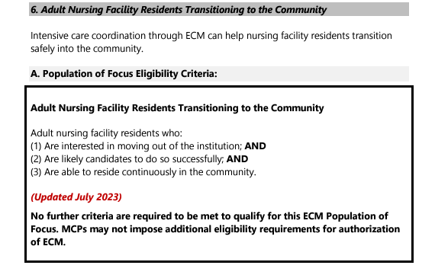
Eligibility Criteria

Slide 8
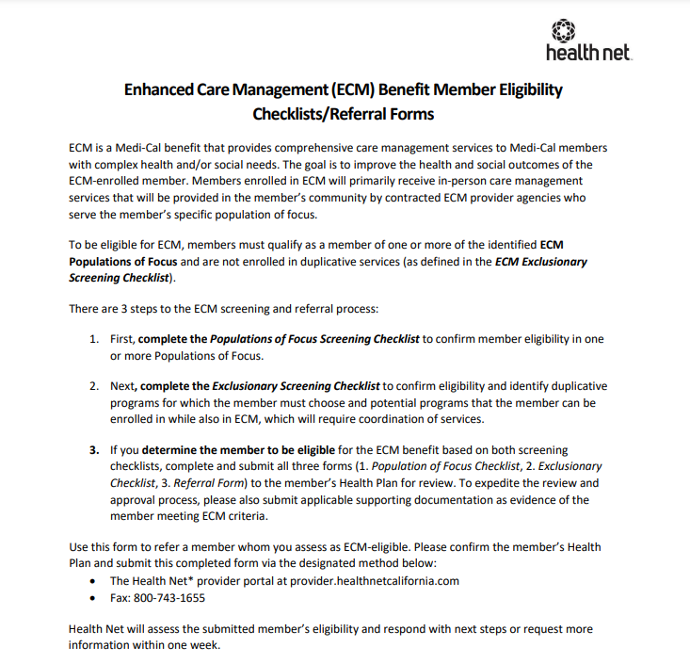
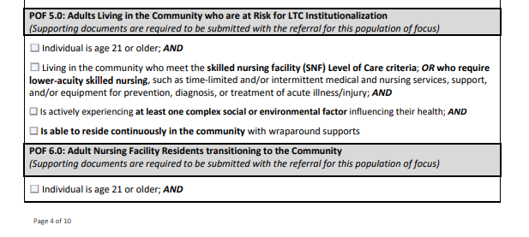
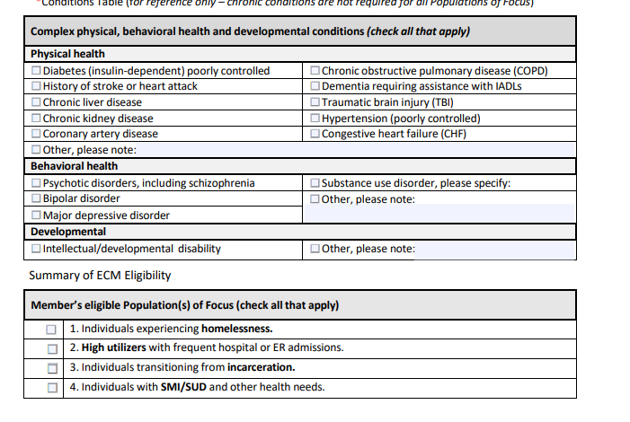
ECM Referral Form

Slide 9
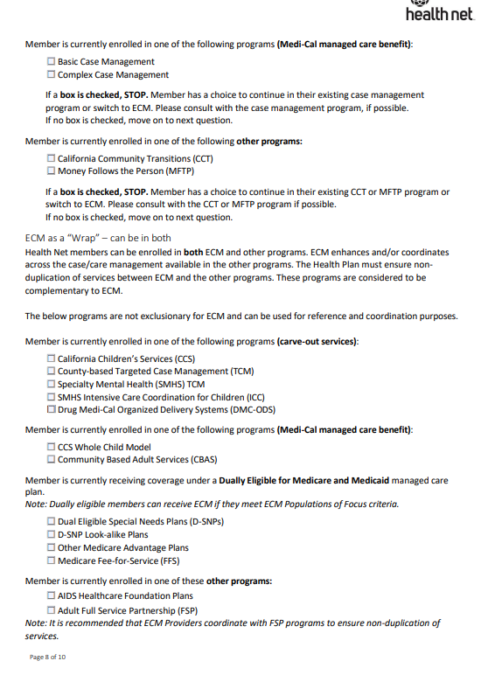
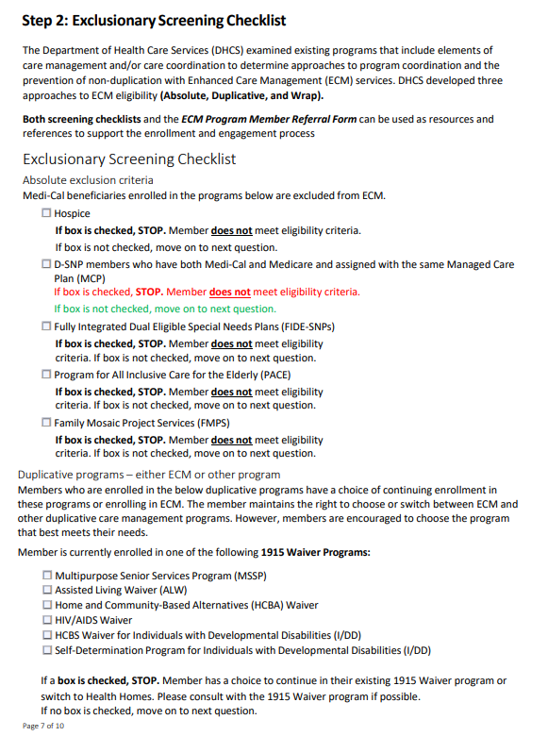
ECM Referral Form

Slide 10
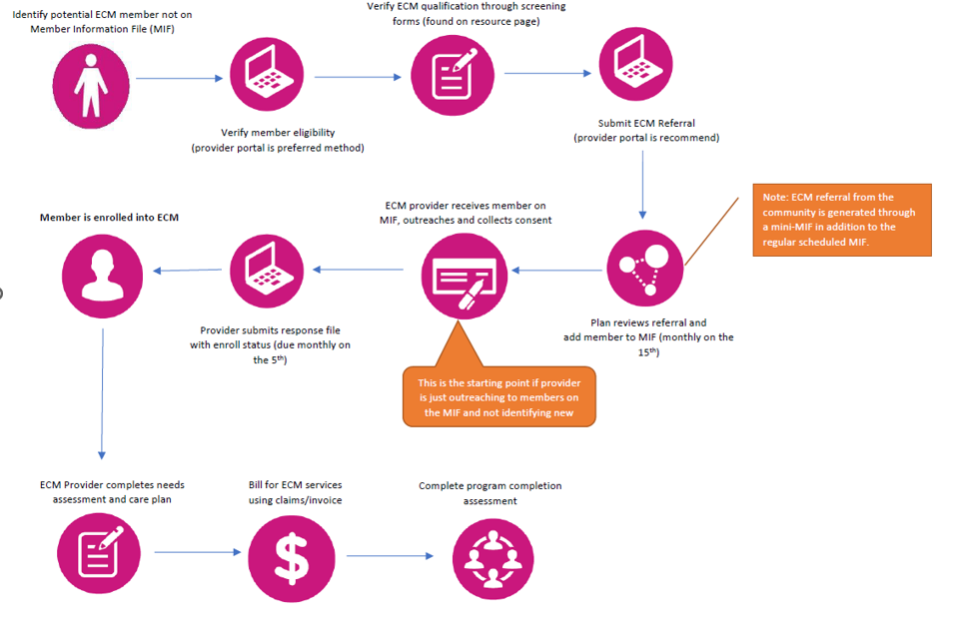
ECM End-To End Process
https://wwwˌhealthnetˌcom/content/healthnet/en_us/providers/support/calaim-resources/ecm-processˌhtml

Slide 11


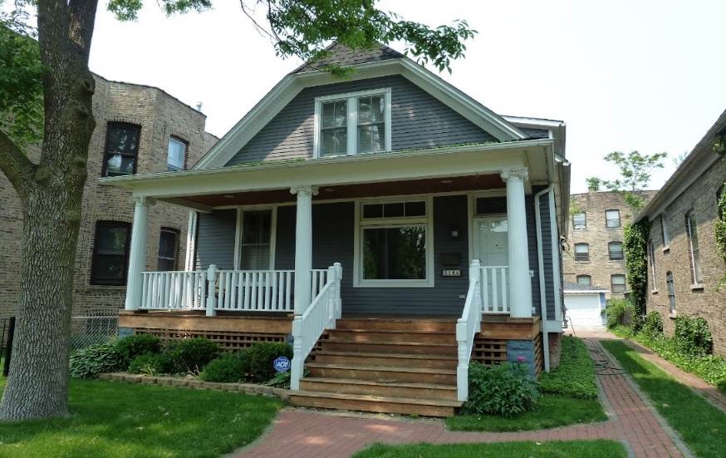
CalAIM’s Community Supports (CS)
Medically appropriate and cost-effective alternatives to state plan services.
These services provide considerable flexibility for plans to go beyond services defined in the Medicaid state plan to address social needs.
Member
Housing Transition Navigation Services
Housing Deposits
Housing Tenancy & Sustaining Services
Short-Term Post-Hospitalization Housing
Recuperative Care (Medical Respite)
Respite Services
Day Habilitation Programs
Nursing Facility Transition (NFT)/Diversion to Assisted Living Facilities, such as Residential Care Facilities for the Elderly (RCFE) & Adult Residential Facilities (ARF)
Community Transition Services/NFT to a Home
Personal Care & Homemaker Services
Environmental Accessibility Adaptations (Home Modifications)
Medically-Supported Food/Meals/Medically Tailored Meals
Sobering Centers
Asthma Remediation

Slide 12
Community Support Descriptions
Services to Address Homelessness & Housing:
Community Supports | Description
Housing Deposits | Funding for one‑time services necessary to establish a household, including security deposits to obtain a lease, first month’s coverage of utilities, or first and last month’s rent required prior to occupancy.
Housing transition navigation services | Assistance with obtaining housing. This may include assistance with searching for housing or completing housing applications, as well as developing an individual housing support plan.
Housing tenancy and sustaining services | Assistance with maintaining stable tenancy once housing is secured. This may include interventions for behaviors that may jeopardize housing, such as late rental payment and services, to develop financial literacy.
Recuperative Services:
Community Supports | Description
Recuperative care (medical respite) | Short‑term residential care for beneficiaries who no longer require hospitalization, but still need to recover from injury or illness.
Respite | Short‑term relief provided to caregivers of beneficiaries who require intermittent temporary supervision.
Short term post hospitalization housing | Setting in which beneficiaries can continue receiving care for medical psychiatric, or substance use disorder needs immediately after exiting a hospital.
Sobering Centers | Alternative destinations for beneficiaries who are found to be intoxicated and would otherwise be transported to an emergency department or jail.
Nonmedical services that can be provided as alternatives to standard Medicaid benefits in the managed care delivery system.
ILOS are intended to be provided “in-lieu of” standard Medicaid benefit.

Slide 13
Community Support Descriptions
Services for Long-Term Well0Being in Home-Like Settings:
Community Supports | Description
Asthma remediation | Physical modifications to a beneficiary’s home to mitigate environmental asthma triggers.
Day habilitation programs | Programs provided to assist beneficiaries with developing skills necessary to reside in home‑like settings, often provided by peer mentor‑type caregivers. These programs can include training on use of public transportation or preparing meals.
Environmental accessibility adaptations | Physical adaptations to a home to ensure the health and safety of the beneficiary. These may include ramps and grab bars.
Meals/medically tailored meals | Meals delivered to the home that are tailored to meet beneficiaries unique dietary needs, including following discharge from a hospital.
Nursing Facility transition/diversion to assisted living facilities | Services provided to assist beneficiaries transitioning from nursing facility care to community settings, or prevent beneficiaries from being admitted to nursing facilities.
Nursing facility transition to a home | Services provided to assist beneficiaries transitioning from nursing facility care to home settings in which they are responsible for living expenses.
Personal care and homemaker services | Services provided to assist beneficiaries with daily living activities, such as bathing, dressing, housecleaning, and grocery shopping.
Nonmedical services that can be provided as alternatives to standard Medicaid benefits in the managed care delivery system.
ILOS are intended to be provided in-lieu of standard Medicaid benefit.

Slide 14
CS Screening and Referral
All providers are able to refer a member to our contracted CS providers if they have deemed that the member qualifies for CS services. We highly encourage providers to use the CS authorization guides to determine if the member qualifies for CS services. Providers can refer members to CS by referring them through findhelp or sending the member information to contracted CS providers in our ECM/CS provider directory.
https://communitysupportsecmˌfindhelpˌcom/

Slide 15
CalAIM Resources
CalAIM-- For Providers
https://wwwˌhealthnetˌcom/content/healthnet/en_us/providers/support/calaim-resourcesˌhtml
CalAIM-- For Members
https://wwwˌhealthnetˌcom/content/healthnet/en_us/members/medi-cal/calaim-resourcesˌhtml
Notes:
CalAIM-- For Providers--
https://www.healthnet.com/content/healthnet/en_us/providers/support/calaim-resources.html
CalAIM-- For Members—
https://www.healthnet.com/content/healthnet/en_us/members/medi-cal/calaim-resources.html

