Slide 1


CalAIM Statewide Older Adult Collaborative
February 11, 2026
California Health Policy Strategies, LLC
Notes:
David

Slide 2
Agenda
Agenda Item | Speaker | Time
Welcome and Introductions | David Panush | 3 min
In the Spotlight: Office of Medicare Innovation and Integration Chief | Lauren Solis | 45 min
Future Presentation: A Preview | MJ Pandher | 8 min
Announcements and Upcoming Meetings | Jasmine Lacsamana | 4 min
California Health Policy Strategies, LLC

Slide 3


In the Spotlight
February 11, 2026
California Health Policy Strategies, LLC

Slide 4
Office of Medicare Innovation and Integration
Overview for CalAIM Statewide Older Adults Collaborative
Lauren Gavin Solis, OMII Chief
February 11, 2026

Slide 5
Office of Medicare Innovation and Integration
The DHCS Office of Medicare Innovation and Integration (OMII) provides focused leadership and expertise on innovative models of care for Medicare beneficiaries in California, including both Medicare-only individuals and those dually eligible for Medicare and Medi-Cal.
OMII’s mission is to improve health outcomes, quality, affordability, and equity for Medicare beneficiaries, consistent with the Governor’s Master Plan for Aging and CalAIM.

Slide 6
OMII’s Key Functions
Leads DHCS policy development for dual eligibles, including integration through Dual Eligible Special Needs Plans (D-SNPs) and the Program of All-Inclusive Care for the Elderly (PACE).
Coordinates with federal, state, and local partners to align enrollment, benefits, and care delivery systems.
Oversees data analysis, stakeholder engagement, and technical assistance to support integrated care and policy innovation.
Supports new and existing models that increase access to Long-Term Services and Supports (LTSS).

Slide 7
Latest Updates from OMII
Medi-Medi Plans: Effective January 2026, expanded Medi-Medi Plans from 12 to 41 counties to improve integration and care coordination for dual eligibles.
PACE Transition: Effective January 2026, the PACE branch moved under OMII to strengthen program alignment and integration.
BridgeCare Pilots: As part of the CalAIM Section 1115 demonstration renewal, DHCS is seeking approval from CMS to provide Home and Community-Based Services (HCBS) and caregiver supports to "near duals” with significant health needs who lack resources for adequate care.

Slide 8
Medi-Medi Plans

Slide 9
The Need for Coordinated Care
For most dual eligible members, Medicare and Medi-Cal operate separately, with different funding streams.
This fragmented system can be confusing and hard to navigate. It may not provide person-centered services.
CalAIM Approach: Health plans required to coordinate care across Medicare and Medi-Cal, known as Medi-Medi Plans.
  Previously available in 12 counties.
  Launched in 29 additional counties on January 1, 2026.
  A list of Medi-Medi Plans by county is available on the DHCS website.
Notes:
[Lauren Solis]

Slide 10
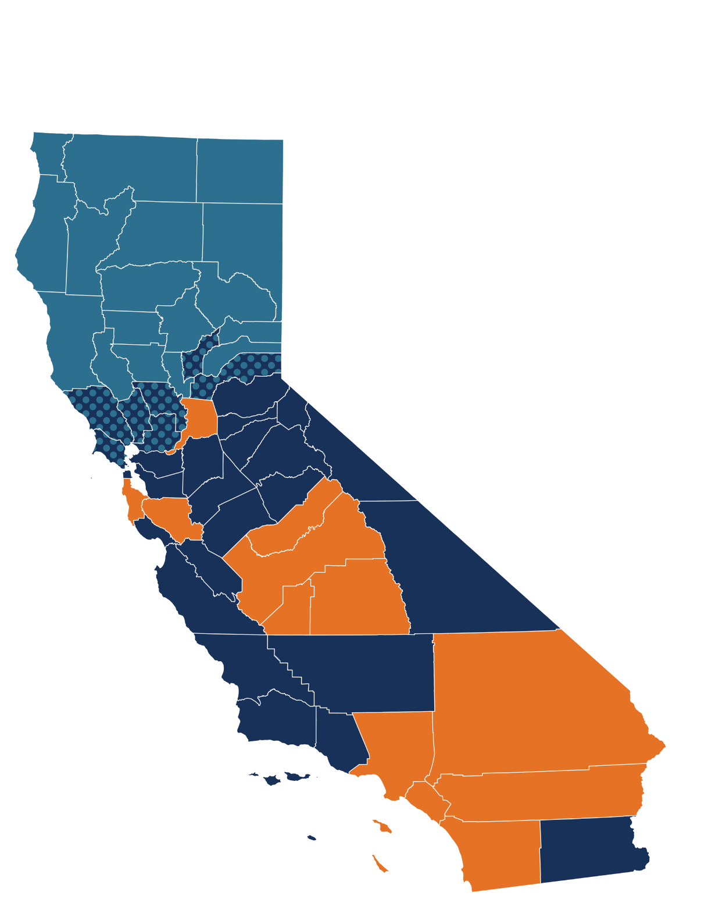

Medi-Medi Plans in
California Counties
Existing counties (launched in 2023 or 2024): Fresno, Kings, Los Angeles, Madera, Orange, Riverside, Sacramento, San Bernardino, San Diego, San Mateo, Santa Clara, Tulare
Newly added as of 2026: Alameda, Alpine, Amador, Calaveras, Contra Costa, El Dorado, Imperial, Inyo, Kern, Mariposa, Merced, Mono, Monterey, San Benito, San Francisco, San Joaquin, San Luis Obispo, Santa Barbara, Santa Cruz, Stanislaus, Tuolumne, Ventura
One plan newly added as of 2026 (additional option expected after 2026): Marin, Napa, Placer, Solano, Sonoma, Yolo, Yuba
Will be phased in after 2026: Butte, Colusa, Del Norte, Glenn, Humboldt, Lake, Lassen, Mendocino, Modoc, Nevada, Plumas, Shasta, Sierra, Siskiyou, Sutter, Tehama, Trinity
Notes:
[Lauren Solis]

Slide 11

Medi-Medi Plans
Medi-Medi Plans are a type of Medicare Advantage plan in California only available to dual eligible members. Medi-Medi Plans operate with exclusively aligned enrollment.
Members enrolled in a Medi-Medi Plan receive coordinated care. A Medi-Medi Plan member’s Medicare benefits are delivered through the D-SNP, and their Medi-Cal benefits are delivered through the MCP.
Enrollment in Medi-Medi Plans is voluntary.
D-SNP + MCP
Medi-Medi Plan
D-SNP provides care coordination and Medicare services, such as:
Hospitals
Doctor visits
Prescription drugs
MCP provides wrap-around services, such as:
Medicare cost-sharing
LTSS
Transportation
Other Medi-Cal benefits
Notes:
[Lauren Solis]

Slide 12

Care Coordination in
Medi-Medi Plans
Physicians
Hospitals
Medi-Medi Plans help members with all of their health care needs and coordinate benefits and care, including carved-out benefits, medical and home and community-based services, durable medical equipment, and prescriptions.
Instead of Medi-Cal Enhanced Care Management (ECM), Medi-Medi Plans provide California Integrated Care Management (CICM).
Dental
Rx &
Pharmacies
Behavioral
Health
Labs &
X-rays
Nursing Facilities
Medical
Transport
Community
Supports
Durable
Medical Equipment
LTSS
Notes:
[Lauren Solis]

Slide 13
Resources for Members
Dual eligible members can learn more about Medi-Medi Plans by viewing the Medi-Medi Plan Fact Sheet on the DHCS Medi-Medi Plan webpage.
  The fact sheet is available in English, Spanish, Hmong, Vietnamese, Traditional Chinese/Cantonese, Russian, Khmer/Cambodian, Arabic, Farsi, American Sign Language, and Mexican Sign Language.
For more information about coordinated care for dual eligibles, visit the DHCS Integrated Care for Dual Eligible Beneficiaries Website.
For support, members can contact:
  Health Insurance Counseling and Advocacy Program (HICAP) for free counseling on health care options: 1-800-434-0222
  Medicare Medi-Cal Ombudsman Program (MMOP) for help resolving issues with providers or health plans: 1-855-501-3077
Notes:
[Lauren Solis]

Slide 14
Resources for Providers and Stakeholders
Providers should direct questions to their contracted Medi-Cal plan.
Providers and other stakeholders can also submit general questions to DHCS at info@calduals.org.
To learn more about Medi-Medi Plans, providers and stakeholders can:
  Visit the DHCS Medi-Medi Plan Webpage.
  View the Medi-Medi Plans: Information for Providers Fact Sheet.
For more information about coordinated care for dual eligibles, visit the DHCS Integrated Care for Dual Eligible Beneficiaries Website.
Notes:
[Lauren Solis]

Slide 15
Questions?

Slide 16
Future Presentation: A Preview
February 11, 2026
California Health Policy Strategies, LLC

Slide 17

MJ Pandher, Social Services Director
California Health Policy Strategies, LLC
Notes:
Zoom link for H.R. 1 webinar: https://us02web.zoom.us/webinar/register/WN_Dw8CnQFzRy2N4WCzpX5DXA#/registration

Slide 18


Wrap-Up and Next Steps
February 11, 2026
California Health Policy Strategies, LLC

Slide 19

Upcoming Webinar
Zoom Registration Link can be found here.
California Health Policy Strategies, LLC
Notes:
Zoom Registration Link can be found here.

Slide 20

Upcoming Webinar
Hosted by the Primary Care Development Corporation, the Zoom Registration Link can be found here.
California Health Policy Strategies, LLC
Notes:
Hosted by Primary Care Development Corporation, the Zoom Registration Link can be found here.

Slide 21
Announcements and
Upcoming Meetings
Upcoming Meetings – Zoom registration link here.
  Wednesday, April 15, 12:00PM
  Wednesday, June 10, 12:00PM
Ad-Hoc Meetings
  ECM Managers/Directors Ad-Hoc Meeting
      February 18, 2026
  Medicare 101
      Part 1: March 4, 2026, at 2:00PM;
      Part 2: March 24, 2026, at 2:00PM
          Link forthcoming
  Social Services Aging 101: Webinar Series
      Part 1: April 30, 2026, at 2:00PM;
          Link forthcoming
California Health Policy Strategies, LLC

Slide 22
Appendix
California Health Policy Strategies, LLC
Notes:
Zoom link for H.R. 1 webinar: https://us02web.zoom.us/webinar/register/WN_Dw8CnQFzRy2N4WCzpX5DXA#/registration

Slide 23

Resource Highlight
WEBINAR RECORDING
COMPLETE TOOLKIT
ADDITIONAL INFORMATION
California Health Policy Strategies, LLC
Notes:
For county IHSS Social Workers and Public Authority Staff
Provides information and resources to educate IHSS recipients, caregivers, family member about ECM

