Slide 1


CalAIM Statewide Older Adult Collaborative
December 10, 2025
California Health Policy Strategies, LLC
Notes:
David

Slide 2
Agenda
Agenda Item | Speaker | Time
Welcome and Introductions | David Panush | 3 min
CalAIM Community Supports: Q4 2024 – Q1 2025 Overview | David Panush | 18 min
Sharing Perspectives | Barbra McLendon, Alzheimer’s Los Angeles; Stephanie Pierini, 24-Hour Home Care; Rebecca Sullivan, Local Health Plans of California; | 35 min
Announcements and Upcoming Meetings | Jasmine Lacsamana | 4 min
California Health Policy Strategies, LLC

Slide 3

CalAIM Community Supports: Utilization by County and Managed Care Plan -
2024 Q2-2025 Q1
December 2025
Reese Murray
California Health Policy Strategies, LLC

Slide 4

Individuals Receiving Community Supports 2024 Q2 – 2025 Q1
California Health Policy Strategies, LLC
Community Support | 2024 Q2 | 2024 Q3 | 2024 Q4 | 2025 Q1 | Change (2024 Q4 – 2025 Q1) | Change (2024 Q2 – 2025 Q1)
Asthma Remediation | 422 | 570 | 649 | 858 | + 209 | + 436
Community Transition Services | 206 | 221 | 237 | 281 | + 44 | + 75
Day Habilitation | 1,124 | 1,790 | 1,573 | 1,997 | + 424 | + 873
Environmental Accessibility Adaptations | 515 | 807 | 988 | 1,277 | + 289 | + 762
Housing Deposits | 1,896 | 2,860 | 3,213 | 3,483 | + 270 | + 1,587
Housing Tenancy and Sustaining | 9,930 | 9,001 | 20,026 | 21,150 | + 1,124 | + 11,220
Housing Transition Navigation | 30,534 | 37,061 | 45,745 | 52,442 | + 6,697 | + 21,908
Medically Tailored Meals | 79,882 | 84,490 | 89,443 | 86,411 | - 3,032 | + 6,529
Nursing Facility Transition | 393 | 517 | 797 | 1,350 | + 553 | + 957
Personal Care or Homemaker Services | 2,505 | 3,775 | 4,315 | 4,948 | + 633 | + 2,443
Recuperative Care (Medical Respite) | 3,320 | 3,681 | 4,301 | 5,227 | + 926 | +1,907
Respite Services | 539 | 1,518 | 1,925 | 2,973 | + 1,048 | + 2,434
Short-Term Post-Hospitalization Housing | 869 | 1,507 | 2,394 | 3,159 | + 765 | + 2,290
Sobering Centers | 895 | 1,087 | 829 | 1,285 | + 456 | + 390
1

Slide 5

Personal Care and Homemaker Services
2
California Health Policy Strategies, LLC

Slide 6
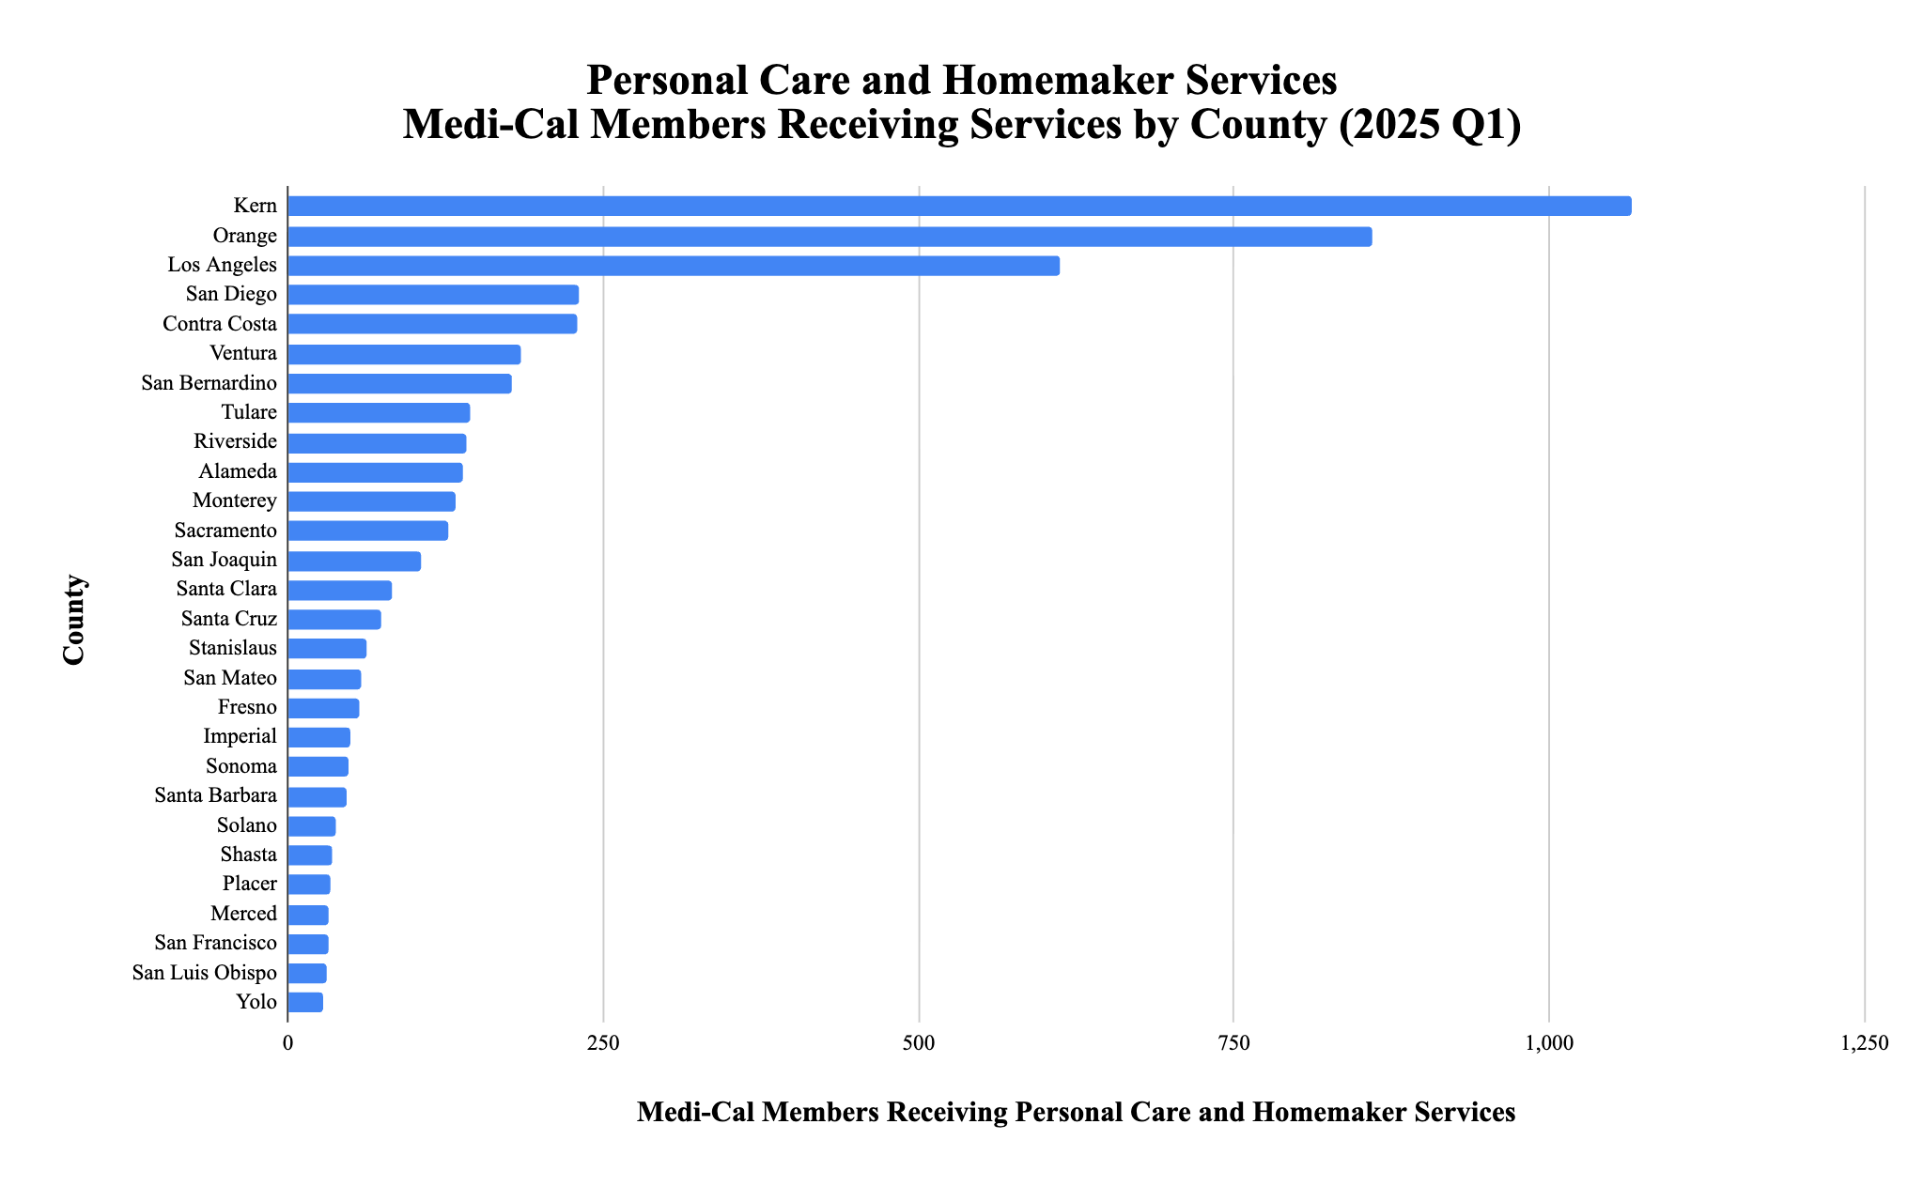

California Health Policy Strategies, LLC

Slide 7
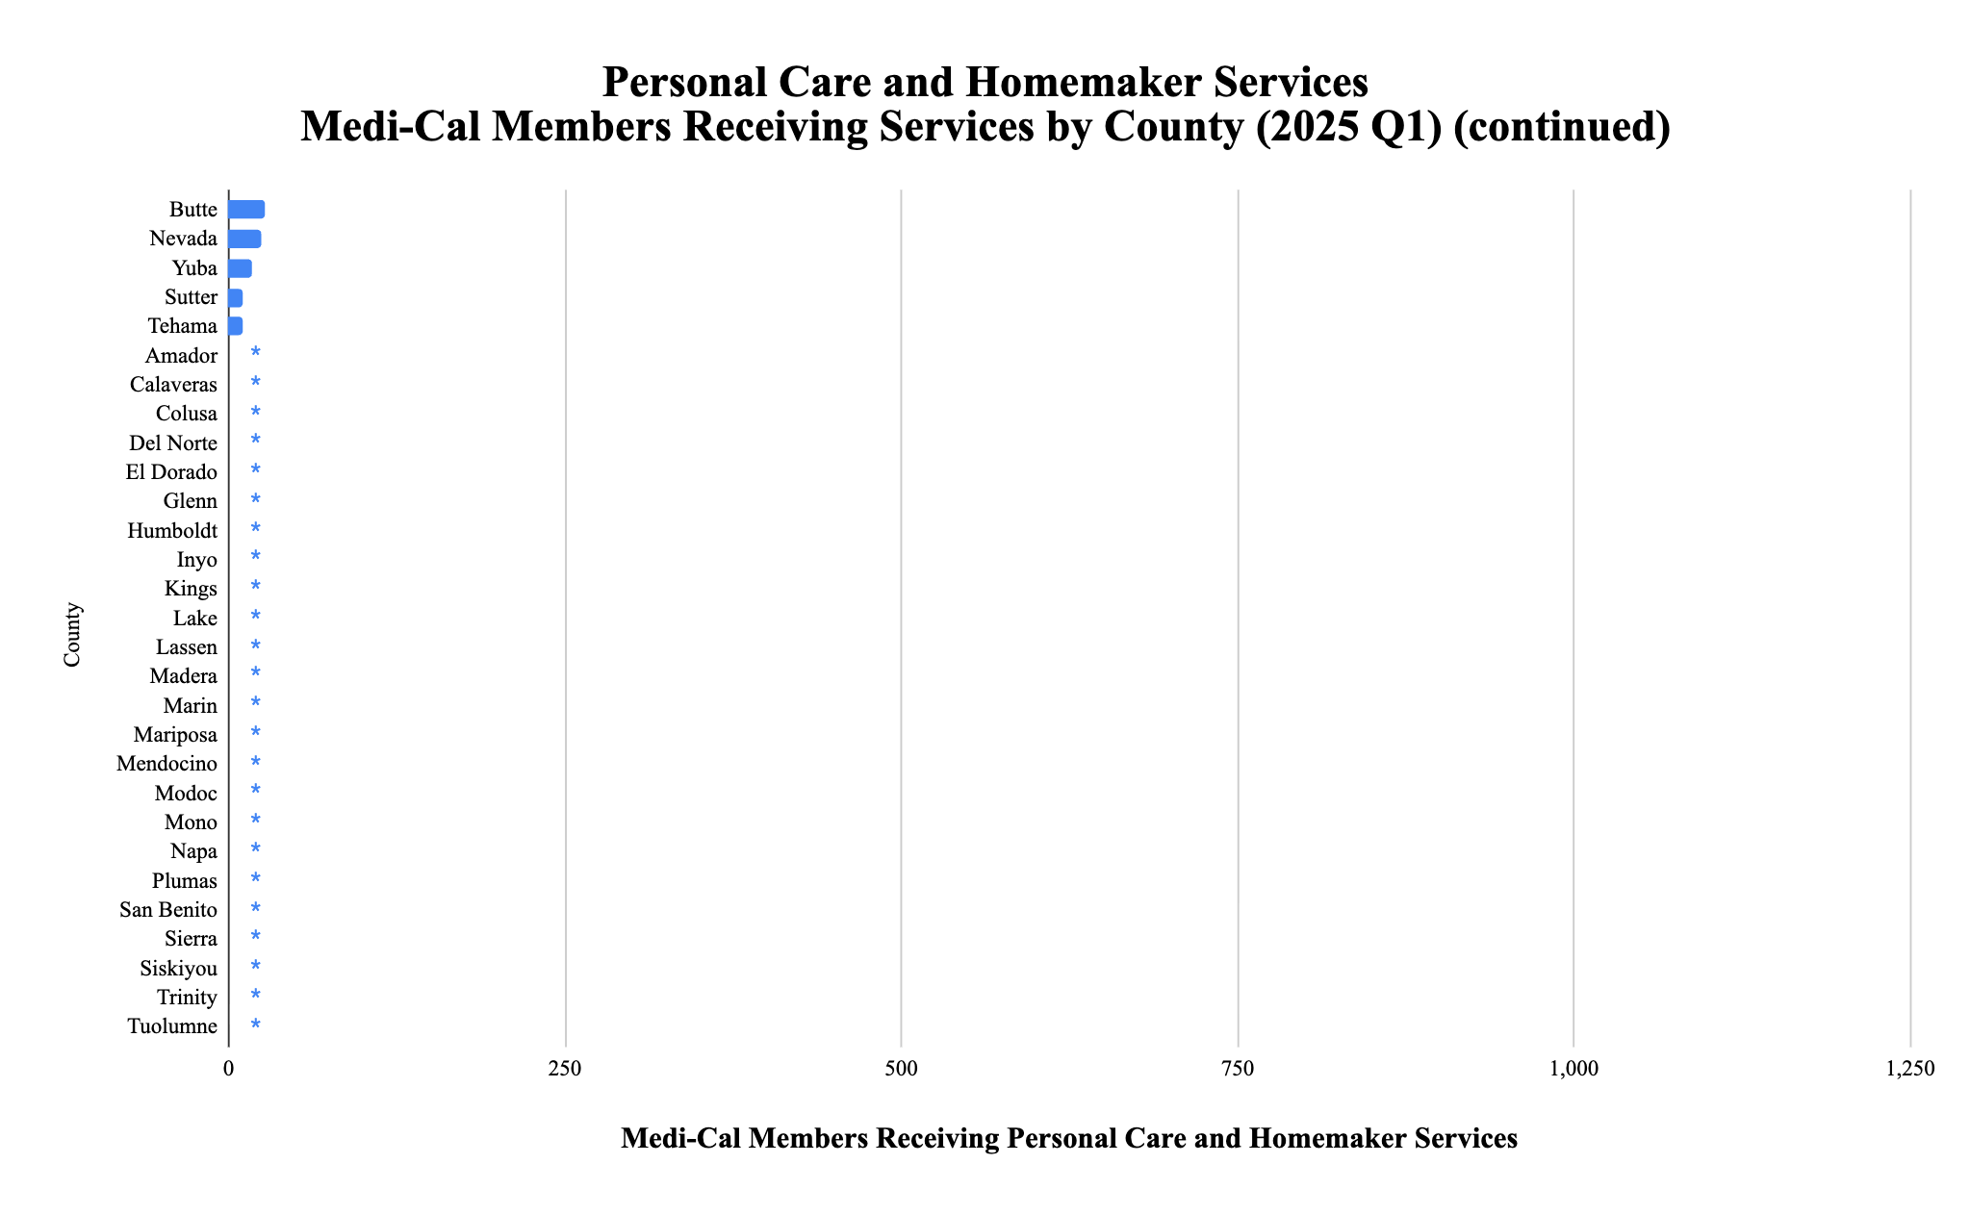
*
*
*
*
*
*
*
*
*
*
*
*
*
*
*
*
*
*
*
*
*
*
*
*
*
*
* denotes utilization of between 0-10 Medi-Cal members
California Health Policy Strategies, LLC

Slide 8
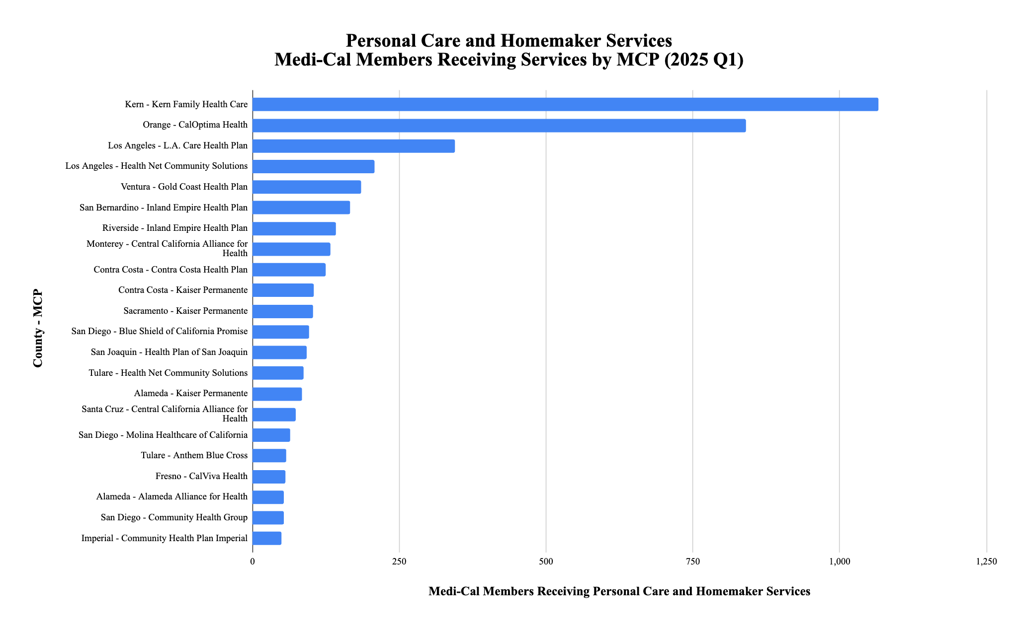
California Health Policy Strategies, LLC

Slide 9
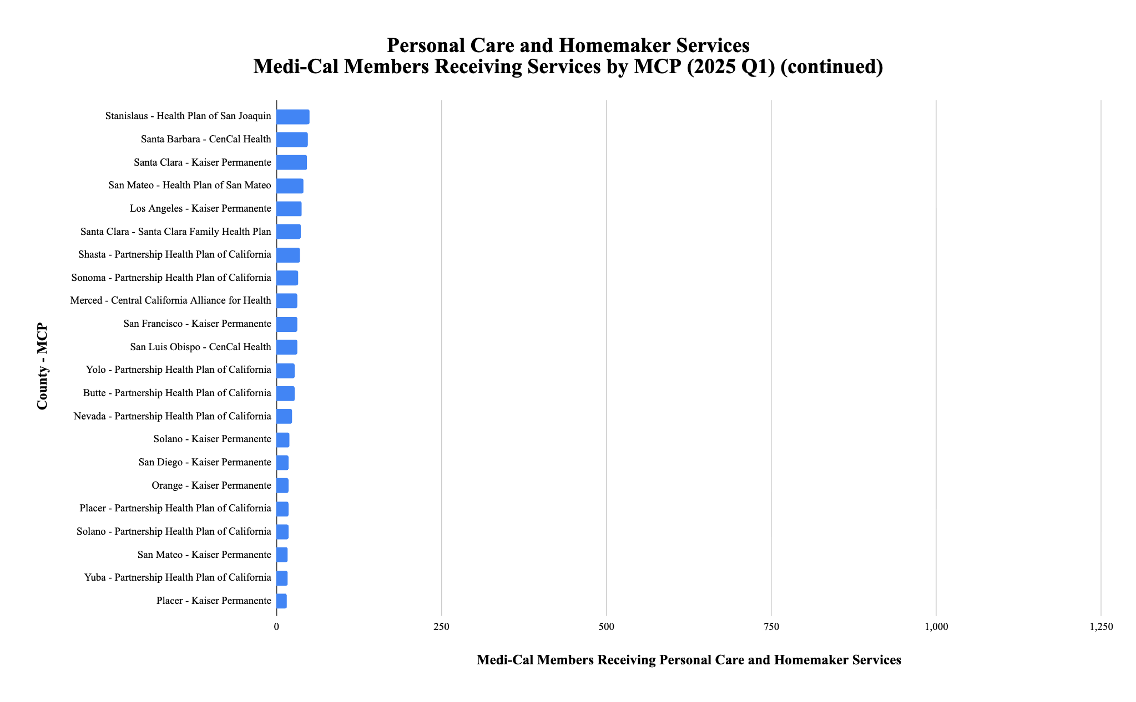
California Health Policy Strategies, LLC

Slide 10
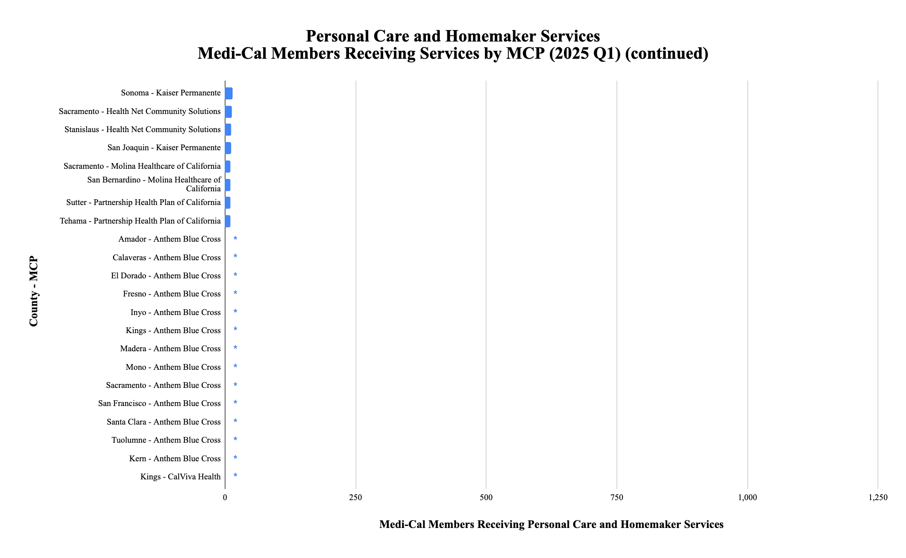
*
*
*
*
*
*
*
*
*
*
*
*
*
*
*
*
*
*
*
*
* denotes utilization of between 0-10 Medi-Cal members
California Health Policy Strategies, LLC

Slide 11
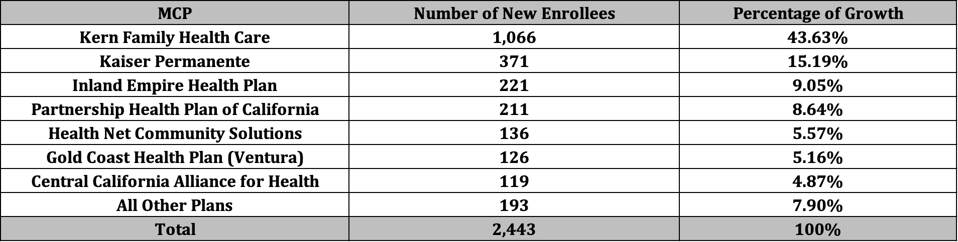
Personal Care and Homemaker Services Population of Focus
Of the 2,443 enrollees gained during these twelve months, over 90% of the growth can be attributed to these seven plans.
California Health Policy Strategies, LLC 10

Slide 12
Respite Services
16
California Health Policy Strategies, LLC

Slide 13
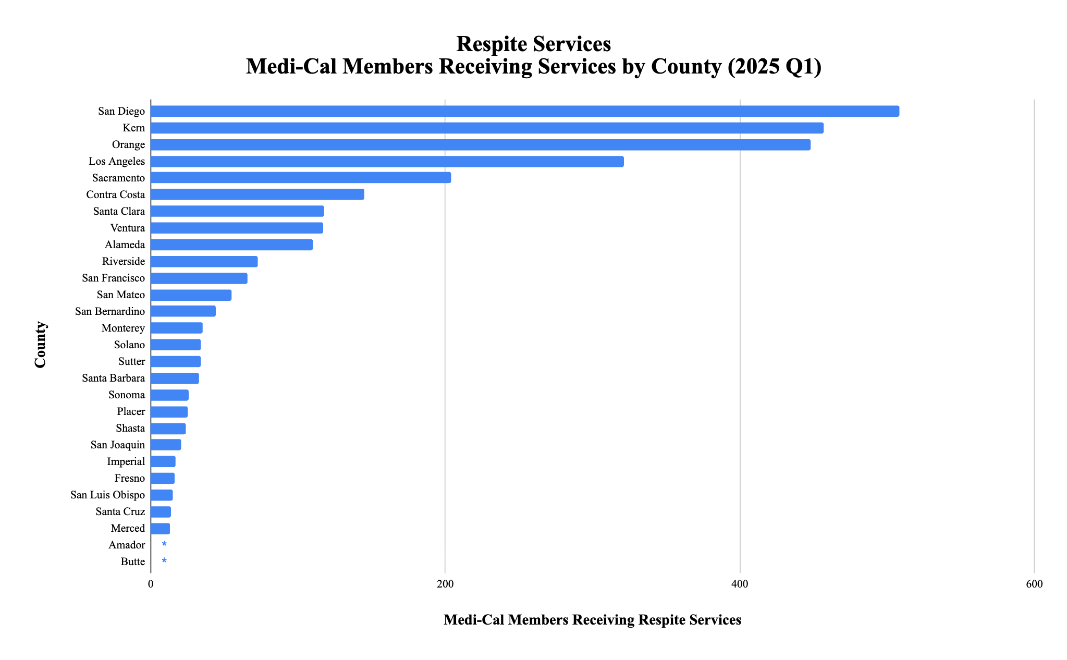
*
*
*
*
*
*
*
*
*
*
*
* denotes utilization of between 0-10 Medi-Cal members
California Health Policy Strategies, LLC

Slide 14
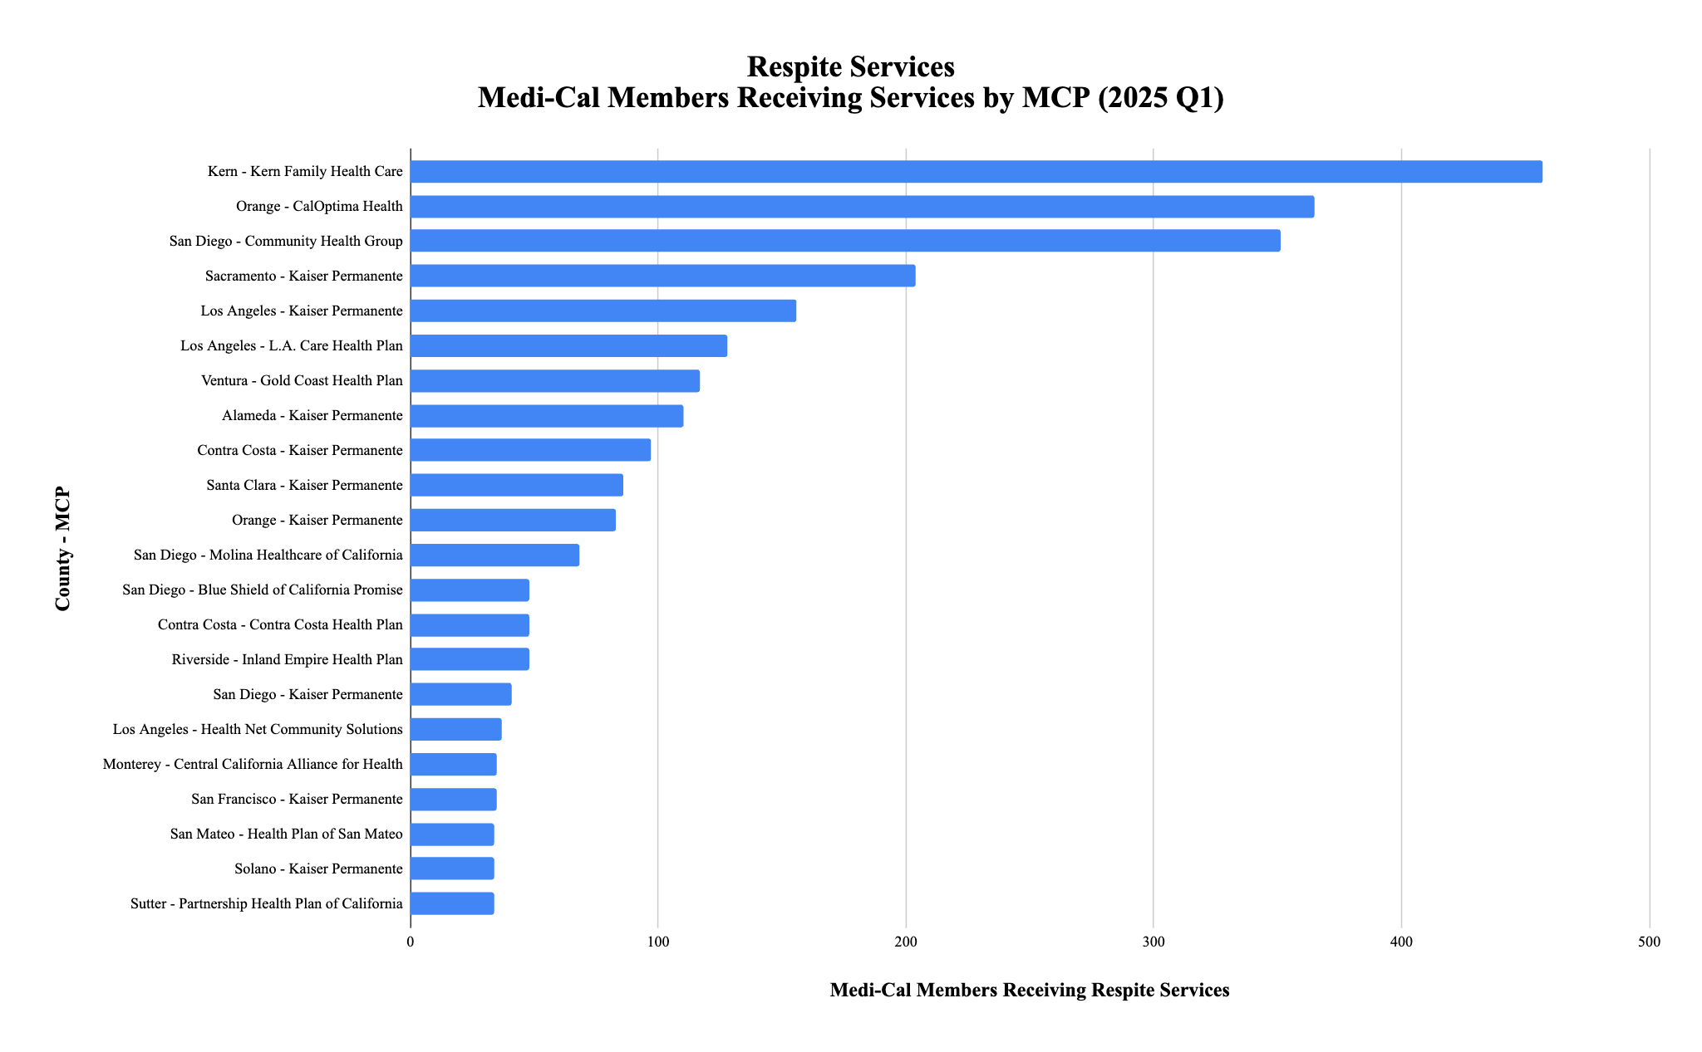
California Health Policy Strategies, LLC

Slide 15
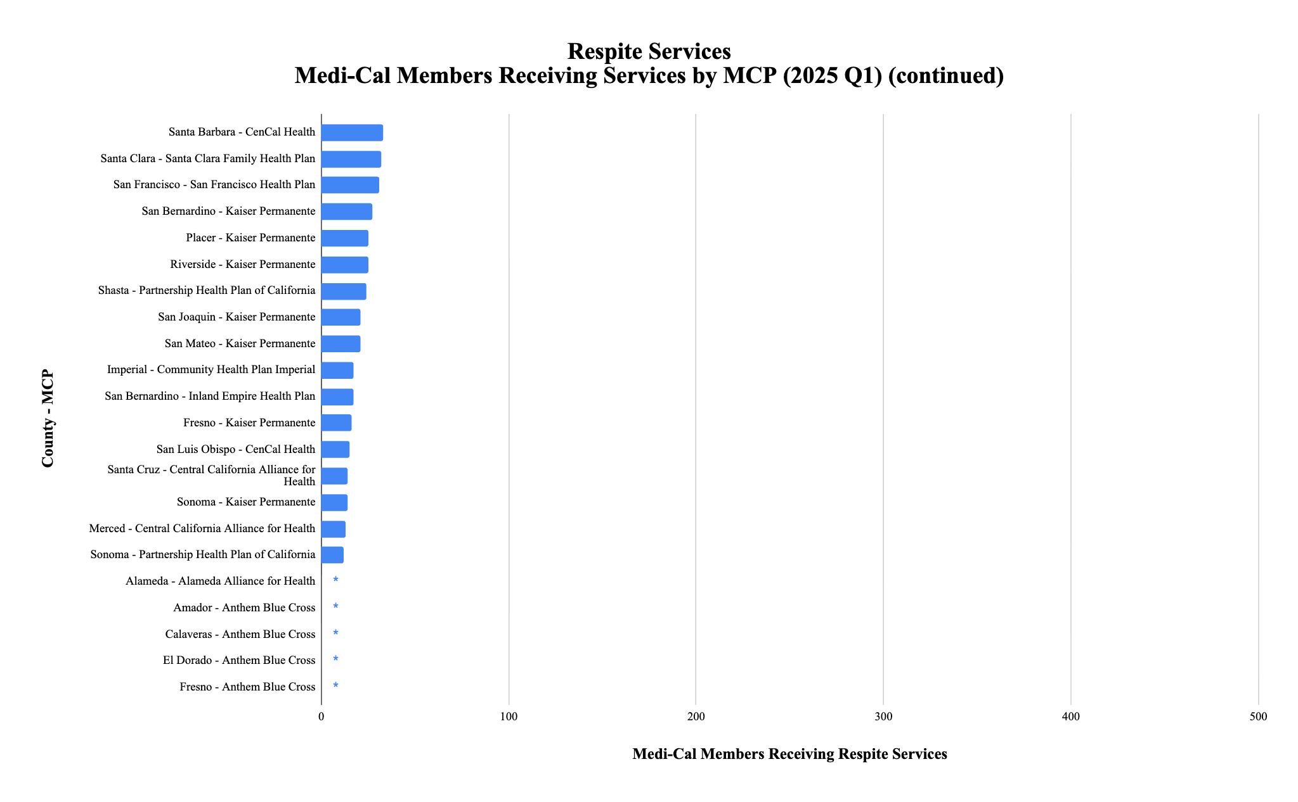
*
*
*
*
*
*
*
*
*
*
*
*
*
* denotes utilization of between 0-10 Medi-Cal members
California Health Policy Strategies, LLC

Slide 16
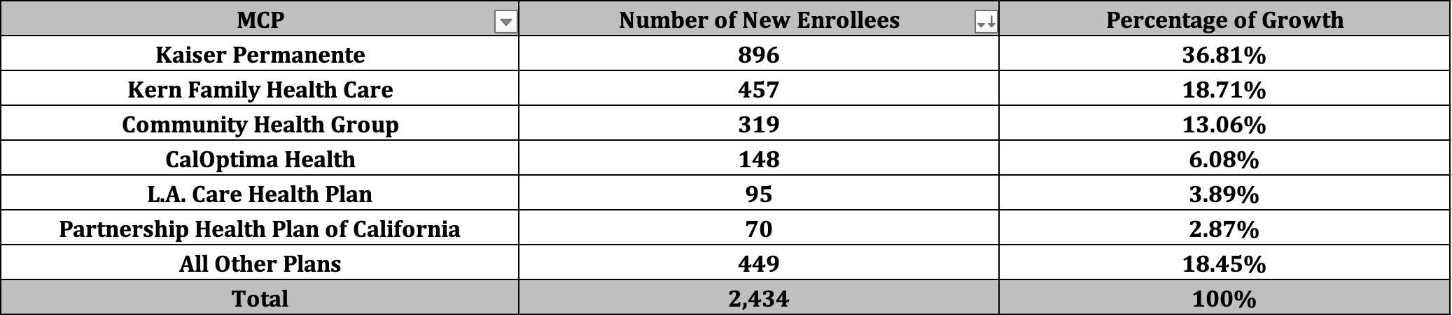
Respite Services Population of Focus
Of the 2,434 enrollees gained during these twelve months, approximately 80% of the growth can be attributed to these six plans.
California Health Policy Strategies, LLC 24

Slide 17

Sharing Perspectives
December 10, 2025
California Health Policy Strategies, LLC

Slide 18

Stephanie Pierini, Community Development Director
Provider Perspective
24 Hour Home Care
California Health Policy Strategies, LLC
Notes:
Zoom link for H.R. 1 webinar: https://us02web.zoom.us/webinar/register/WN_Dw8CnQFzRy2N4WCzpX5DXA#/registration

Slide 19

Barbra McLendon, Associate Vice President
Advocate Perspective
Alzheimer’s Los Angeles
California Health Policy Strategies, LLC
Notes:
Zoom link for H.R. 1 webinar: https://us02web.zoom.us/webinar/register/WN_Dw8CnQFzRy2N4WCzpX5DXA#/registration

Slide 20

Rebecca Sullivan, Director of Government Affairs, CalAIM & MLTSS
Plan Perspective
Local Health Plans of California
California Health Policy Strategies, LLC
Notes:
Zoom link for H.R. 1 webinar: https://us02web.zoom.us/webinar/register/WN_Dw8CnQFzRy2N4WCzpX5DXA#/registration

Slide 21


Wrap-Up and Next Steps
December 10, 2025
California Health Policy Strategies, LLC

Slide 22

Resource Highlight
WEBINAR RECORDING
COMPLETE TOOLKIT
ADDITIONAL INFORMATION
California Health Policy Strategies, LLC
Notes:
For county IHSS Social Workers and Public Authority Staff
Provides information and resources to educate IHSS recipients, caregivers, family member about ECM

Slide 23
Announcements and Upcoming Meetings
Upcoming Meetings – Zoom registration link here.
Wednesday, February 11th, 12:00PM
Wednesday, April 15, 12:00PM
Wednesday, June 10, 12:00PM
Ad-Hoc Meetings
ECM Managers/Directors Ad-Hoc Meeting
Bi-monthly on the second Wednesday of the month
Social Services Aging 101: Webinar Series
January and February 2026
Medi-Cal 101 Series (redux)
First quarter of 2026
California Health Policy Strategies, LLC

Slide 24
CalAIM Statewide Older Adult Collaborative
December 10, 2025
California Health Policy Strategies, LLC
Notes:
David

Slide 25
Appendix
California Health Policy Strategies, LLC
Notes:
Zoom link for H.R. 1 webinar: https://us02web.zoom.us/webinar/register/WN_Dw8CnQFzRy2N4WCzpX5DXA#/registration

Slide 26
CalAIM Community Supports: Utilization by County and Managed Care Plan -
2024 Q2-2025 Q1
December 2025
Reese Murray
California Health Policy Strategies, LLC

Slide 27
Individuals Receiving Community Supports 2024 Q2 – 2025 Q1
California Health Policy Strategies, LLC
Community Support | 2024 Q2 | 2024 Q3 | 2024 Q4 | 2025 Q1 | Change (2024 Q4 – 2025 Q1) | Change (2024 Q2 – 2025 Q1)
Asthma Remediation | 422 | 570 | 649 | 858 | + 209 | + 436
Community Transition Services | 206 | 221 | 237 | 281 | + 44 | + 75
Day Habilitation | 1,124 | 1,790 | 1,573 | 1,997 | + 424 | + 873
Environmental Accessibility Adaptations | 515 | 807 | 988 | 1,277 | + 289 | + 762
Housing Deposits | 1,896 | 2,860 | 3,213 | 3,483 | + 270 | + 1,587
Housing Tenancy and Sustaining | 9,930 | 9,001 | 20,026 | 21,150 | + 1,124 | + 11,220
Housing Transition Navigation | 30,534 | 37,061 | 45,745 | 52,442 | + 6,697 | + 21,908
Medically Tailored Meals | 79,882 | 84,490 | 89,443 | 86,411 | - 3,032 | + 6,529
Nursing Facility Transition | 393 | 517 | 797 | 1,350 | + 553 | + 957
Personal Care or Homemaker Services | 2,505 | 3,775 | 4,315 | 4,948 | + 633 | + 2,443
Recuperative Care (Medical Respite) | 3,320 | 3,681 | 4,301 | 5,227 | + 926 | +1,907
Respite Services | 539 | 1,518 | 1,925 | 2,973 | + 1,048 | + 2,434
Short-Term Post-Hospitalization Housing | 869 | 1,507 | 2,394 | 3,159 | + 765 | + 2,290
Sobering Centers | 895 | 1,087 | 829 | 1,285 | + 456 | + 390
1

Slide 28
Personal Care and Homemaker Services
2
California Health Policy Strategies, LLC

Slide 29
California Health Policy Strategies, LLC

Slide 30
*
*
*
*
*
*
*
*
*
*
*
*
*
*
*
*
*
*
*
*
*
*
*
*
*
*
* denotes utilization of between 0-10 Medi-Cal members
California Health Policy Strategies, LLC

Slide 31
California Health Policy Strategies, LLC

Slide 32
California Health Policy Strategies, LLC

Slide 33
*
*
*
*
*
*
*
*
*
*
*
*
*
*
*
*
*
*
*
*
* denotes utilization of between 0-10 Medi-Cal members
California Health Policy Strategies, LLC

Slide 34
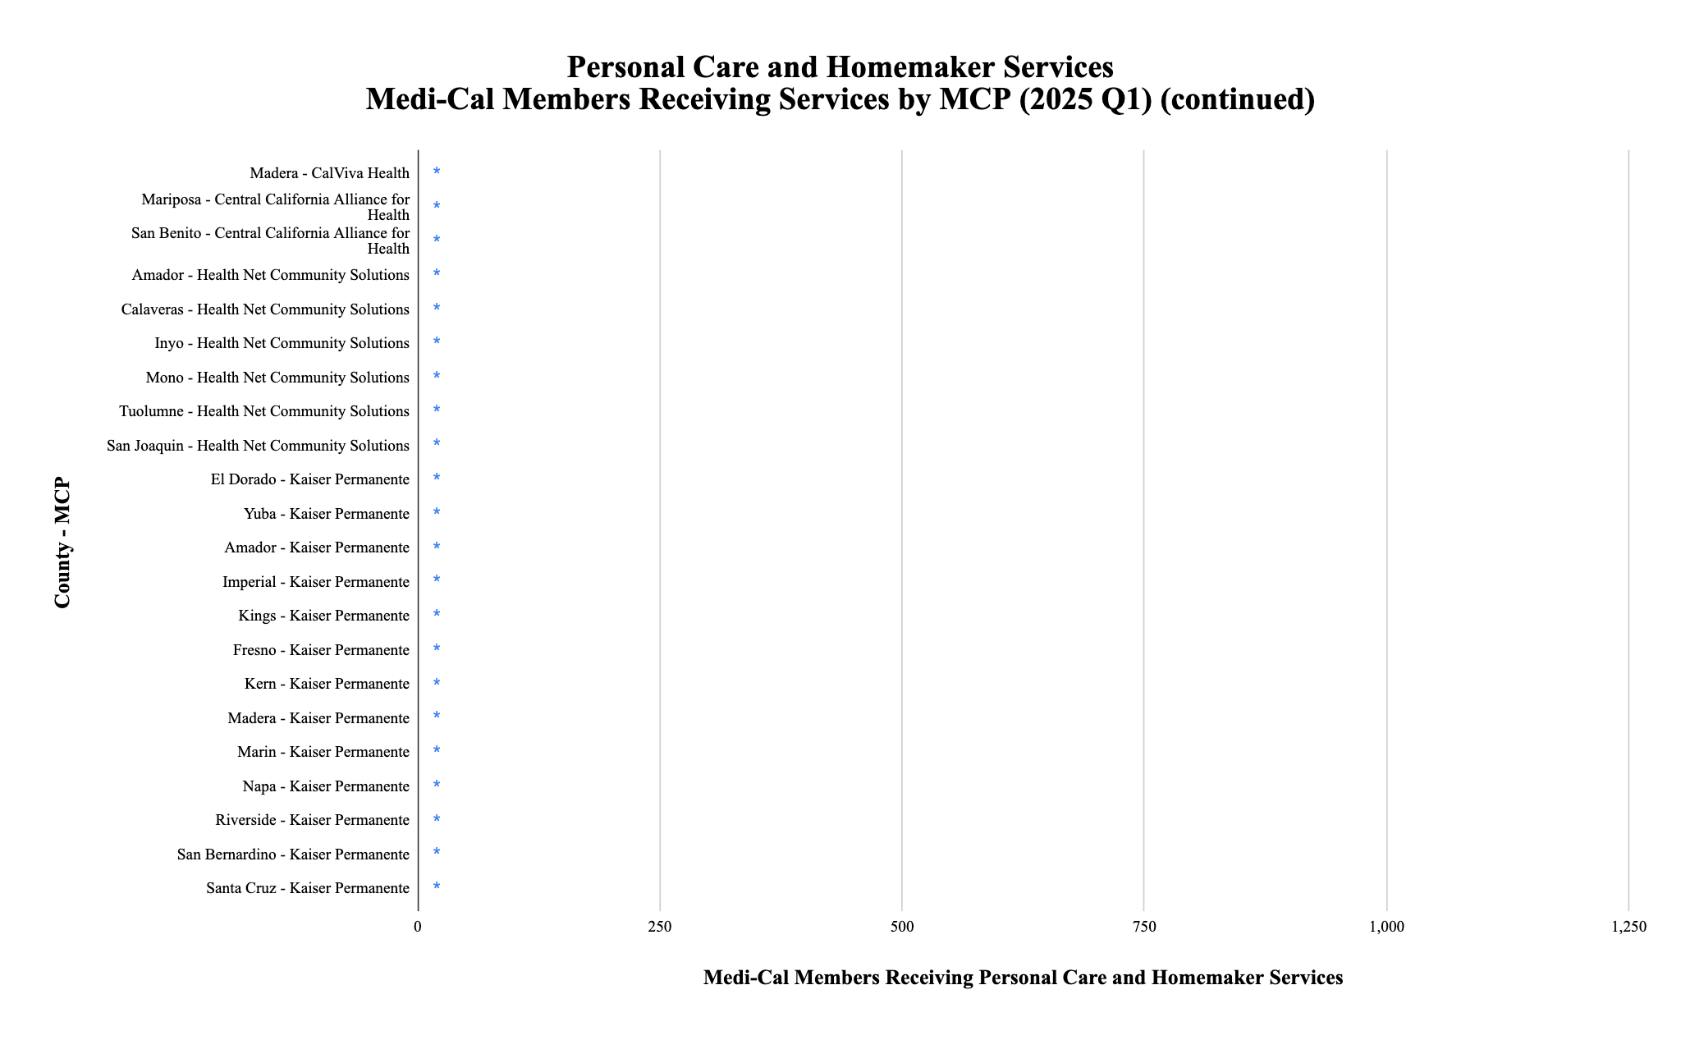
*
*
*
*
*
*
*
*
*
*
*
*
*
*
*
*
*
*
*
*
*
*
*
* denotes utilization of between 0-10 Medi-Cal members
California Health Policy Strategies, LLC

Slide 35
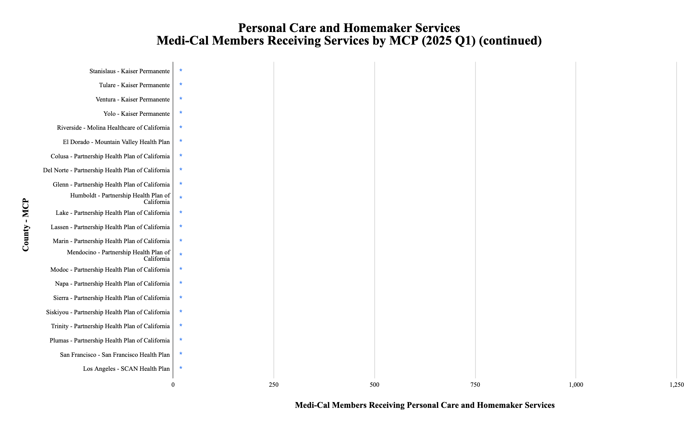
*
*
*
*
*
*
*
*
*
*
*
*
*
*
*
*
*
*
*
*
*
* denotes utilization of between 0-10 Medi-Cal members
California Health Policy Strategies, LLC

Slide 36
Personal Care and Homemaker Services Population of Focus
Of the 2,443 enrollees gained during these twelve months, over 90% of the growth can be attributed to these seven plans.
California Health Policy Strategies, LLC 10

Slide 37
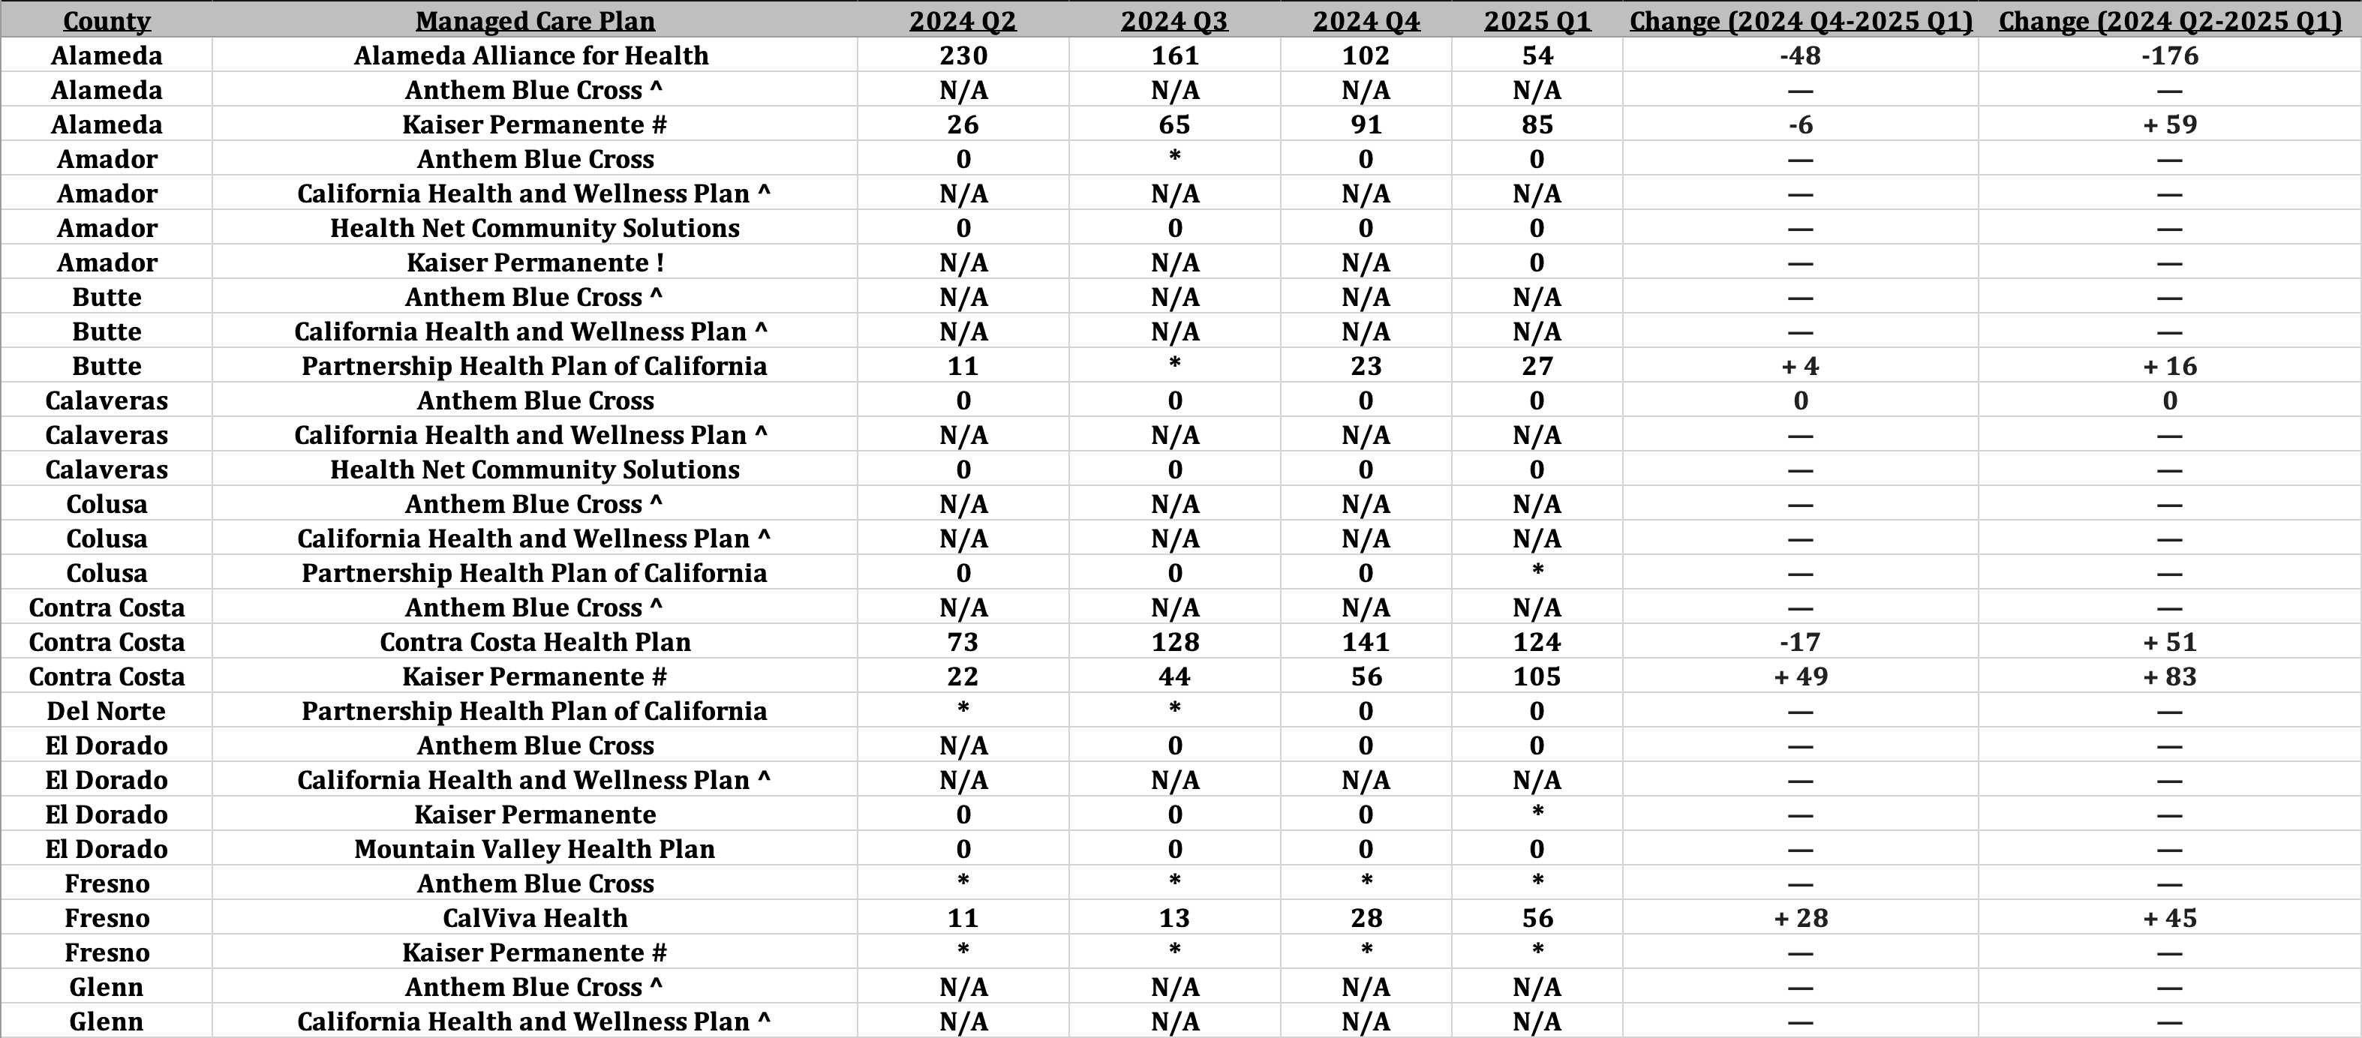
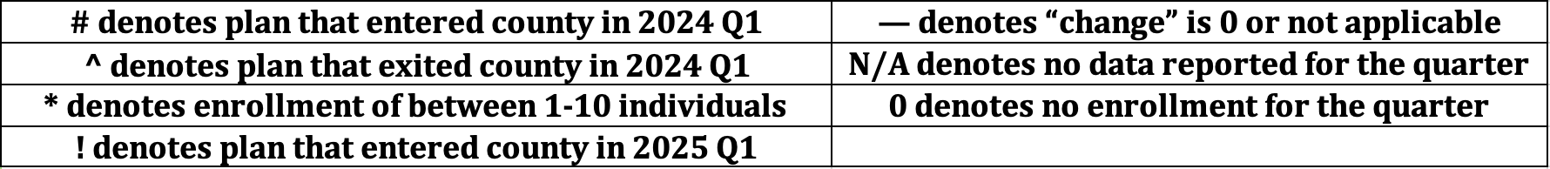
Personal Care and Homemaker Services: Utilization and Growth by County and Managed Care Plan
Source: DHCS, Total Number of Members Who Utilized Community Supports by MCP and County by Service by
Quarter, https://geohub-cadhcs.hub.arcgis.com/datasets/CADHCS::ecm-community-support-data-tables-for-quarterly-implementation-report/explore?layer=48
11
California Health Policy Strategies, LLC

Slide 38

Project Plan Overview
October 8, 2025
California Health Policy Strategies, LLC

Slide 39
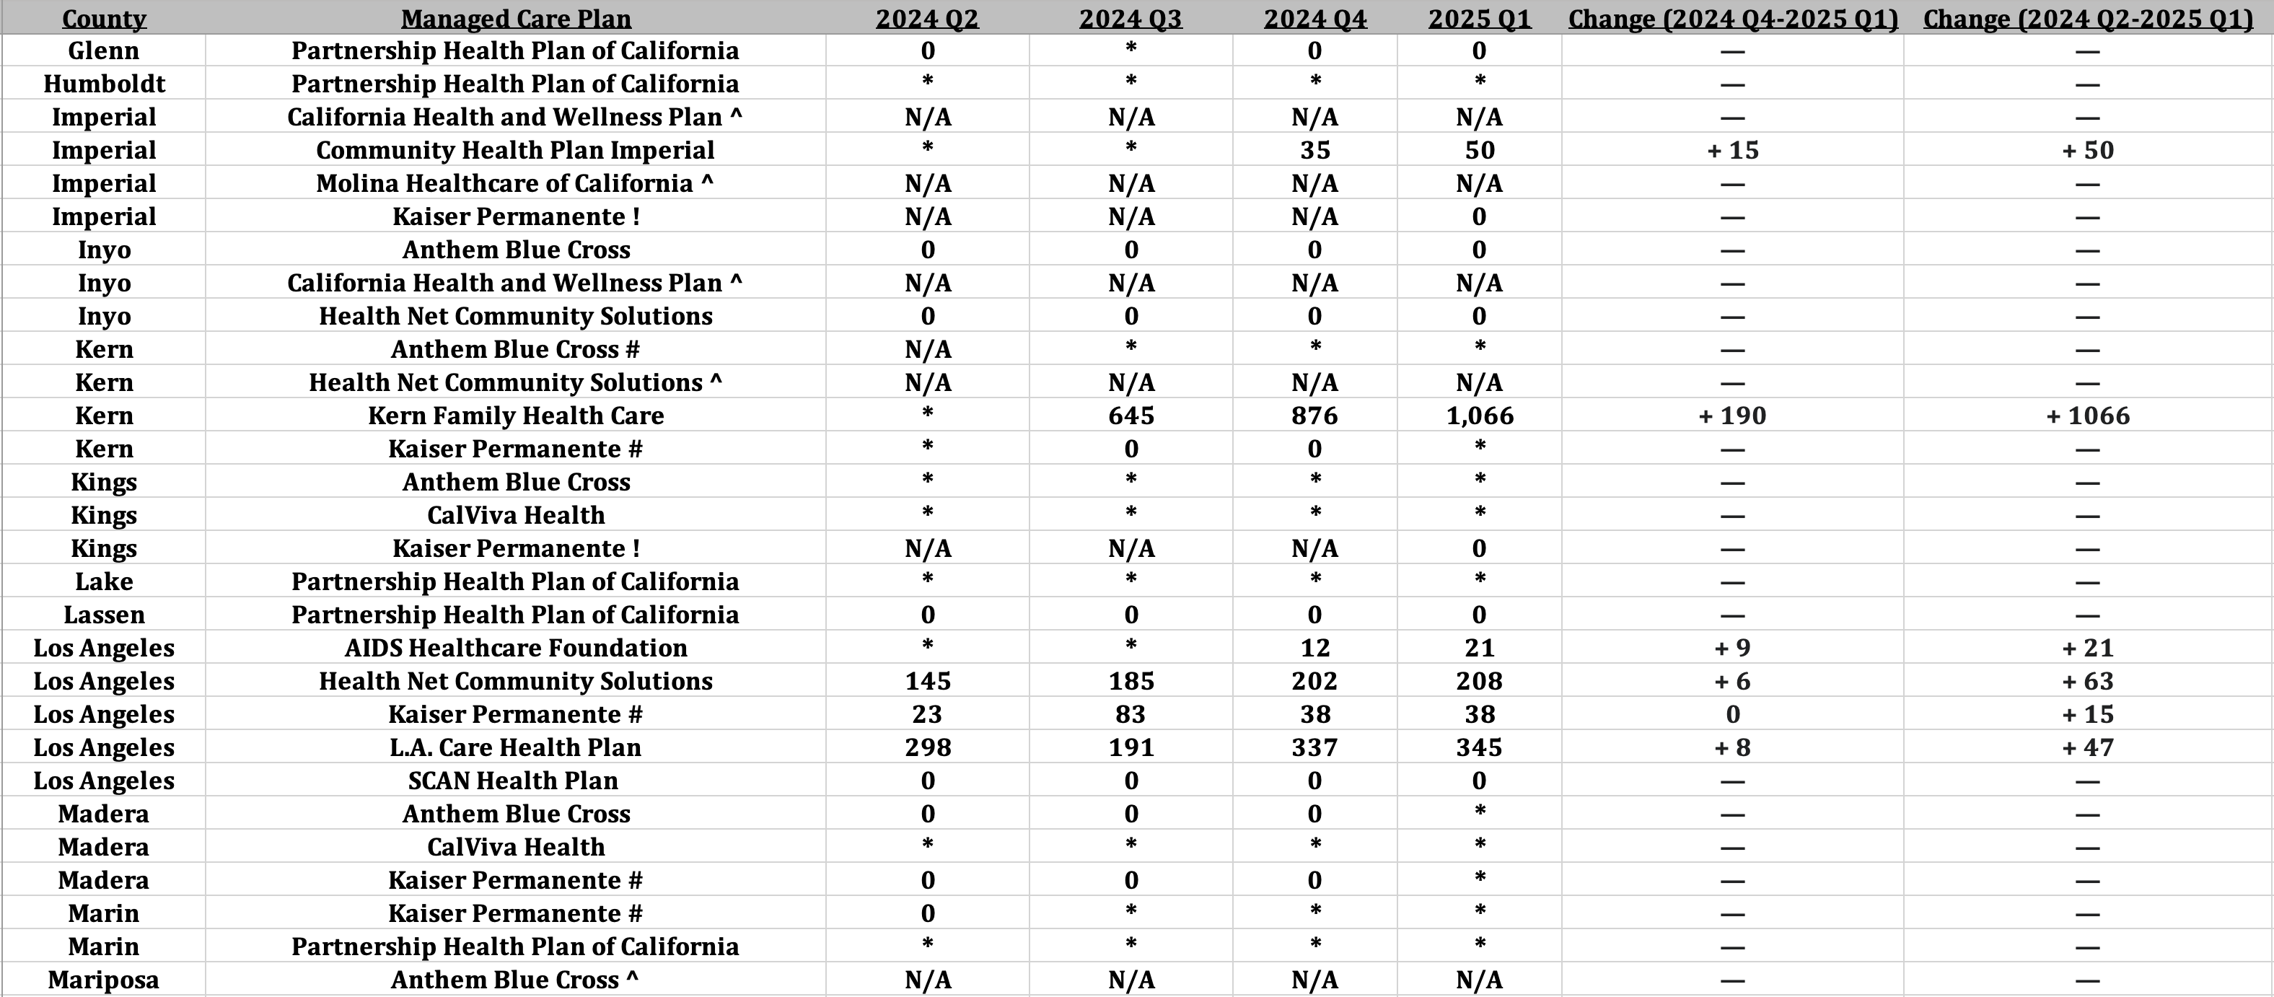
Personal Care and Homemaker Services: Utilization and Growth by County and Managed Care Plan (continued)
Source: DHCS, Total Number of Members Who Utilized Community Supports by MCP and County by Service by
Quarter, https://geohub-cadhcs.hub.arcgis.com/datasets/CADHCS::ecm-community-support-data-tables-for-quarterly-implementation-report/explore?layer=48
12
California Health Policy Strategies, LLC

Slide 40
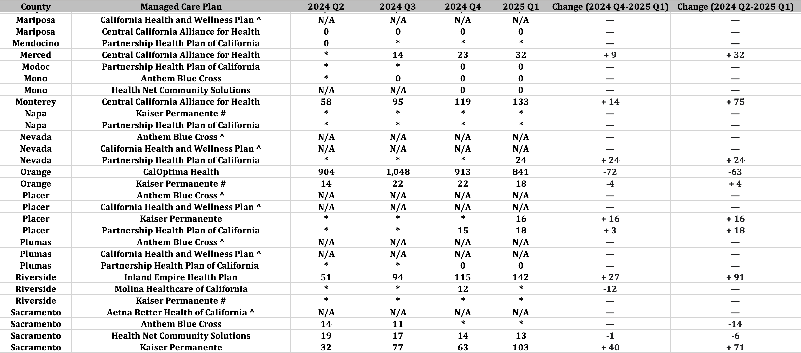
Personal Care and Homemaker Services : Utilization and Growth by County and Managed Care Plan (continued)
Source: DHCS, Total Number of Members Who Utilized Community Supports by MCP and County by Service by
Quarter, https://geohub-cadhcs.hub.arcgis.com/datasets/CADHCS::ecm-community-support-data-tables-for-quarterly-implementation-report/explore?layer=48
13
California Health Policy Strategies, LLC

Slide 41
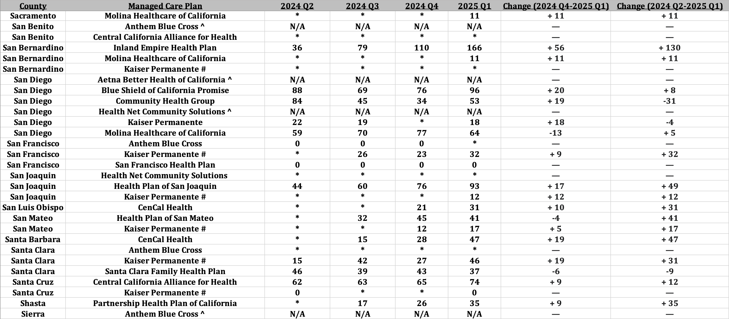
Personal Care and Homemaker Services : Utilization and Growth by County and Managed Care Plan (continued)
Source: DHCS, Total Number of Members Who Utilized Community Supports by MCP and County by Service by
Quarter, https://geohub-cadhcs.hub.arcgis.com/datasets/CADHCS::ecm-community-support-data-tables-for-quarterly-implementation-report/explore?layer=48
14
California Health Policy Strategies, LLC

Slide 42
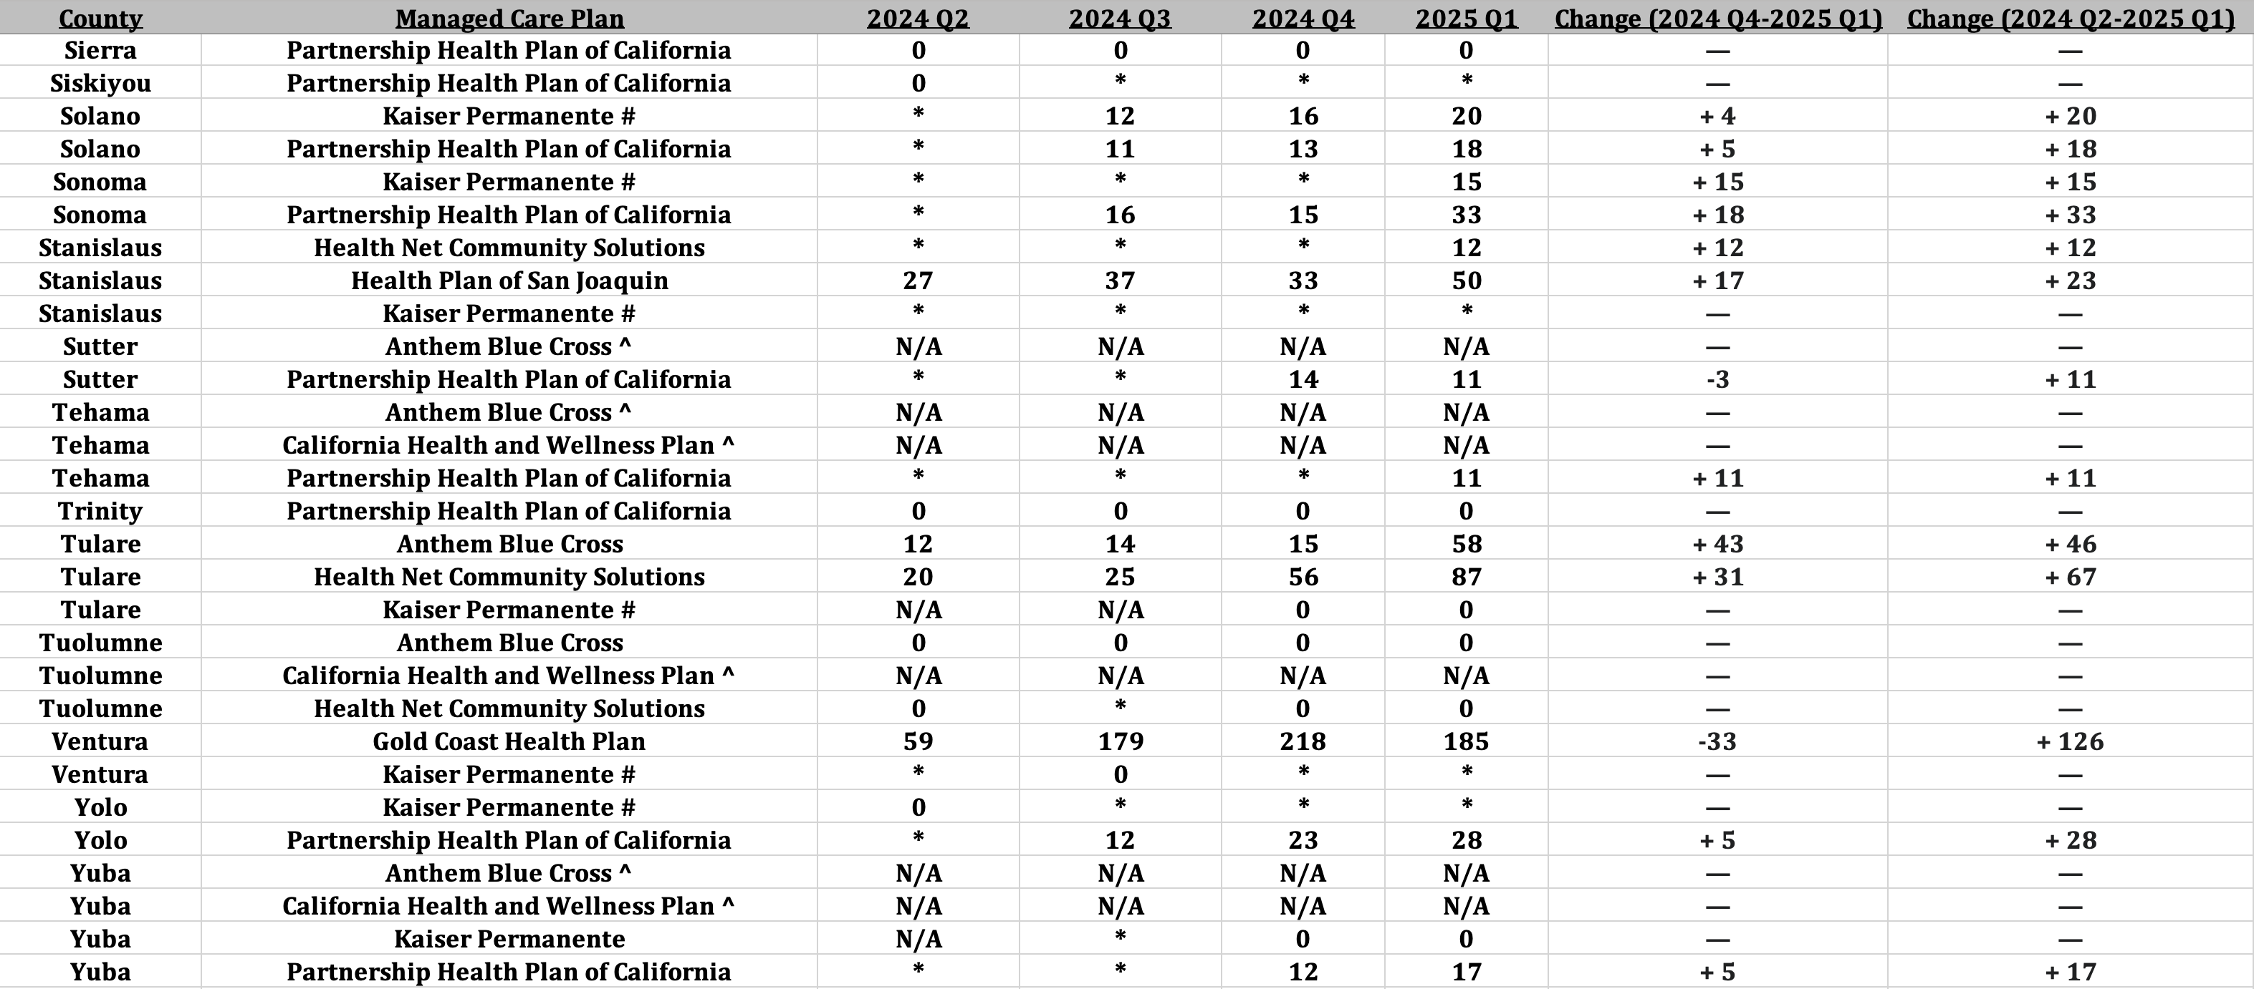
Personal Care and Homemaker Services : Utilization and Growth by County and Managed Care Plan (continued)
Source: DHCS, Total Number of Members Who Utilized Community Supports by MCP and County by Service by
Quarter, https://geohub-cadhcs.hub.arcgis.com/datasets/CADHCS::ecm-community-support-data-tables-for-quarterly-implementation-report/explore?layer=48
15
California Health Policy Strategies, LLC

Slide 43
Respite Services
16
California Health Policy Strategies, LLC

Slide 44
*
*
*
*
*
*
*
*
*
*
*
* denotes utilization of between 0-10 Medi-Cal members
California Health Policy Strategies, LLC

Slide 45
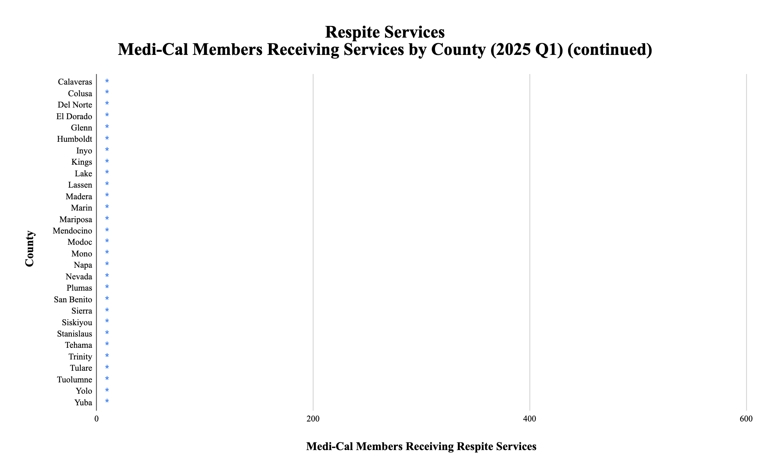
*
*
*
*
*
*
*
*
*
*
*
*
*
*
*
*
*
*
*
*
*
*
*
*
*
*
*
*
*
* denotes utilization of between 0-10 Medi-Cal members
California Health Policy Strategies, LLC

Slide 46
California Health Policy Strategies, LLC

Slide 47
*
*
*
*
*
*
*
*
*
*
*
*
*
* denotes utilization of between 0-10 Medi-Cal members
California Health Policy Strategies, LLC

Slide 48
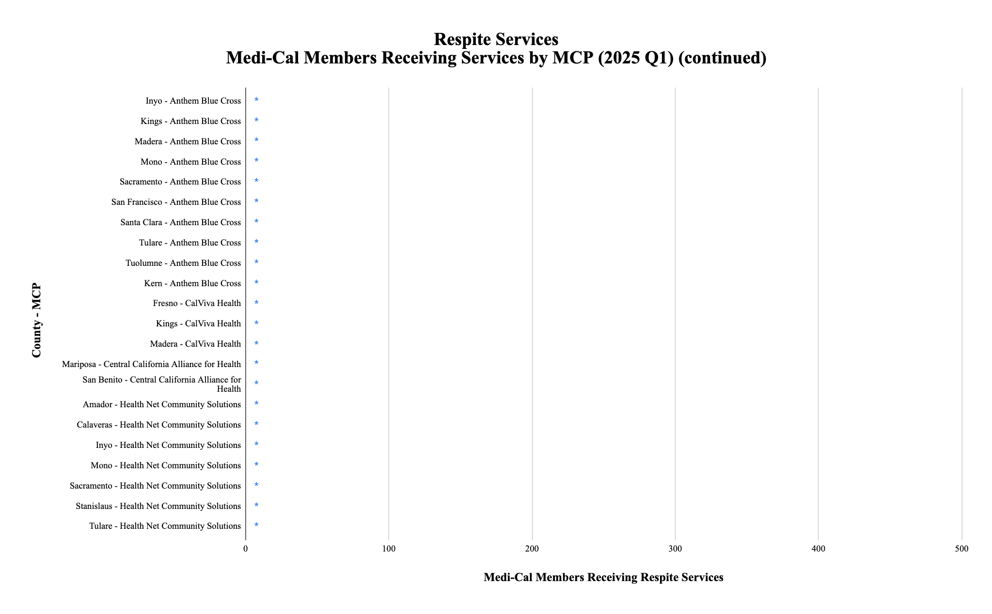
*
*
*
*
*
*
*
*
*
*
*
*
*
*
*
*
*
*
*
*
*
*
* denotes utilization of between 0-10 Medi-Cal members
California Health Policy Strategies, LLC

Slide 49
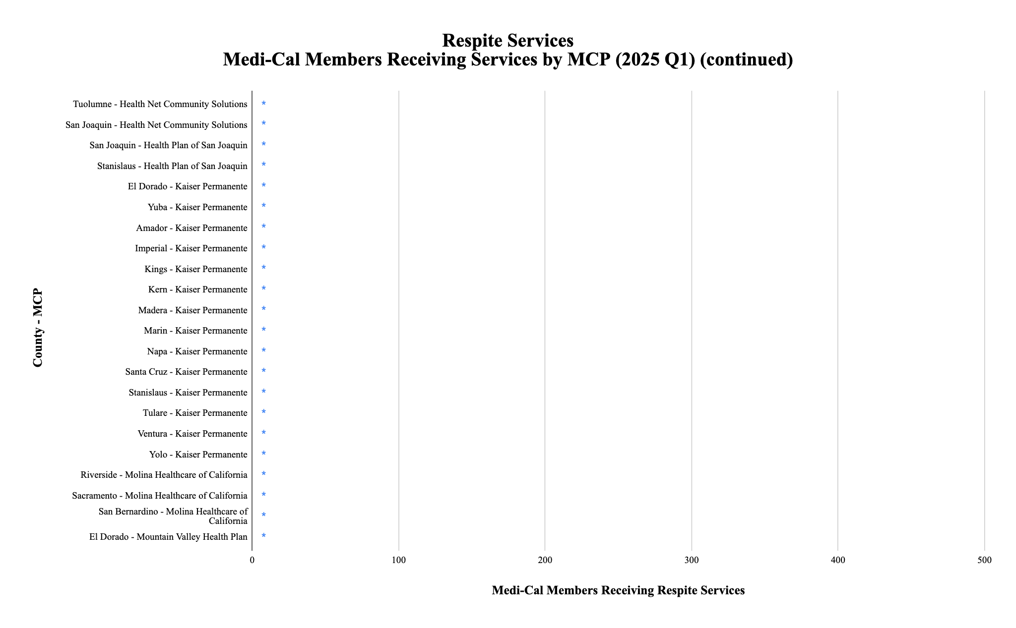
*
*
*
*
*
*
*
*
*
*
*
*
*
*
*
*
*
*
*
*
*
* denotes utilization of between 0-10 Medi-Cal members
California Health Policy Strategies, LLC

Slide 50
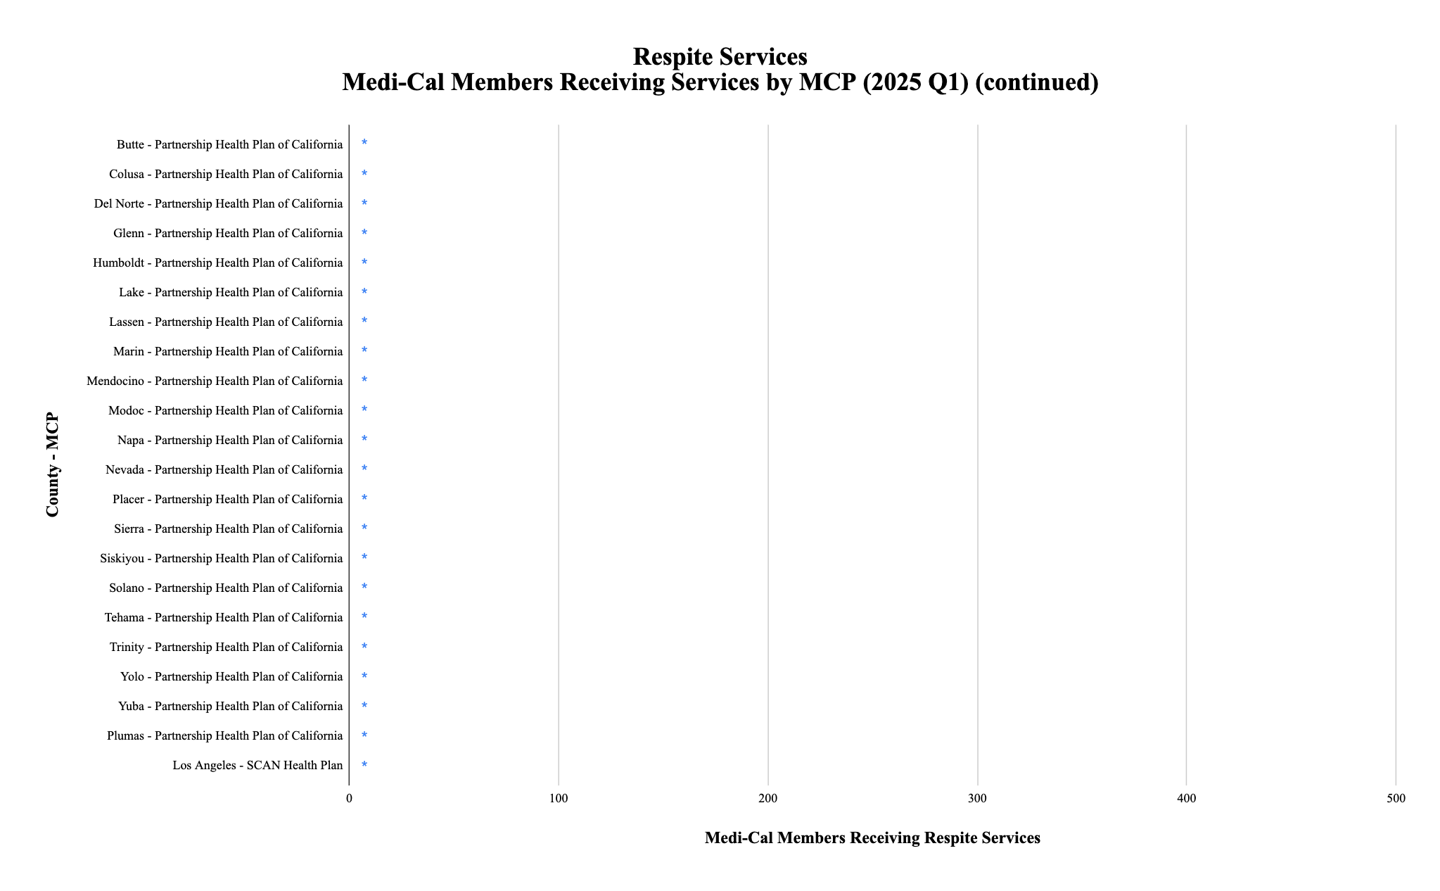
*
*
*
*
*
*
*
*
*
*
*
*
*
*
*
*
*
*
*
*
*
* denotes utilization of between 0-10 Medi-Cal members
California Health Policy Strategies, LLC

Slide 51
Respite Services Population of Focus
Of the 2,434 enrollees gained during these twelve months, approximately 80% of the growth can be attributed to these six plans.
California Health Policy Strategies, LLC 24

Slide 52
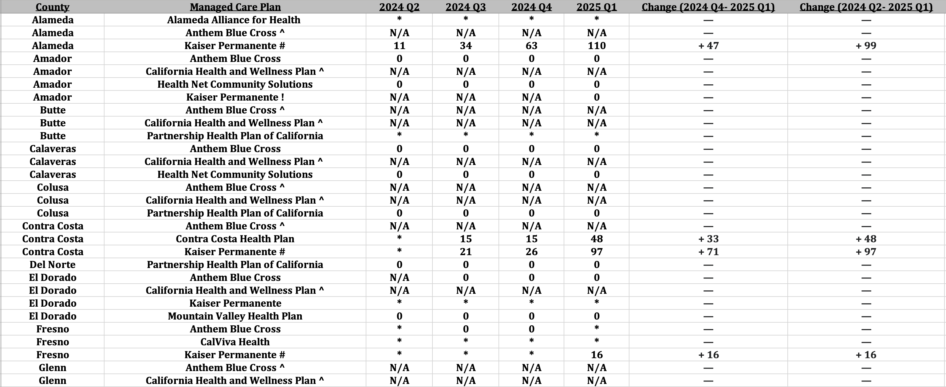
Respite Services: Utilization and Growth by County and Managed Care Plan
Source: DHCS, Total Number of Members Who Utilized Community Supports by MCP and County by Service by
Quarter, https://geohub-cadhcs.hub.arcgis.com/datasets/CADHCS::ecm-community-support-data-tables-for-quarterly-implementation-report/explore?layer=48
25
California Health Policy Strategies, LLC

Slide 53
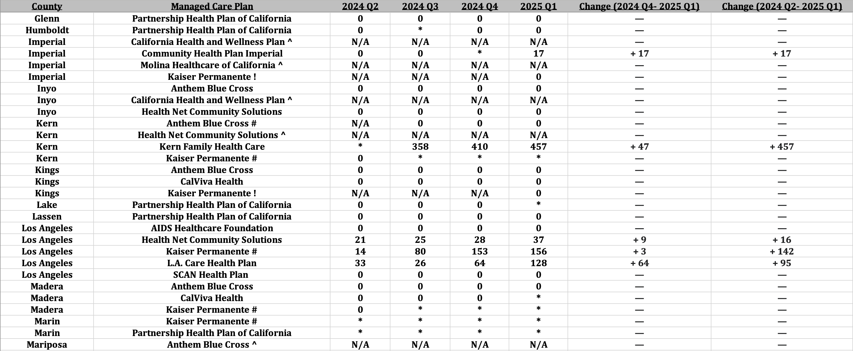
Respite Services: Utilization and Growth by County and Managed Care Plan (continued)
Source: DHCS, Total Number of Members Who Utilized Community Supports by MCP and County by Service by
Quarter, https://geohub-cadhcs.hub.arcgis.com/datasets/CADHCS::ecm-community-support-data-tables-for-quarterly-implementation-report/explore?layer=48
26
California Health Policy Strategies, LLC

Slide 54
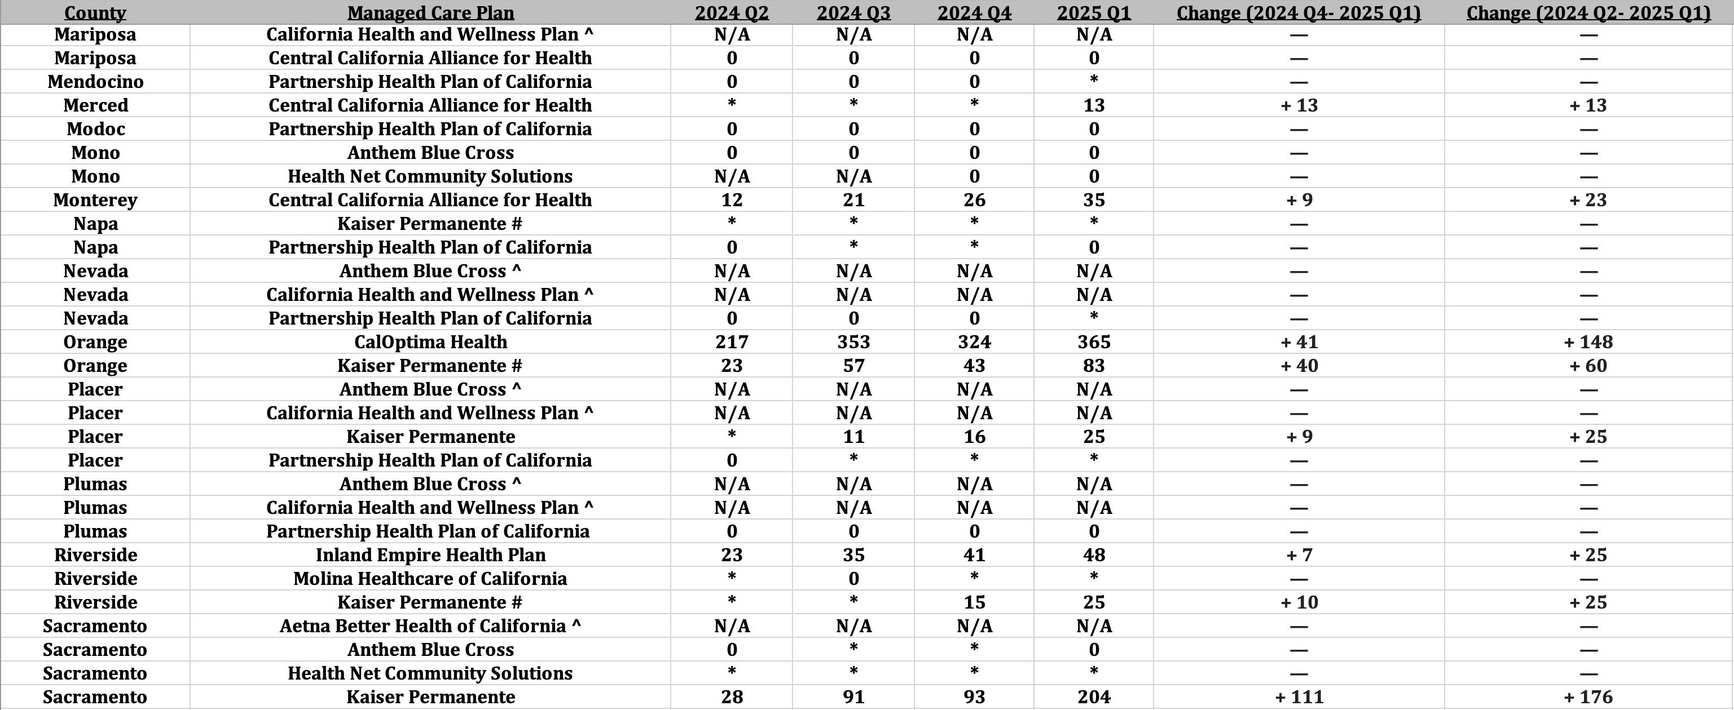
Respite Services: Utilization and Growth by County and Managed Care Plan (continued)
Source: DHCS, Total Number of Members Who Utilized Community Supports by MCP and County by Service by
Quarter, https://geohub-cadhcs.hub.arcgis.com/datasets/CADHCS::ecm-community-support-data-tables-for-quarterly-implementation-report/explore?layer=48
27
California Health Policy Strategies, LLC

Slide 55
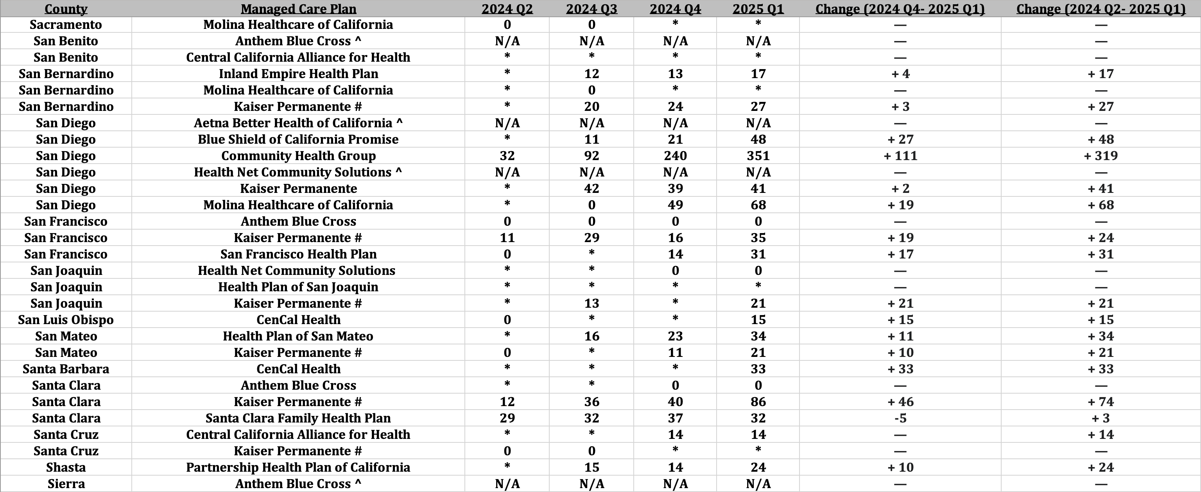
Respite Services: Utilization and Growth by County and Managed Care Plan (continued)
Source: DHCS, Total Number of Members Who Utilized Community Supports by MCP and County by Service by
Quarter, https://geohub-cadhcs.hub.arcgis.com/datasets/CADHCS::ecm-community-support-data-tables-for-quarterly-implementation-report/explore?layer=48
28
California Health Policy Strategies, LLC

Slide 56
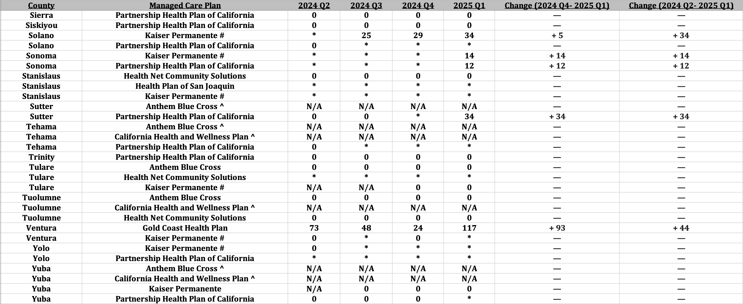
Respite Services: Utilization and Growth by County and Managed Care Plan (continued)
Source: DHCS, Total Number of Members Who Utilized Community Supports by MCP and County by Service by
Quarter, https://geohub-cadhcs.hub.arcgis.com/datasets/CADHCS::ecm-community-support-data-tables-for-quarterly-implementation-report/explore?layer=48
29
California Health Policy Strategies, LLC

Slide 57
About the Author
Reese Murray is a 4th year undergraduate student at California Polytechnic State University, San Luis Obispo. She is majoring in Mathematics and hopes to use her degree to help marginalized communities through data analytics.
•
About California Health Policy Strategies (CalHPS), LLC
•
CalHPS is a mission-driven health policy consulting group in Sacramento. For more information, visit www.calhps.com.
California Health Policy Strategies, LLC
30

