Slide 1


CalAIM Statewide Older Adult Collaborative
October 8, 2025
California Health Policy Strategies, LLC
Notes:
David

Slide 2
Agenda
Agenda Item | Speaker | Time
Welcome and Introductions | David Panush | 3 min
Data Level-Set: Enhanced Care Management (ECM) Q4 2024 | David Panush | 10 min
Project Updates | David Panush; Jasmine DeGuzman Lacsamana | 7 min
Project Plan Overview | Archstone Foundation; CalHPS | 35 min
Announcements and Upcoming Meetings | David Panush | 5 min
California Health Policy Strategies, LLC

Slide 3


Data Level-Set: ECM/Community Supports Q4 2024
October 8, 2025
California Health Policy Strategies, LLC

Slide 4

Statewide ECM Growth by Medi-Cal Member Age Group
Source: DHCS, “Total Number of Members Who Received ECM by Quarter in Any County Since Launch,” https://cadhcs.maps.arcgis.com/apps/dashboards/f415bb29324a45ceaaa 2361862870599
California Health Policy Strategies, LLC
Age Group | 2024 Q1 | 2024 Q2 | 2024 Q3 | 2024 Q4 | Change from 2024 Q3 to 2024 Q4 | Change Across the Four Quarters
Members Under Age 21 | 17,425 | 23,339 | 28,387 | 31,093 | + 2,706 | + 13,668
Members Aged 21 or Older | 93,739 | 104,265 | 115,257 | 118,396 | + 3,139 | + 24,657
Total | 111,164 | 127,604 | 143,644 | 149,489 | + 5,845 | + 38,325
1

Slide 5
Statewide ECM Enrollment Growth By Population of Focus*
California Health Policy Strategies, LLC
Population of Focus | 2024 Q1 | 2024 Q2 | 2024 Q3 | 2024 Q4 | Change from 2024 Q3 to 2024 Q4 | Change Across the Four Quarters
Adult Individuals and Families Experiencing Homelessness | 33,966 | 39,622 | 49,063 | 58,086 | + 9,023 | + 24,120
Adult Individuals Transitioning from Incarceration | 1,565 | 1,802 | 2,185 | 2,418 | + 233 | + 853
Adult Individuals At Risk of Long-Term Care Institutionalization | 11,472 | 14,080 | 16,647 | 18,548 | + 1,901 | + 7,076
Adult Individuals At Risk of Avoidable Hospital or ED Utilization | 39,534 | 42,452 | 45,521 | 53,630 | + 8,109 | + 14,096
Adult Individuals with Serious Mental Health or SUD needs | 40,059 | 46,095 | 50,040 | 55,988 | + 5,948 | + 15, 929
Nursing Facility Residents Who Want to Transition to the Community | 676 | 796 | 843 | 1,030 | + 187 | + 354
Youth Involved in Child Welfare | 1,739 | 1,608 | 2,819 | 3,286 | + 467 | + 1,547
Youth Transitioning from Incarceration | 87 | 149 | 109 | 96 | - 13 | + 9
Youth with Serious Mental Health or SUD Needs | 6,946 | 8,950 | 10,310 | 11,609 | + 1,299 | + 4,663
Youth at Risk of Avoidable Hospital or ED Utilization | 6,763 | 9,321 | 10,801 | 11,852 | + 1,051 | + 5,089
Youth Individuals Experiencing Homelessness | 4,444 | 6,342 | 7,827 | 9,677 | + 1,850 | + 5,233
Youth Enrolled in CA’s Children’s Services with Additional Needs | 2,170 | 3,281 | 3,912 | 4,641 | + 729 | + 2,471
*Members can be included in more than one population of focus.
2

Slide 6
Individuals Receiving Community Supports in 2024
California Health Policy Strategies, LLC
Community Support | 2024 Q1 | 2024 Q2 | 2024 Q3 | 2024 Q4 | Change (2024 Q3 – 2024 Q4) | Change (2024 Q1 – 2024 Q4)
Asthma Remediation | 536 | 422 | 570 | 649 | + 79 | + 113
Community Transition Services | 175 | 206 | 221 | 237 | + 16 | + 62
Day Habilitation | 1,191 | 1,124 | 1,790 | 1,573 | -217 | + 382
Environmental Accessibility Adaptations | 374 | 515 | 807 | 988 | + 181 | + 614
Housing Deposits | 1,485 | 1,896 | 2,860 | 3,213 | + 353 | + 1,728
Housing Tenancy and Sustaining | 11,178 | 9,930 | 9,001 | 20,026 | + 11,025 | + 8,848
Housing Transition Navigation | 24,550 | 30,534 | 37,061 | 45,745 | + 8,684 | + 21,195
Medically Tailored Meals | 65,178 | 79,882 | 84,490 | 89,443 | + 4,953 | + 24,265
Nursing Facility Transition | 436 | 393 | 517 | 797 | + 280 | + 361
Personal Care or Homemaker Services | 1,865 | 2,505 | 3,775 | 4,315 | + 540 | + 2,450
Recuperative Care (Medical Respite) | 2,615 | 3,320 | 3,681 | 4,301 | + 620 | + 1,686
Respite Services | 444 | 539 | 1,518 | 1,925 | + 407 | + 1,481
Short-Term Post-Hospitalization Housing | 702 | 869 | 1,507 | 2,394 | + 887 | + 1,692
Sobering Centers | 786 | 895 | 1,087 | 829 | -258 | + 43
1

Slide 7
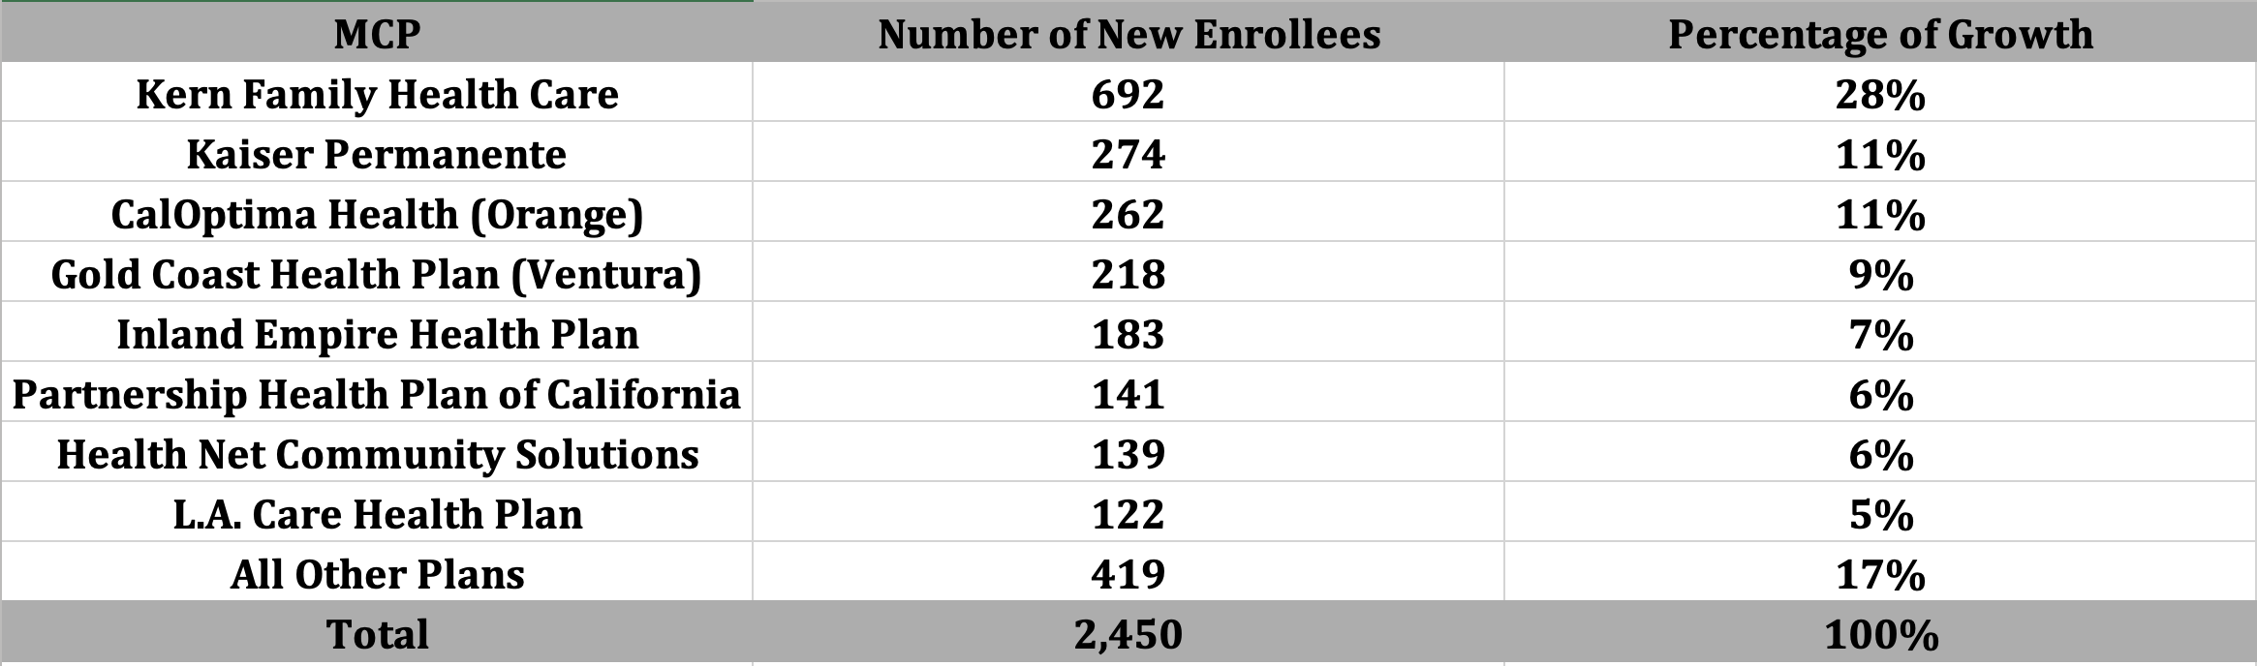

Personal Care and Homemaker Services Population of Focus
Of the 2,450 enrollees gained in 2024, approximately 80% of the growth can be attributed to these eight plans.
California Health Policy Strategies, LLC 10

Slide 8
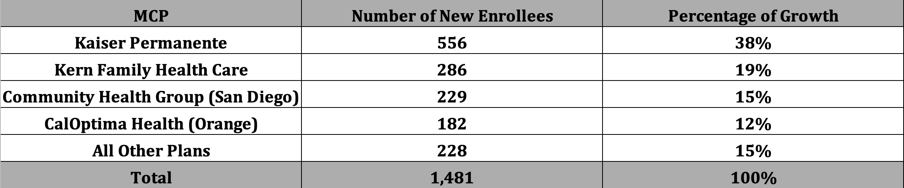
Respite Services Population of Focus
Of the 1,481 enrollees gained in 2024, approximately 85% of the growth can be attributed to these four plans.
California Health Policy Strategies, LLC 24

Slide 9
Personal
Care/Homemaker Services & Respite Community Supports: Enrollment and Utilization Statewide (Q4 2024)
DHCS, Total Number of Members Who Utilized Community Supports by MCP and County by Service by Quarter, https://geohub-cadhcs.hub.arcgis.com/datasets/CADHCS::ecm-community-support-data-tables-for-quarterly-implementation-report/explore?layer=48
California Health Policy Strategies, LLC
Population of Focus | Statewide as of Dec 2024 | Growth Q1-Q4 2024 | Percentage Growth Q1-Q4 2024
Personal Care/Homemakers | 4,315 | 2,450 | 57%
Respite | 1,925 | 1,481 | 77%
2

Slide 10
Key Takeaways
For adult individuals at risk of LTC institutionalization, San Diego, Los Angeles, Merced, Monterey, and Santa Clara counties had the highest total number of ECM enrollees, accounting for 58% of all ECM enrollments for PoF #5 in Q4 2024
Of the 7,076 new ECM enrollees gained in 2024, 80% of the growth can be attributed to the following eight plans: Central California Alliance for Health, L.A. Care Health Plan, San Francisco Health Plan, CalOptima Health (Orange), Inland Empire Health Plan (Riverside), Partnership Health Plan of California, Community Health Group (San Diego), and Alameda Alliance for Health.
For Community Supports, Personal Homemaker Services saw a growth of 57% and Respite Services saw a growth of 77% by the end of Q4 2024.
California Health Policy Strategies, LLC

Slide 11
Our Goal
ECM Goal: As a Collaborative, our goal is to increase ECM enrollment for Population of Focus #5 (Adult Individuals at Risk of Long-Term Care) to 75,000 individuals by the end of 2026.
CS Goal: Our goal is to increase Community Supports enrollment for Personal Homemaker and Respite Services to 10,000 and 6,000 individuals, respectively, by the end of 2026.
California Health Policy Strategies, LLC

Slide 12

Project Updates
October 8, 2025
California Health Policy Strategies, LLC

Slide 13
Project Updates
CalAIM Older Adults Collaborative
Name change
Focus includes dementia
New Staff: Caroline Davis
California Health Policy Strategies, LLC
Notes:
Jasmine

Slide 14

Project Plan Overview
October 8, 2025
California Health Policy Strategies, LLC

Slide 15
Webinars
Medi-Cal 101 Series (redux): This series will be a redux of the previous series from December 2024, but there will be additional valuable material added to help bolster the core understanding of Medicaid. (Lead Staff: Jane Ogle)
Social Services Aging 101: An informational webinar series that will cover IHSS, SSI, CalFresh, Older Americans Act, and other state and local aging services such as Meals on Wheels. (Lead Staff: Cathy Senderling-McDonald)
Federal Budget Updates: Pertinent updates as it relates to the ever-evolving landscape of federal budget and administrative updates will be covered in this webinar series. These webinars will be done on an ad hoc basis. (Lead Staff: Cathy Senderling-McDonald)
CalAIM and D-SNP Implementation 101: This webinar series will explore CalAIM’s alignment and new policies for Dual Eligible Special Needs Plan (D-SNPs). (Lead Staff: Jane Ogle and Caroline Davis)
California Health Policy Strategies, LLC

Slide 16
Bi-Monthly Collaboratives
We will continue our CalAIM Older Adult Collaboratives into the next fiscal year, but the cadence will officially be moved to bi-monthly in lieu of monthly convenings.
We will continue to explore ways to address barriers by sharing data, bringing together key informants, and providing analysis to help better understand the landscape in California.
Our next CalAIM Older Adult Collaborative:
Wednesday, December 10, 2025, at 12:00PM – link here.
Tentative topics:
Skilled Nursing Facilities
Population of Focus: Adult Nursing Facility Residents Transitioning to the Community
California Health Policy Strategies, LLC

Slide 17
ECM Enrollment Efforts
Ad Hoc Workgroups on ECM Opportunities: Our team will continue to convene focused work groups to brainstorm and work on addressing mutual barriers for the dementia / older adult population.
IHSS Enrollees: Convene work groups whose goal is to identify pathways that can be used to assist high-need, likely eligible IHSS clients in enrolling in ECM. (Lead Staff: Cathy Senderling-McDonald)
Skilled Nursing Facilities: This body of work will focus on building a comprehensive, easy-to-digest toolkit that will detail the ECM enrollment process for individuals who are interested in being part of the SNF to community transition population of focus. (Lead Staff: David Panush)
Adult Day Health Care Programs / CBAS: Over 40,000 individuals participate in ADHC / CBAS programs, many of whom are likely eligible for ECM and/or Community Supports. This workgroup will identify barriers to entry and suggest options to better streamline efforts. (Lead Staff: Cathy Senderling-McDonald)
Home and Community-Based Services (HCBS) Waiver Waitlists: While awaiting HCBS access, individual who are likely good candidates for ECM could be receiving services. This workgroup seeks to identify best practices for identifying candidates and, subsequently, approaching them to ask if they would like to receive ECM services. (Lead Staff: David Panush)
California Health Policy Strategies, LLC

Slide 18
Additional Ad Hoc Workgroups
D-SNPs: DHCS’s CalAIM D-SNP Policy Guide for contract year 2026 provides an opportunity to integrate care for individuals with dementia and other complex medical conditions into D-SNP plans serving dual eligibles. We will work to address the new state requirements by encouraging heavy involvement from MCPs, CBOs, providers, advocates, and others participating in our Collaborative. (Lead Staff: Jane Ogle and Caroline Davis)
MCP Workgroup: We will continue our work from 2025 by leading workgroups with health plan staff centered around CalAIM implementation challenges and perspectives shared during our Collaborative meetings, barriers to accessing ECM and Community Supports, and other options for improvement and streamlining of efforts (Lead staff: Jane Ogle)
San Diego County Workgroup: Collaborating with county staff and other stakeholders to identify barriers and strategies for increased ECM enrollment and Community Supports utilization. (Lead Staff: David Panush)
California Health Policy Strategies, LLC

Slide 19


Wrap-Up and Next Steps
October 8, 2025
California Health Policy Strategies, LLC

Slide 20
Announcements and Upcoming Meetings
Upcoming Meetings – Zoom registration link here.
Wednesday, December 10th, 12:00 PM
Wednesday, February 11th, 12:00 PM
Wednesday, April 15, 12:00 PM
Wednesday, June 10, 12:00 PM
Ad-Hoc Meetings
To Be Announced
ECM Managers/Directors Ad-Hoc Meeting
For MCP Staff
IHSS Toolkit Presentation and Orientation
November 13, 2025, at 11:00AM, Zoom link forthcoming
California Health Policy Strategies, LLC
Notes:
Zoom link for H.R. 1 webinar: https://us02web.zoom.us/webinar/register/WN_Dw8CnQFzRy2N4WCzpX5DXA#/registration

Slide 21
Appendix
California Health Policy Strategies, LLC
Notes:
Zoom link for H.R. 1 webinar: https://us02web.zoom.us/webinar/register/WN_Dw8CnQFzRy2N4WCzpX5DXA#/registration

Slide 22
Adult Individuals At Risk of Long-Term Care Institutionalization
California Health Policy Strategies, LLC

Slide 23
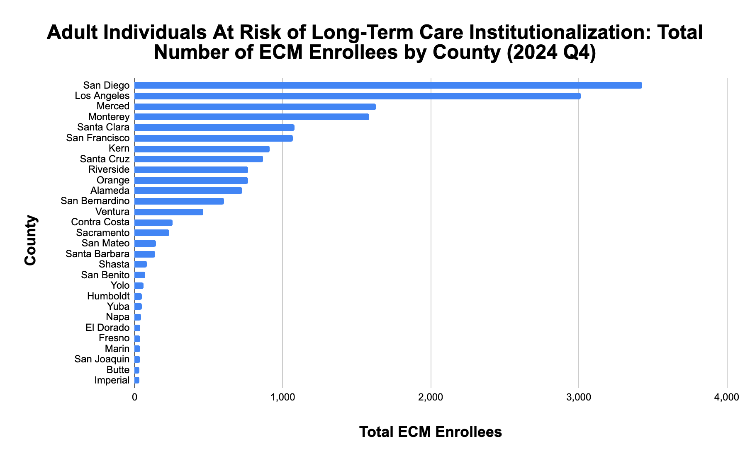
California Health Policy Strategies, LLC
4

Slide 24
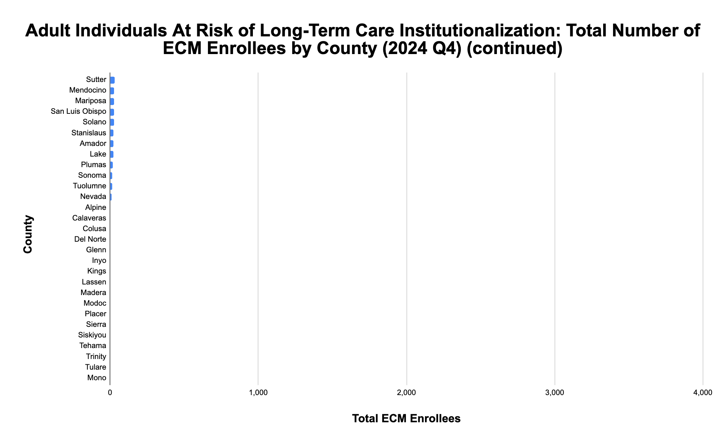
*
*
*
*
*
*
*
*
*
*
*
*
*
*
*
*
*
* denotes enrollment of between 0-10 individuals
California Health Policy Strategies, LLC
5

Slide 25
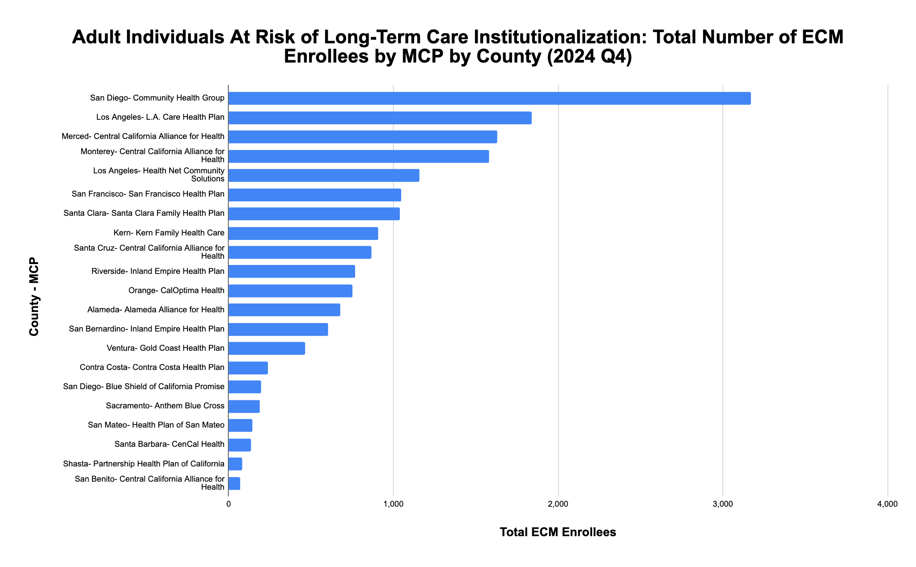
California Health Policy Strategies, LLC 6

Slide 26
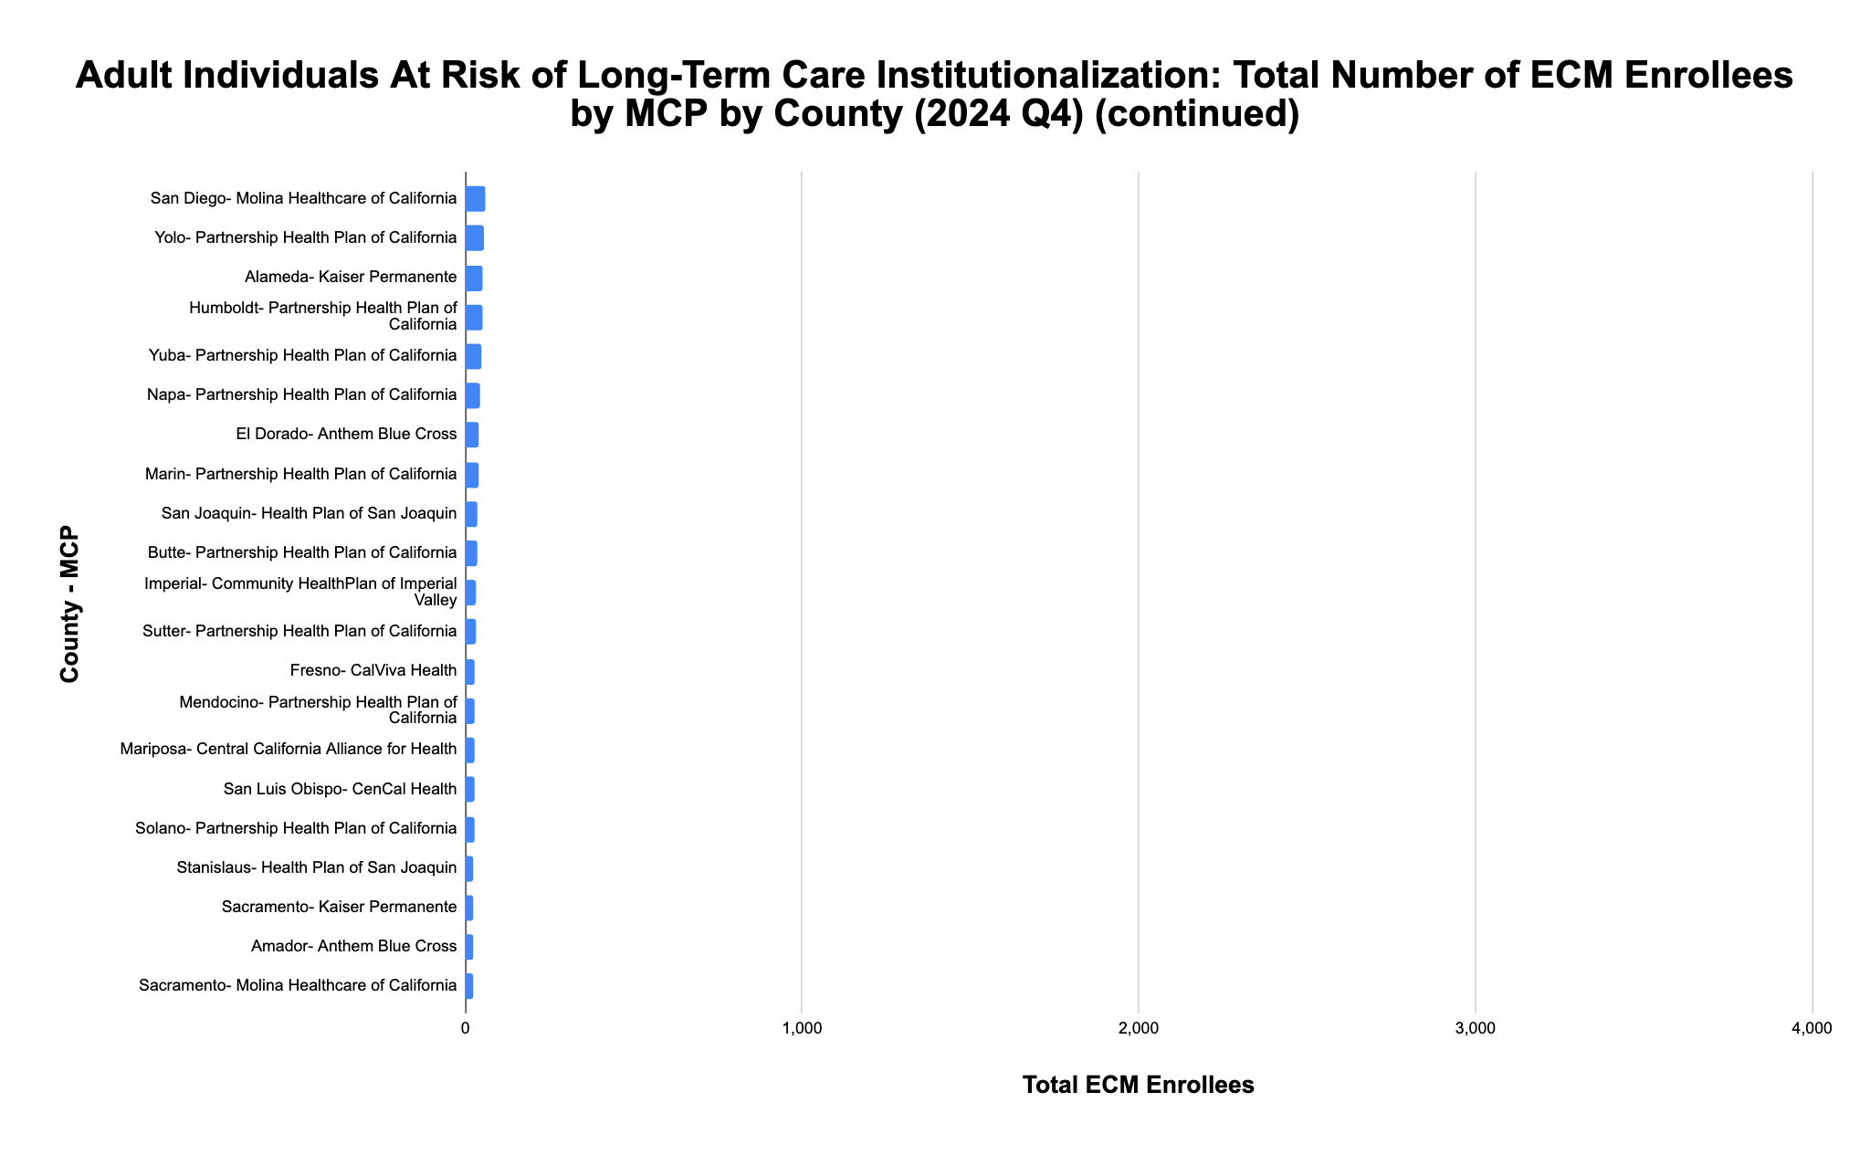
California Health Policy Strategies, LLC 7

Slide 27
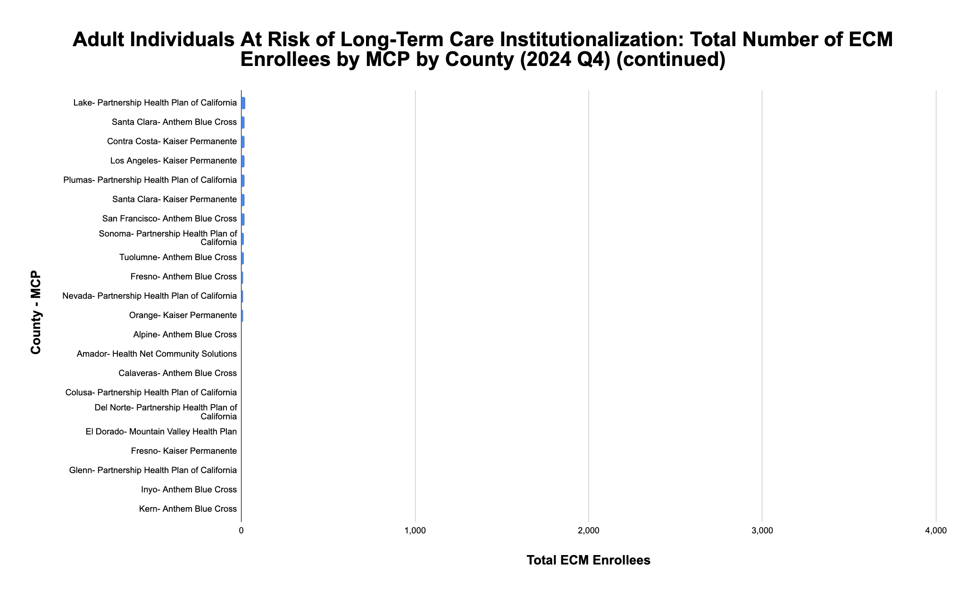
*
*
*
*
*
*
*
*
*
*
* denotes enrollment of between 0-10 individuals
California Health Policy Strategies, LLC 8

Slide 28
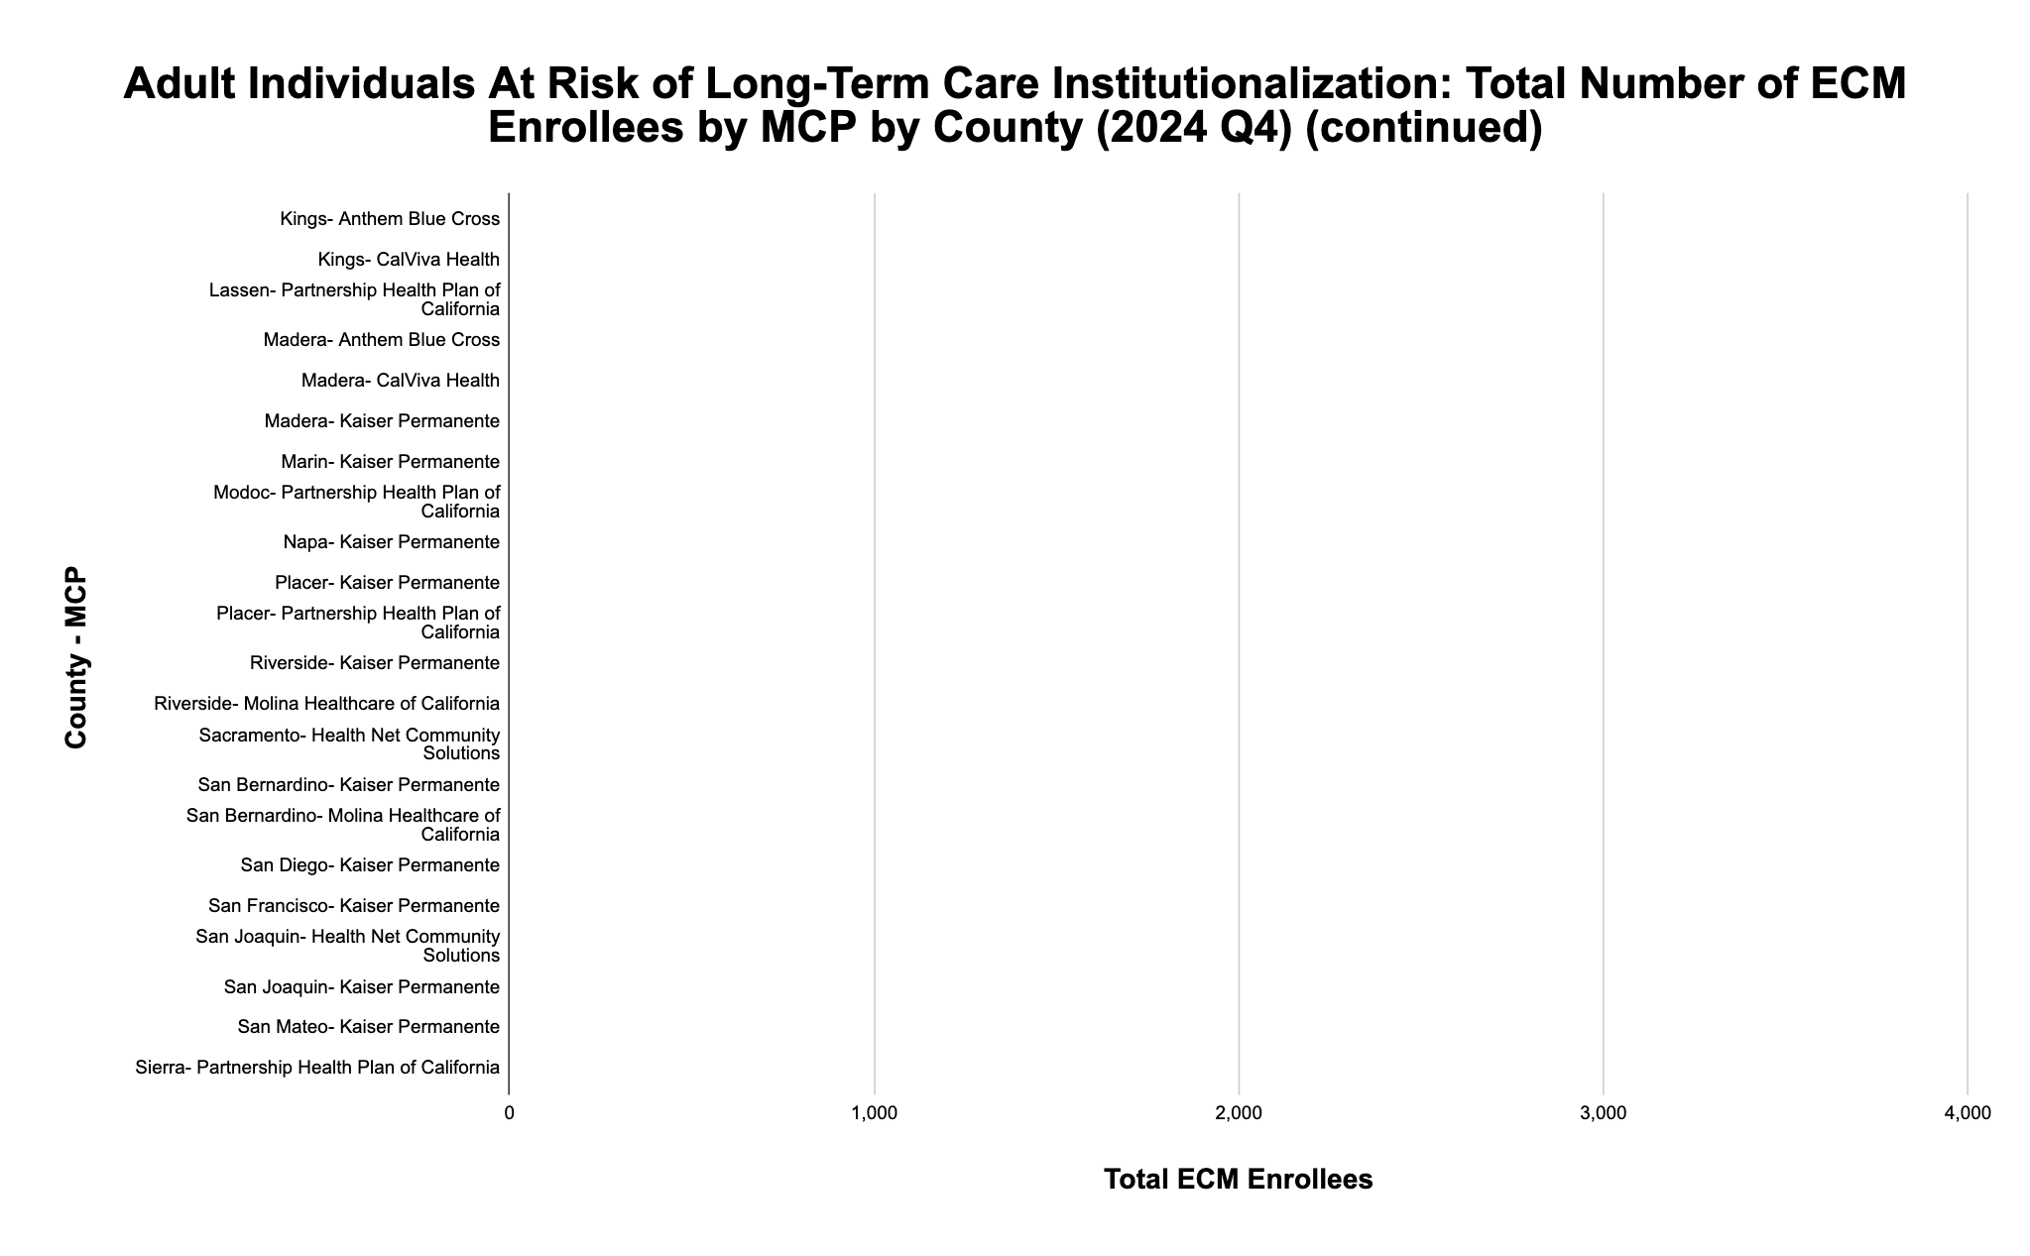
*
*
*
*
*
*
*
*
*
*
*
*
*
*
*
*
*
*
*
*
*
*
* denotes enrollment of between 0-10 individuals
California Health Policy Strategies, LLC 9

Slide 29
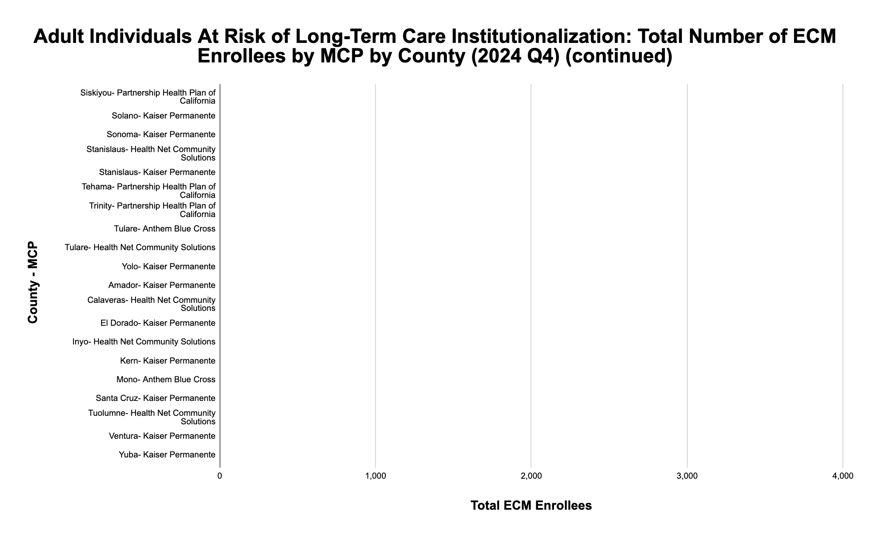
*
*
*
*
*
*
*
*
*
*
*
*
*
*
*
*
*
*
*
*
* denotes enrollment of between 0-10 individuals
California Health Policy Strategies, LLC 10

Slide 30
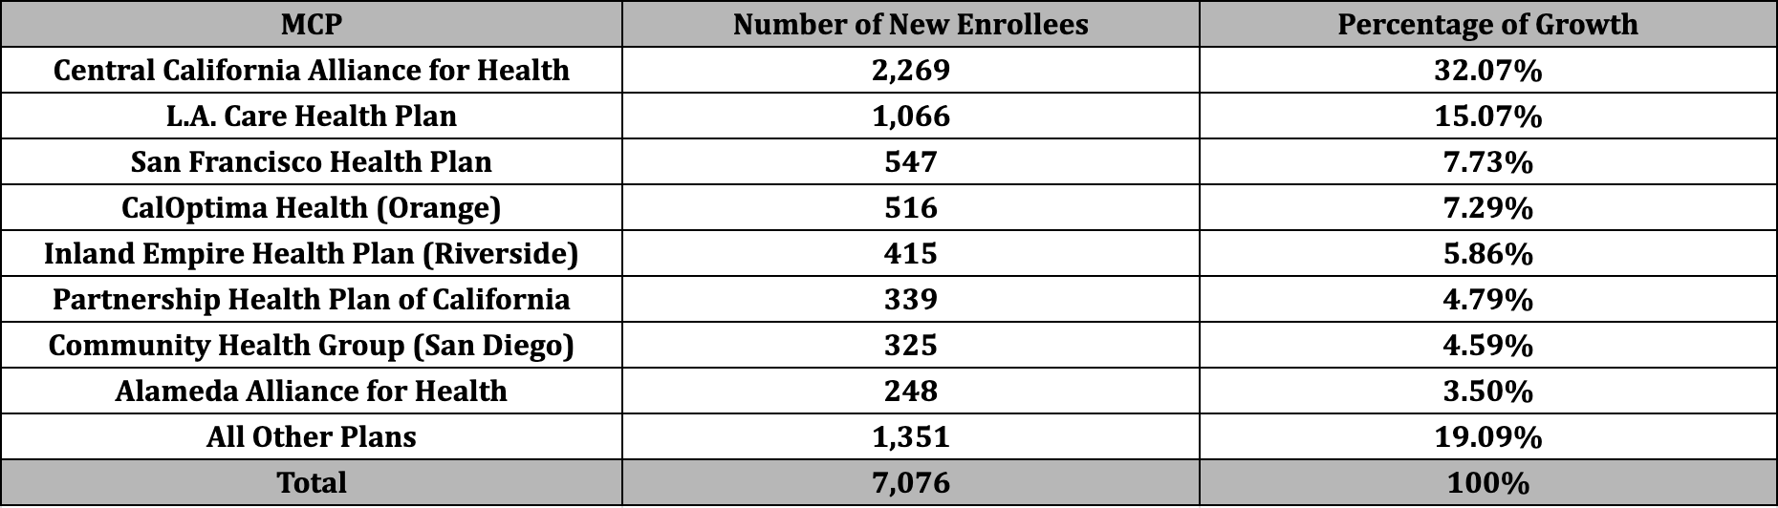
Adult Individuals At Risk of Long-Term Care Institutionalization Population of Focus
Of the 7,076 enrollees gained in 2024, 80% of the growth can be attributed to these eight plans.
California Health Policy Strategies, LLC 11

Slide 31
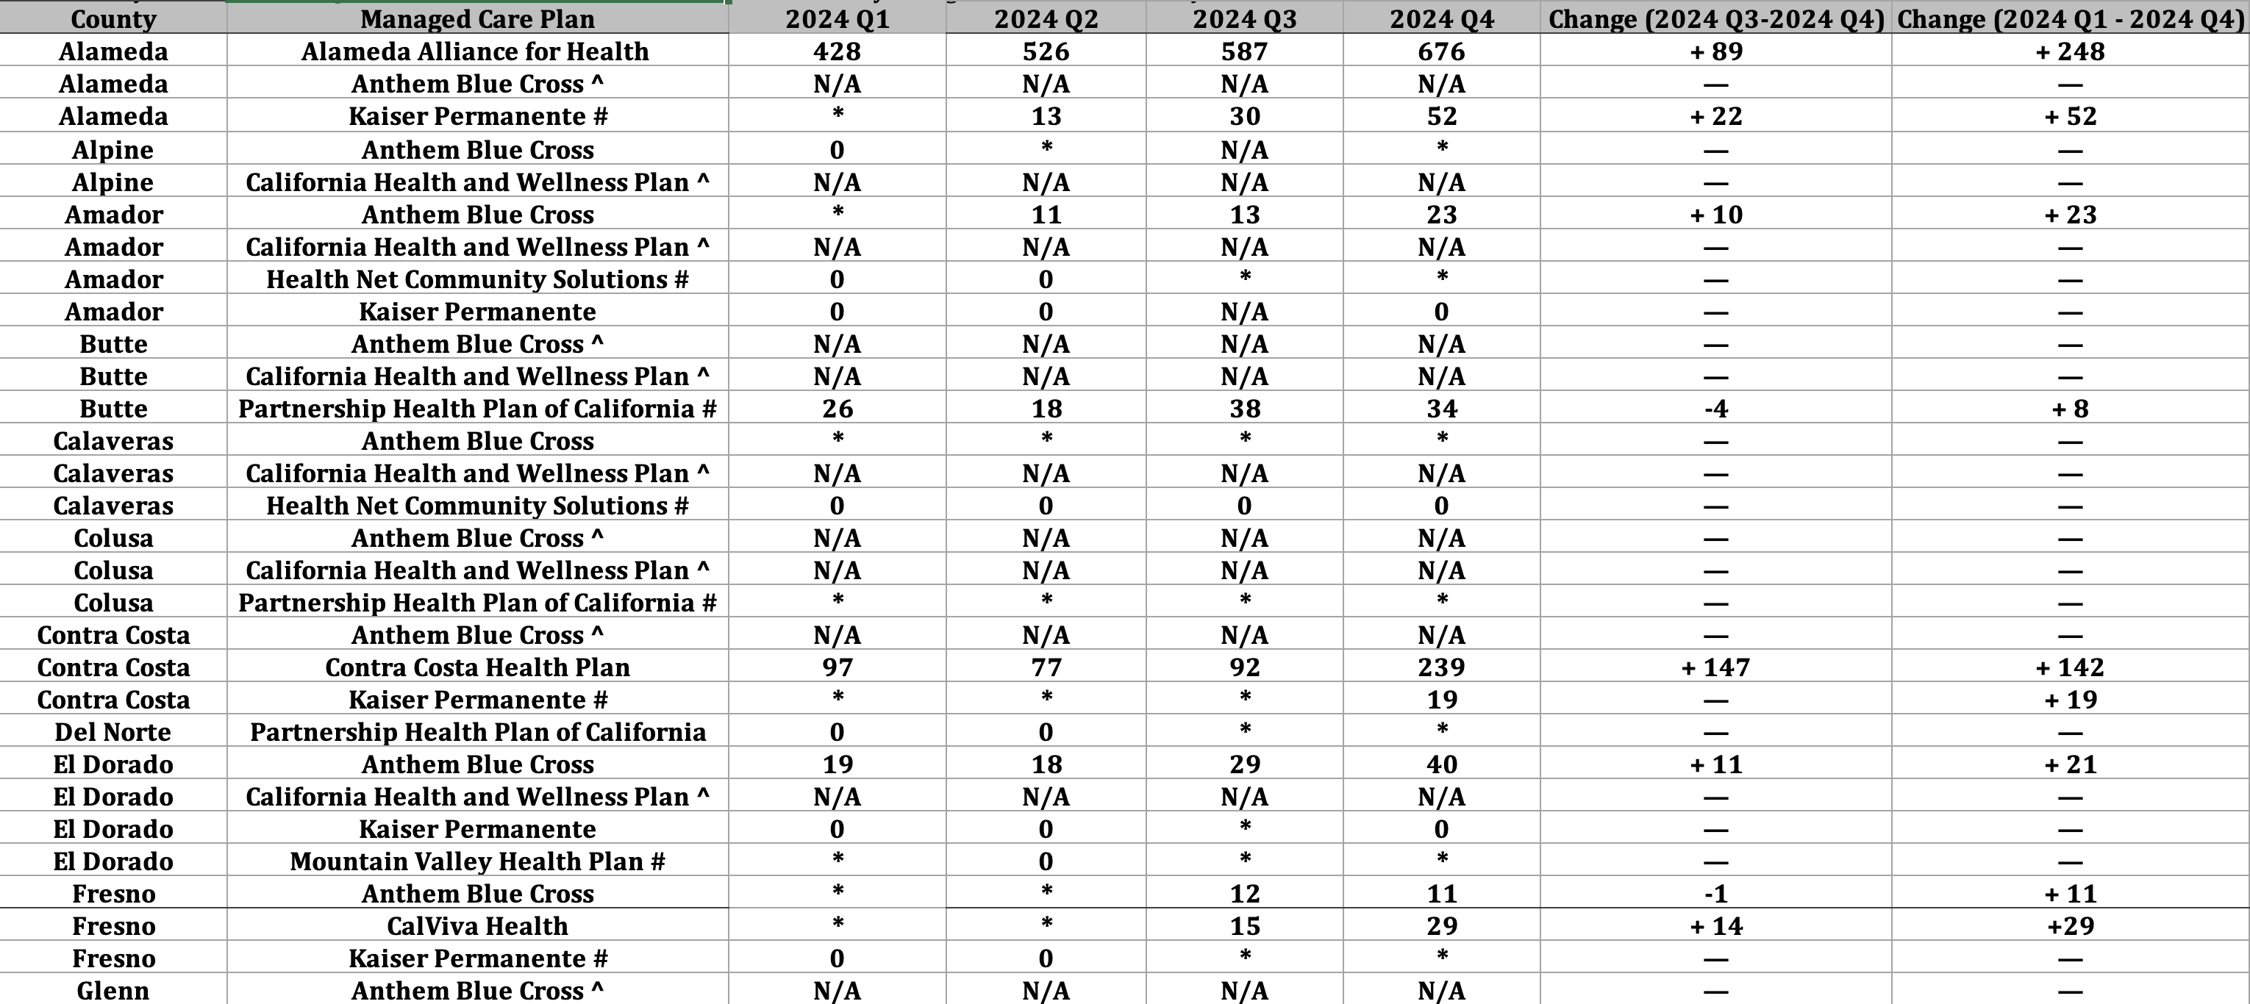
Adult Individuals At Risk of Long-Term Care Institutionalization: ECM Enrollment by County and Managed Care Plan
Source: DHCS, “Total Number of Members Who Received ECM by MCP and County by Population of
Focus by Quarter,” https://geohub-cadhcs.hub.arcgis.com/datasets/CADHCS::ecm-community-support-data-tables-for-quarterly-implementation-report/explore?layer=26&showTable=true
California Health Policy Strategies, LLC
12

Slide 32
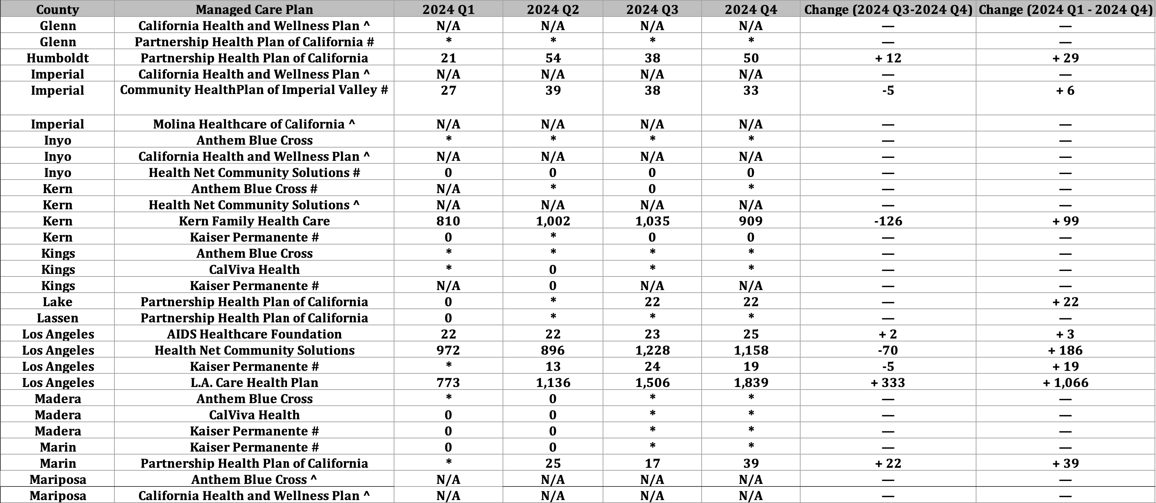
Adult Individuals At Risk of Long-Term Care Institutionalization: ECM Enrollment by County and Managed Care Plan (cont.)
Source: DHCS, “Total Number of Members Who Received ECM by MCP and County by Population of
Focus by Quarter,” https://geohub-cadhcs.hub.arcgis.com/datasets/CADHCS::ecm-community-support-data-tables-for-quarterly-implementation-report/explore?layer=26&showTable=true
California Health Policy Strategies, LLC
13

Slide 33
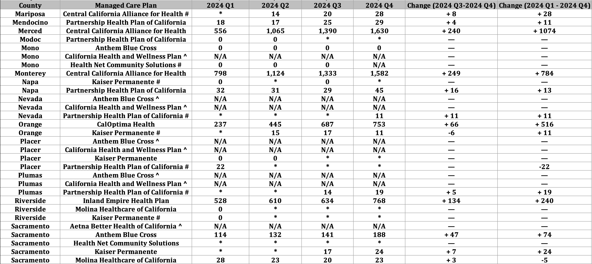
Adult Individuals At Risk of Long-Term Care Institutionalization: ECM Enrollment by County and Managed Care Plan (cont.)
Source: DHCS, “Total Number of Members Who Received ECM by MCP and County by Population of
Focus by Quarter,” https://geohub-cadhcs.hub.arcgis.com/datasets/CADHCS::ecm-community-support-data-tables-for-quarterly-implementation-report/explore?layer=26&showTable=true
California Health Policy Strategies, LLC
14

Slide 34
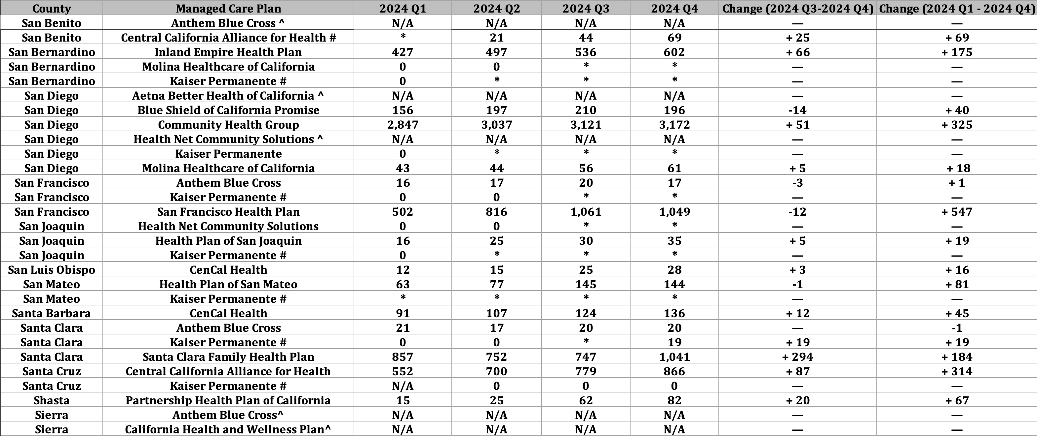
Adult Individuals At Risk of Long-Term Care Institutionalization: ECM Enrollment by County and Managed Care Plan (cont.)
Source: DHCS, “Total Number of Members Who Received ECM by MCP and County by Population of
Focus by Quarter,” https://geohub-cadhcs.hub.arcgis.com/datasets/CADHCS::ecm-community-support-data-tables-for-quarterly-implementation-report/explore?layer=26&showTable=true
California Health Policy Strategies, LLC
15

Slide 35
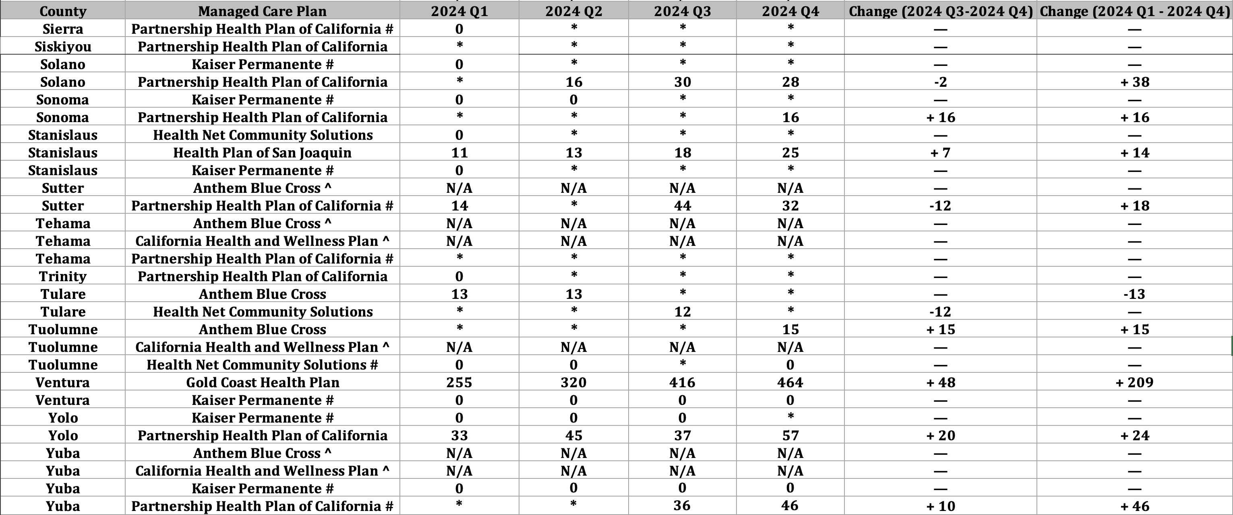
Adult Individuals At Risk of Long-Term Care Institutionalization: ECM Enrollment by County and Managed Care Plan (cont.)
Source: DHCS, “Total Number of Members Who Received ECM by MCP and County by Population of
Focus by Quarter,” https://geohub-cadhcs.hub.arcgis.com/datasets/CADHCS::ecm-community-support-data-tables-for-quarterly-implementation-report/explore?layer=26&showTable=true
California Health Policy Strategies, LLC
16

Slide 36
Webinars
Medi-Cal 101 Series (redux): Led by Jane Ogle, this series will be a redux of the previous series from December 2024, but there will be additional valuable material added to help bolster the core understanding of Medicaid.
Jane will do a deep-dive into the complex and interconnected health and human services programs to help provide a foundational understanding of how to navigate these essential programs. Jane will incorporate relevant information related to the federal budget cuts, as well as other new updates.
Goal: Provide a baseline understanding of Medicaid (aka Medi-Cal in California), as well as providing other relevant updates.
What, if anything, would you like to see in this series?
California Health Policy Strategies, LLC

Slide 37
Webinars
Social Services Aging 101: Cathy Senderling-McDonald of Catbird Strategies will lead an informational webinar series that will cover IHSS, SSI, CalFresh, Older Americans Act, and other state and local aging services such as Meals on Wheels.
Goal: Provide a deeper understanding of the social programming available to eligible individuals in California –and nationally- in times of need.
What, if anything, would you like to see in this series?
California Health Policy Strategies, LLC

Slide 38
Webinars
Federal Budget Updates: Under the leadership of Cathy Senderling-McDonald, this webinar series will provide pertinent updates as it relates to the ever-evolving landscape of federal budget and administrative updates. These webinars will be done on an ad hoc basis.
Goal: Disseminate important information and updates related to the budget and explain how they may impact the work that is being done.
What, if anything, would you like to see in any future webinars on this topic?
California Health Policy Strategies, LLC

Slide 39
Webinars
CalAIM and D-SNP Implementation 101: Jointly led by Jane Ogle and Caroline Davis, this webinar series will explore CalAIM’s alignment and new policies for Dual Eligible Special Needs Plan (D-SNPs).
Goal: Provide a baseline understanding of both programs and how they align and intersect.
What, if anything, would you like to see in this series?
California Health Policy Strategies, LLC

Slide 40
ECM Enrollment Efforts
Ad Hoc Workgroups on ECM Opportunities: On an ad hoc basis, our team will continue to convene focused, ad hoc work groups to brainstorm and work on addressing mutual barriers for the dementia / older adult population. These work groups may include exploration of issue areas, barriers, and best practices, while working toward identification of effective strategies.
Goals: Collaborate and provide a space in which providers servicing similar a similar population(s) can brainstorm and learn from each other; develop and provide policy briefs and other helpful tools (e.g. toolkits) to help foster streamlined implementation
What, if anything, would you like to see in these forums?
California Health Policy Strategies, LLC

Slide 41
ECM Enrollment Workgroup
IHSS Enrollees: Cathy Senderling-McDonald will facilitate work groups whose goal is to identify pathways that can be used to assist high-need, likely eligible IHSS clients in enrolling in ECM.
IHSS Data Transmission to MCPs: Collaboration between DHCS and MCPs to utilize IHSS client information data to increase ECM enrollment of eligible, high need IHSS clients via pathways established through workgroup involvement.
County-based Referrals: Exploration of linkages that facilitate ECM referrals through the use of IHSS assessment information for eligible individuals.
ECM Toolkit for County Social Services Departments: Through the development of educational materials, supplemented by any ad hoc webinars, the toolkit will help to explain the referral process and benefits to both the IHSS client and the Social Services Department personnel.
Goals: Streamlining of information, dissemination of said information to appropriate parties
What, if anything, would you like to see in these forums?
California Health Policy Strategies, LLC

Slide 42
ECM Enrollment Workgroup
Skilled Nursing Facilities: Led by David Panush, this body of work will focus on building a comprehensive, easy-to-digest toolkit that will detail the ECM enrollment process for individuals who are interested in being part of the SNF to community transition population of focus.
We are hoping to look to other key counties (e.g. Alameda) as a focus group from which we can inform our efforts and build a foundational understand.
Goal: Collaborate with subject matter experts to gather best practices which will, then, inform our toolkit for ECM implementation in SNFs
What, if anything, would you like to see in these forums?
California Health Policy Strategies, LLC

Slide 43
ECM Enrollment Workgroup
Adult Day Health Care Programs / CBAS: Over 40,000 individuals participate in ADHC / CBAS programs, many of whom are likely eligible for CalAIM ECM and/or Community Supports. Led by Cathy Senderling-McDonald, this workgroup will identify barriers to entry and suggest options to better streamline efforts.
Goal: Collaborate with attendees to identify barriers and suggest and elevate options for streamlining of efforts to improve enrollment.
What, if anything, would you like to see in these forums?
California Health Policy Strategies, LLC

Slide 44
ECM Enrollment Workgroup
Home and Community-Based Services (HCBS) Waiver Waitlists: A variety of providers and entities have their own waitlists for HCBS programs. While waiting for HCBS access, these individuals, who are likely good candidates for ECM, could be receiving services. Led by David Panush, this workgroup seeks to identify best practices for identifying candidates and, subsequently, approaching them to ask if they would like to receive ECM services.
Goal: Collaborate with attendees to identify barriers and suggest and elevate options for streamlining of efforts to help eligible individuals on the waitlists access ECM services.
What, if anything, would you like to see in these forums?
California Health Policy Strategies, LLC

Slide 45
ECM Enrollment Workgroup
Other Issues: This catchall bucket allows flexibility for us to address the ever-evolving federal landscape. If there is a notable shift, we will be able to request an opportunity to address key issues or revise the activities we are working on.
Goal: Remain transparent and on the same page in terms of the changing federal landscape and its implications.
What, if anything, would you like to see disseminated as a result of this workgroup?
California Health Policy Strategies, LLC

Slide 46
ECM Enrollment Workgroup
San Diego County Workgroup: David Panush will work alongside key county staff to explore the possibility of launching a workgroup that brings together local San Diego MCPs, county agencies, and CBOs to maximize ECM enrollment and Community Supports utilization.
Goal: Identify best practices and develop materials and information that can be disseminated to other counties and organizations.
What, if anything, would you like to see disseminated as a result of this workgroup?
California Health Policy Strategies, LLC

Slide 47
ECM Enrollment Workgroup
San Diego County Workgroup: David Panush will work alongside key county staff to explore the possibility of launching a workgroup that brings together local San Diego MCPs, county agencies, and CBOs to maximize ECM enrollment and Community Supports utilization.
Goal: Identify best practices and develop materials and information that can be disseminated to other counties and organizations.
What, if anything, would you like to see disseminated as a result of this workgroup?
California Health Policy Strategies, LLC

Slide 48
ECM Enrollment Workgroup
D-SNPs: DHCS’s CalAIM D-SNP Policy Guide for contract year 2026 provides an opportunity to integrate care for individuals with dementia and other complex medical conditions into D-SNP plans serving dual eligibles. Jane Ogle will work to address the new state requirements by encouraging heavy involvement from MCPs, CBOs, providers, advocates, and others participating in our Collaborative.
Goal: Identify best practices and develop materials and information that can help ease the burden of the new state requirements for all impacted parties.
What, if anything, would you like to see in this workgroup?
California Health Policy Strategies, LLC

Slide 49
MCP Workgroup
Jane Ogle will continue to lead workgroups with health plan staff centered around CalAIM implementation challenges and perspectives shared during our Collaborative meetings, barriers to accessing ECM and Community Supports, and other options for improvement and streamlining of efforts.
Goals: To share feedback provided to us by Collaborative participants in an effort to improve and iterate existing processes; identify and work to implement best practices
Are you interested in a formal way to share items for Jane to bring to the MCP Workgroup?
California Health Policy Strategies, LLC

