Slide 1


CalAIM Statewide Older Adult Collaborative
August 13, 2025
California Health Policy Strategies, LLC
Notes:
David

Slide 2
Agenda
Agenda Item | Speaker | Time
Welcome and Introductions | David Panush | 3 min
ECM Q4 2024 Data | Reese Murray | 20 min
Partners in Care: ECM Enrollment Strategy | Vanessa Moran | 20 min
Alameda Alliance Updates | Heather Wanket | 10 min
Announcements and Upcoming Meetings | David Panush; Cathy Senderling-McDonald | 5 min
California Health Policy Strategies, LLC

Slide 3

CalAIM Enhanced Care Management Enrollment in 2024 by Population of Focus, County and Managed Care Plan
August 13, 2025
Reese Murray
California Health Policy Strategies, LLC

Slide 4

Statewide ECM Growth by Medi-Cal Member Age Group
Source: DHCS, “Total Number of Members Who Received ECM by Quarter in Any County Since Launch,” https://cadhcs.maps.arcgis.com/apps/dashboards/f415bb29324a45ceaaa 2361862870599
California Health Policy Strategies, LLC
Age Group | 2024 Q1 | 2024 Q2 | 2024 Q3 | 2024 Q4 | Change from 2024 Q3 to 2024 Q4 | Change Across the Four Quarters
Members Under Age 21 | 17,425 | 23,339 | 28,387 | 31,093 | + 2,706 | + 13,668
Members Aged 21 or Older | 93,739 | 104,265 | 115,257 | 118,396 | + 3,139 | + 24,657
Total | 111,164 | 127,604 | 143,644 | 149,489 | + 5,845 | + 38,325
1

Slide 5
Statewide ECM Enrollment Growth By Population of Focus*
California Health Policy Strategies, LLC
Population of Focus | 2024 Q1 | 2024 Q2 | 2024 Q3 | 2024 Q4 | Change from 2024 Q3 to 2024 Q4 | Change Across the Four Quarters
Adult Individuals and Families Experiencing Homelessness | 33,966 | 39,622 | 49,063 | 58,086 | + 9,023 | + 24,120
Adult Individuals Transitioning from Incarceration | 1,565 | 1,802 | 2,185 | 2,418 | + 233 | + 853
Adult Individuals At Risk of Long-Term Care Institutionalization | 11,472 | 14,080 | 16,647 | 18,548 | + 1,901 | + 7,076
Adult Individuals At Risk of Avoidable Hospital or ED Utilization | 39,534 | 42,452 | 45,521 | 53,630 | + 8,109 | + 14,096
Adult Individuals with Serious Mental Health or SUD needs | 40,059 | 46,095 | 50,040 | 55,988 | + 5,948 | + 15, 929
Nursing Facility Residents Who Want to Transition to the Community | 676 | 796 | 843 | 1,030 | + 187 | + 354
Youth Involved in Child Welfare | 1,739 | 1,608 | 2,819 | 3,286 | + 467 | + 1,547
Youth Transitioning from Incarceration | 87 | 149 | 109 | 96 | - 13 | + 9
Youth with Serious Mental Health or SUD Needs | 6,946 | 8,950 | 10,310 | 11,609 | + 1,299 | + 4,663
Youth at Risk of Avoidable Hospital or ED Utilization | 6,763 | 9,321 | 10,801 | 11,852 | + 1,051 | + 5,089
Youth Individuals Experiencing Homelessness | 4,444 | 6,342 | 7,827 | 9,677 | + 1,850 | + 5,233
Youth Enrolled in CA’s Children’s Services with Additional Needs | 2,170 | 3,281 | 3,912 | 4,641 | + 729 | + 2,471
*Members can be included in more than one population of focus.
2

Slide 6
Adult Individuals At Risk of Long-Term Care Institutionalization
California Health Policy Strategies, LLC

Slide 7
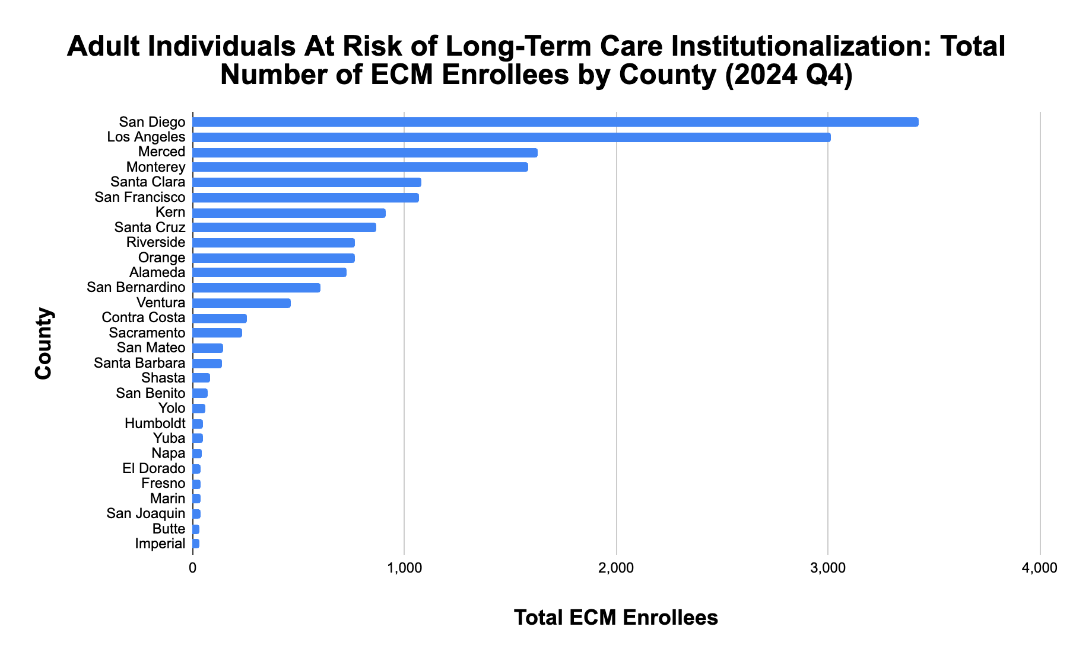

California Health Policy Strategies, LLC
4

Slide 8
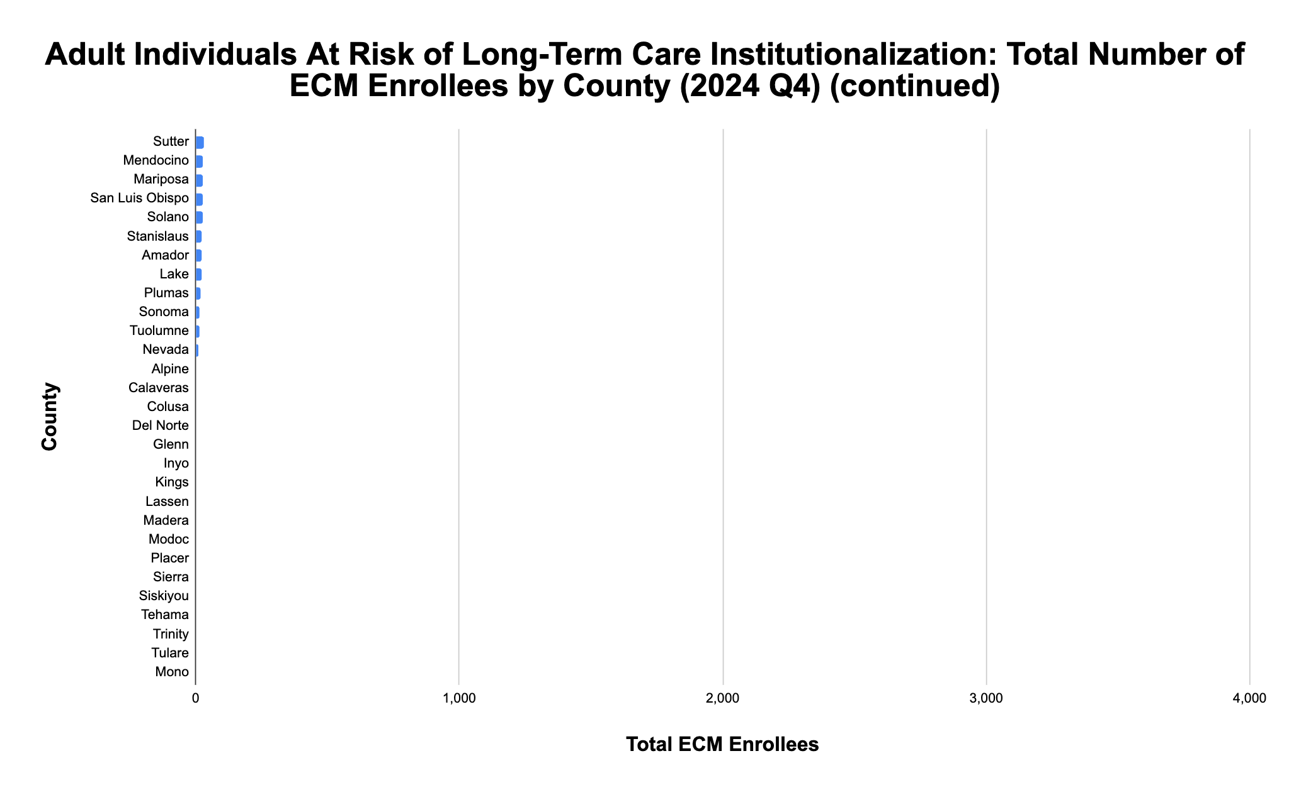
*
*
*
*
*
*
*
*
*
*
*
*
*
*
*
*
*
* denotes enrollment of between 0-10 individuals
California Health Policy Strategies, LLC
5

Slide 9
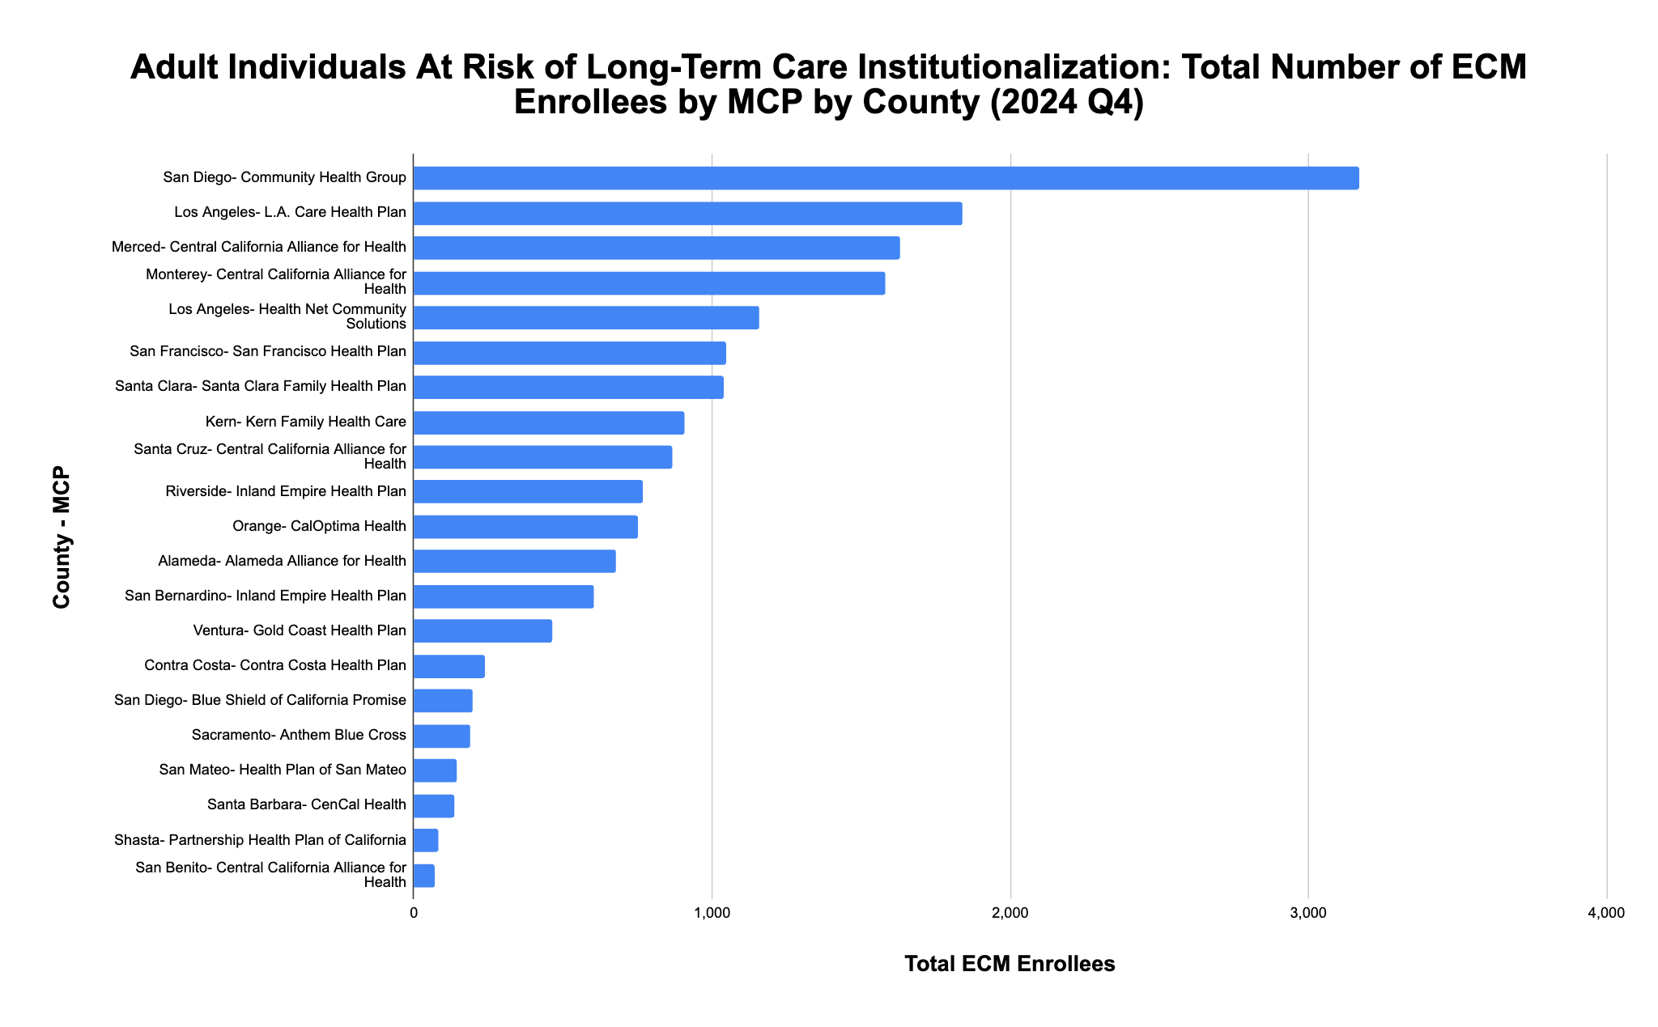
California Health Policy Strategies, LLC 6

Slide 10
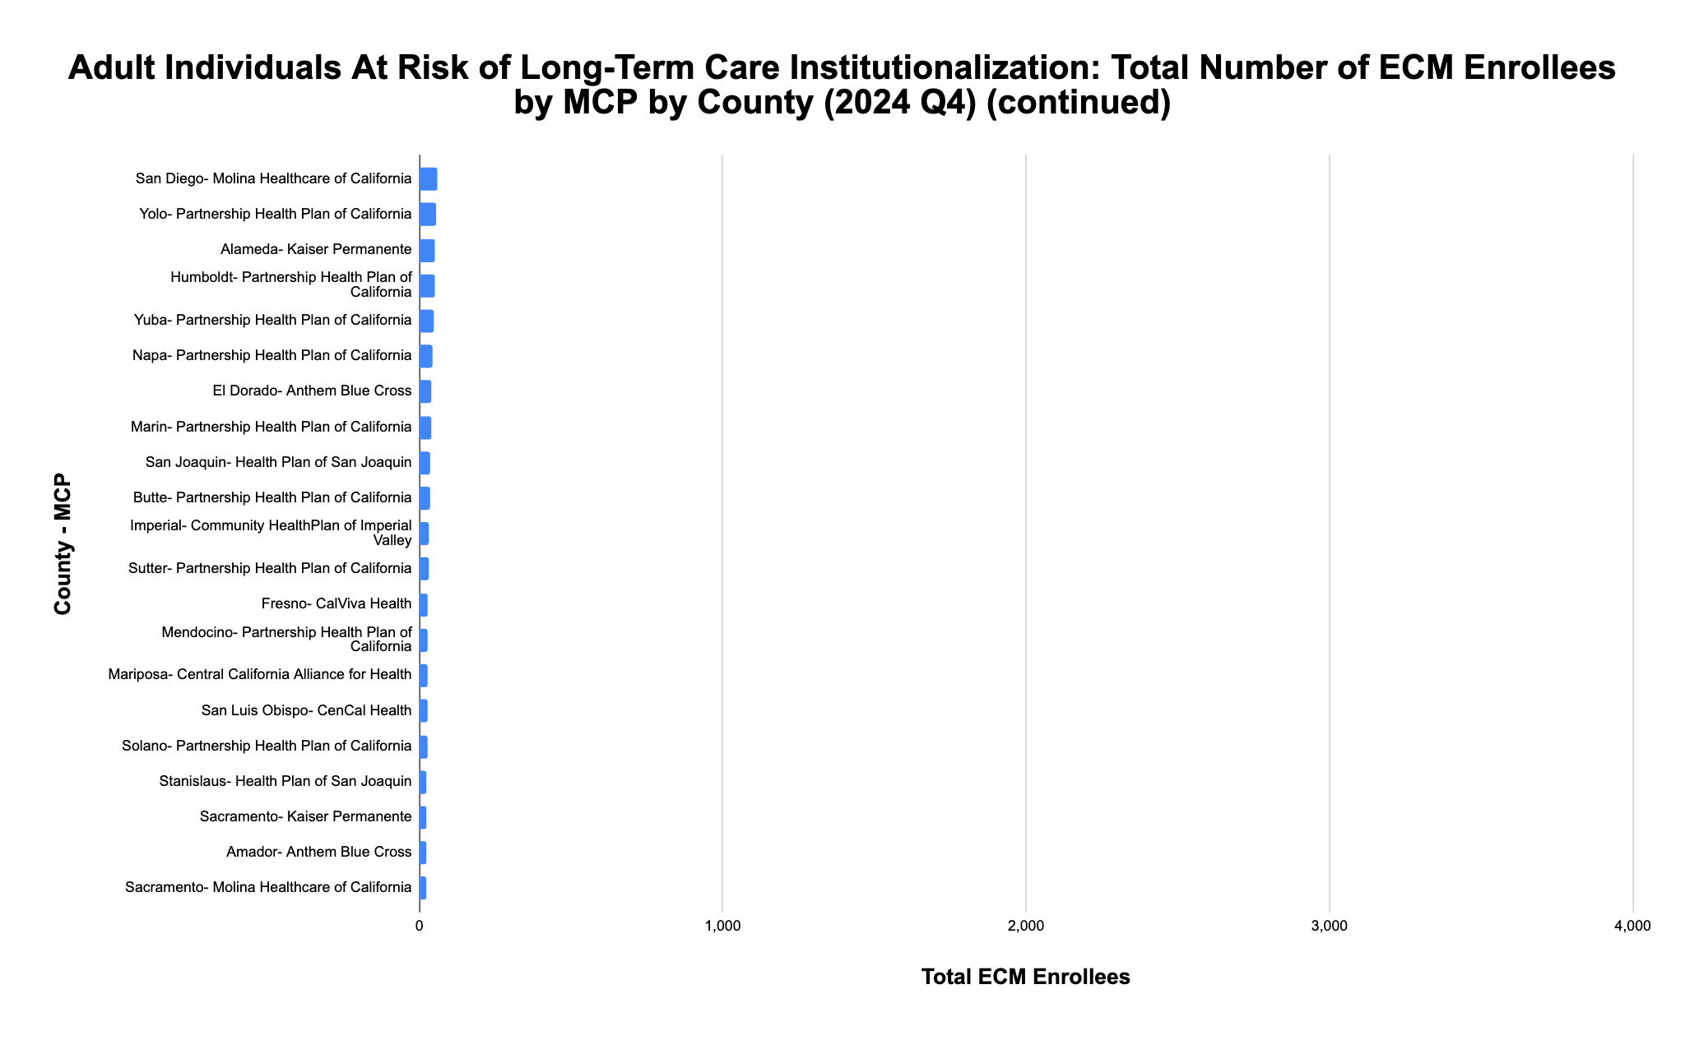
California Health Policy Strategies, LLC 7

Slide 11
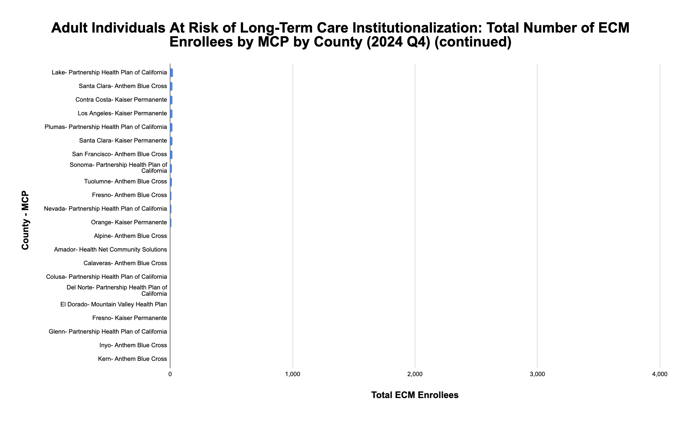
*
*
*
*
*
*
*
*
*
*
* denotes enrollment of between 0-10 individuals
California Health Policy Strategies, LLC 8

Slide 12
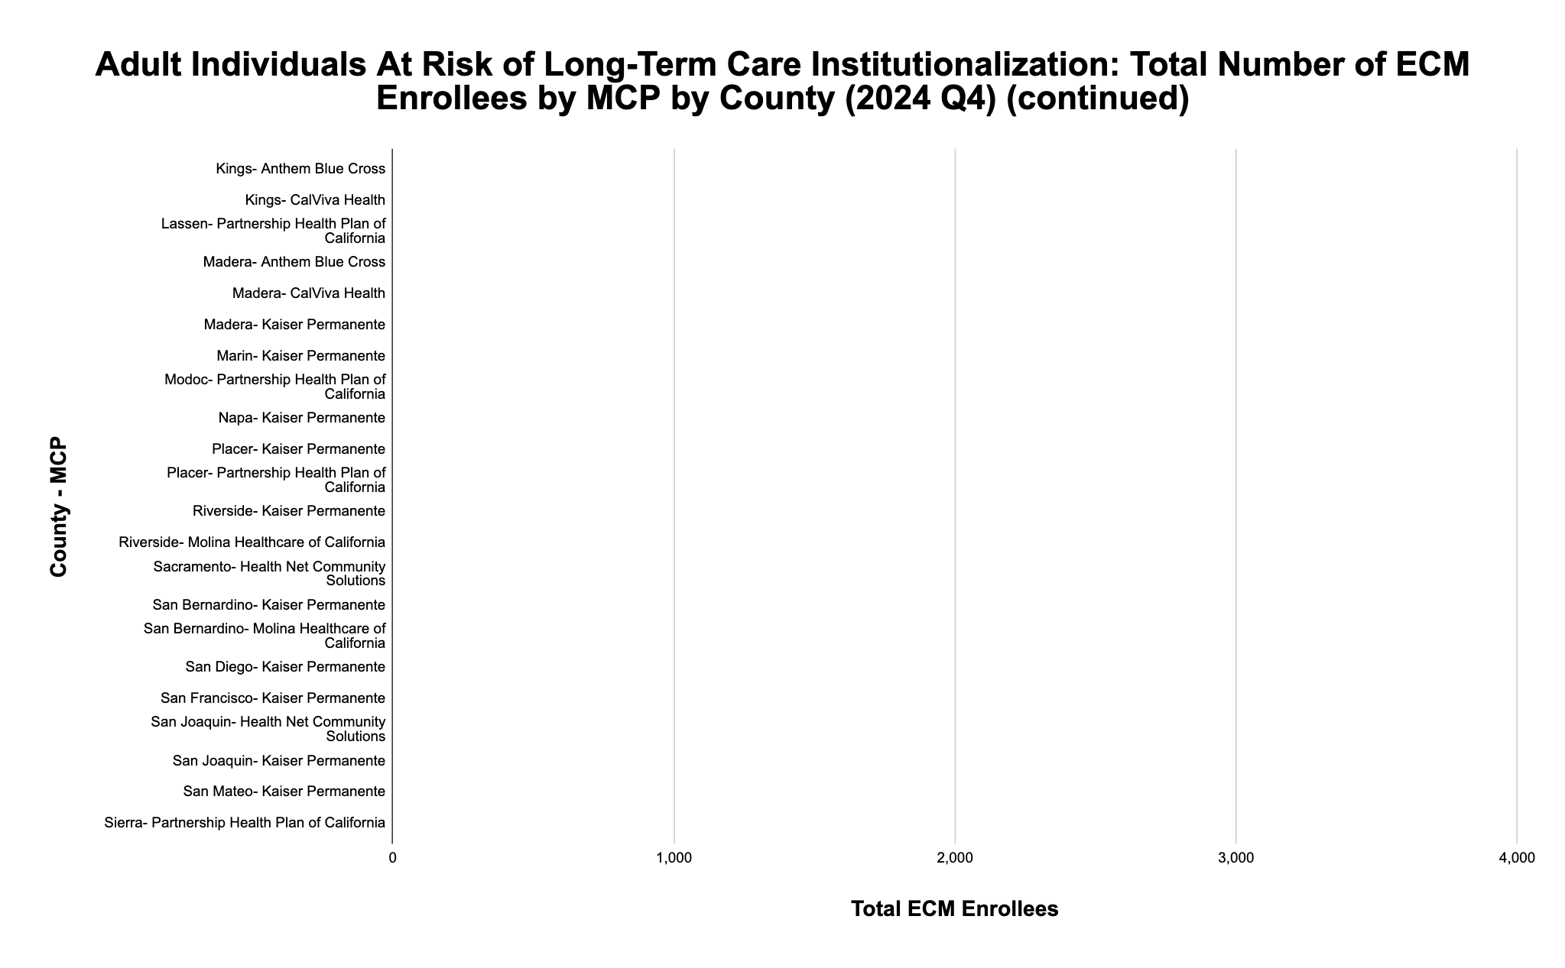
*
*
*
*
*
*
*
*
*
*
*
*
*
*
*
*
*
*
*
*
*
*
* denotes enrollment of between 0-10 individuals
California Health Policy Strategies, LLC 9

Slide 13
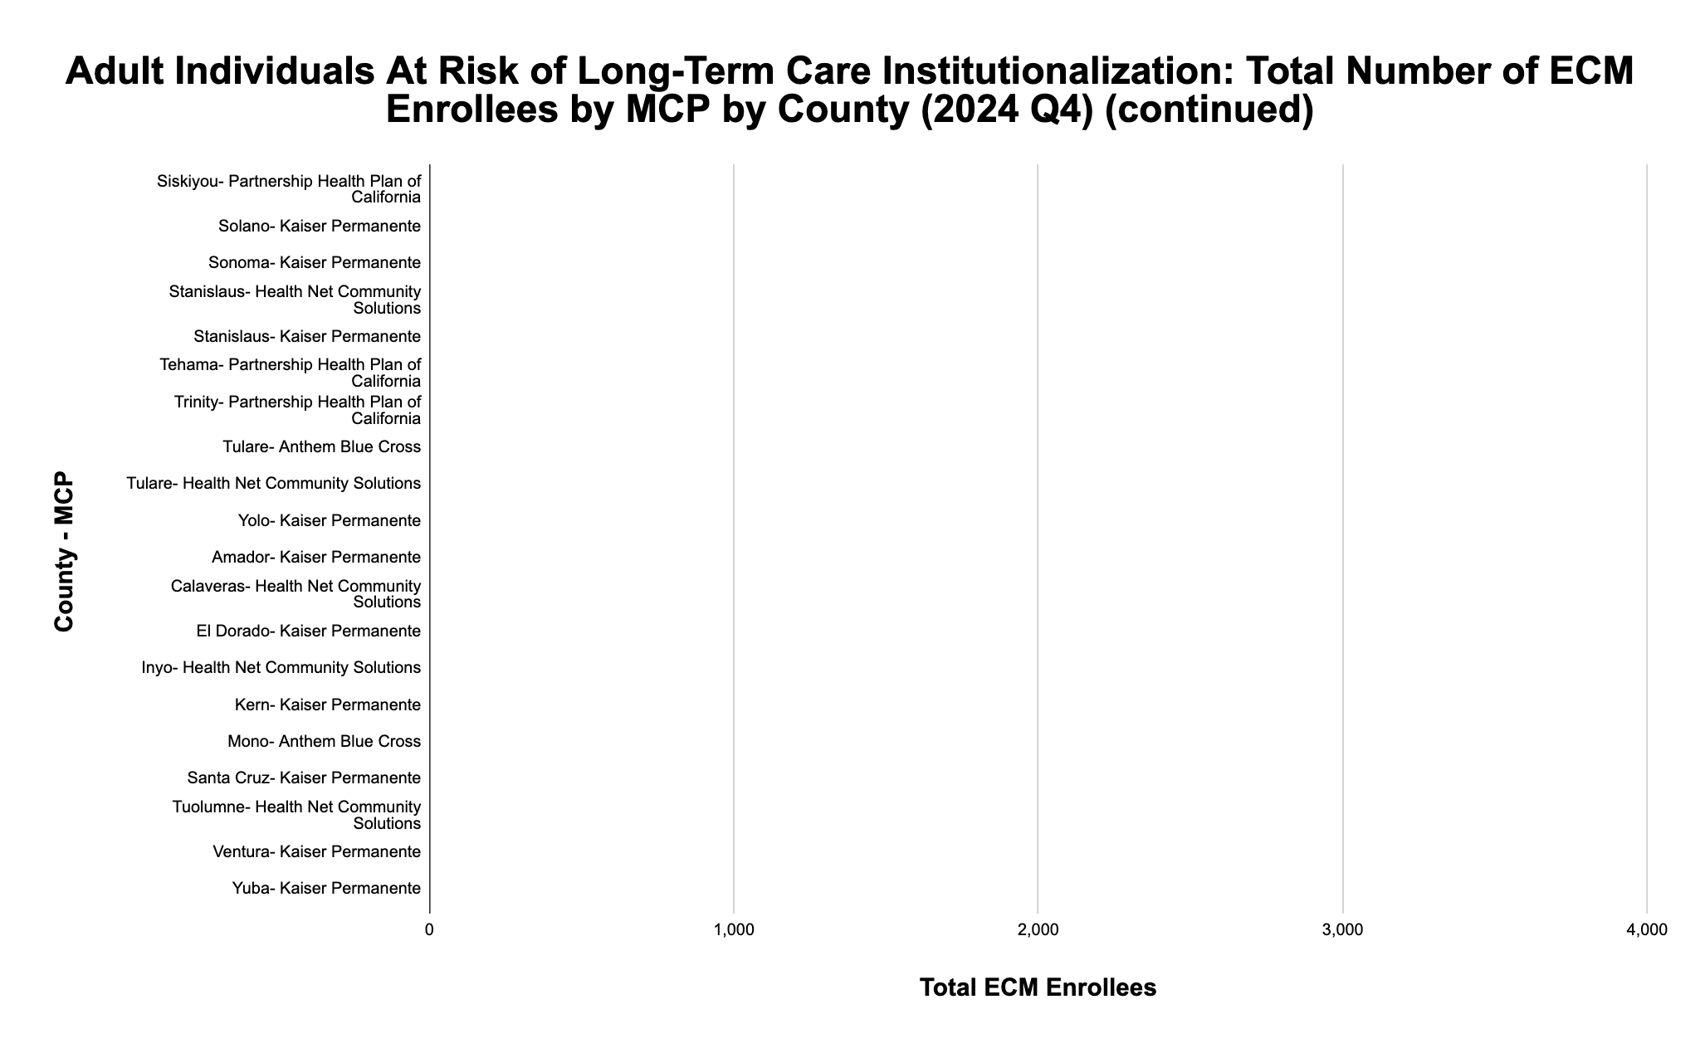
*
*
*
*
*
*
*
*
*
*
*
*
*
*
*
*
*
*
*
*
* denotes enrollment of between 0-10 individuals
California Health Policy Strategies, LLC 10

Slide 14
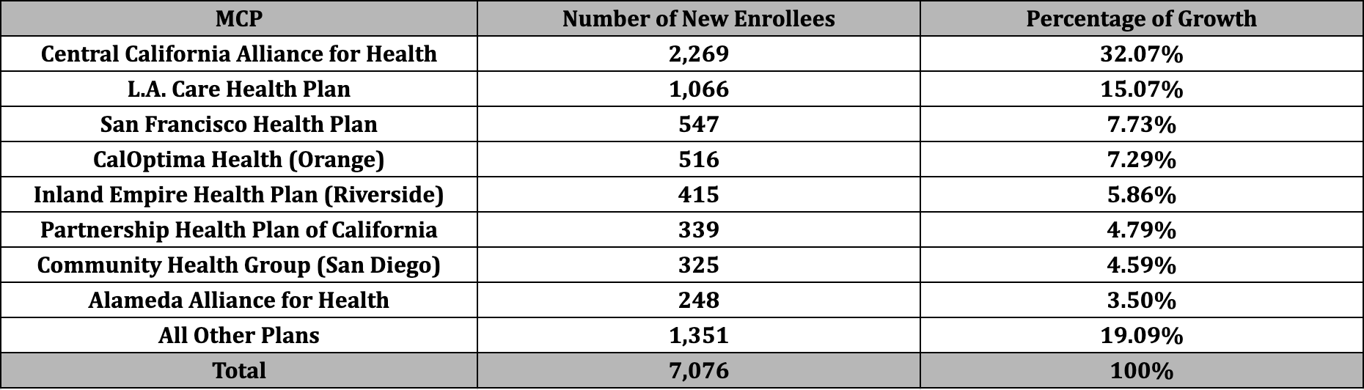
Adult Individuals At Risk of Long-Term Care Institutionalization Population of Focus
Of the 7,076 enrollees gained in 2024, 80% of the growth can be attributed to these eight plans.
California Health Policy Strategies, LLC 11

Slide 15
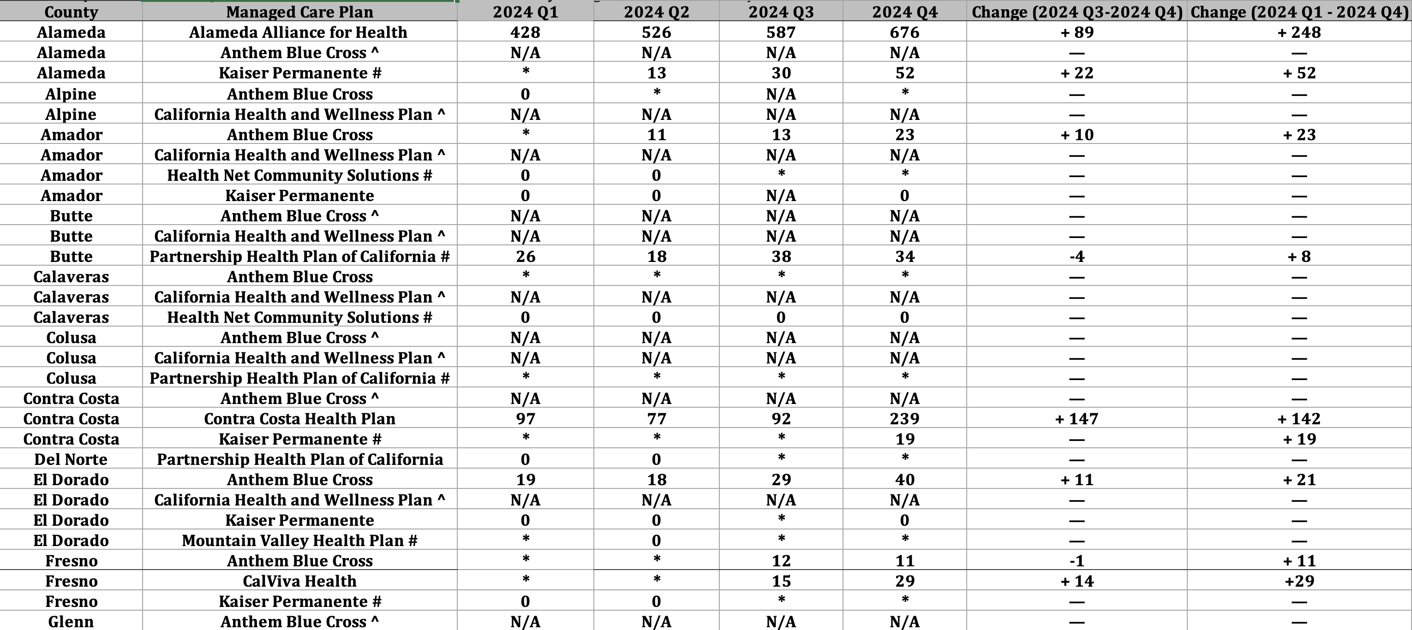
Adult Individuals At Risk of Long-Term Care Institutionalization: ECM Enrollment by County and Managed Care Plan
Source: DHCS, “Total Number of Members Who Received ECM by MCP and County by Population of
Focus by Quarter,” https://geohub-cadhcs.hub.arcgis.com/datasets/CADHCS::ecm-community-support-data-tables-for-quarterly-implementation-report/explore?layer=26&showTable=true
California Health Policy Strategies, LLC
12

Slide 16
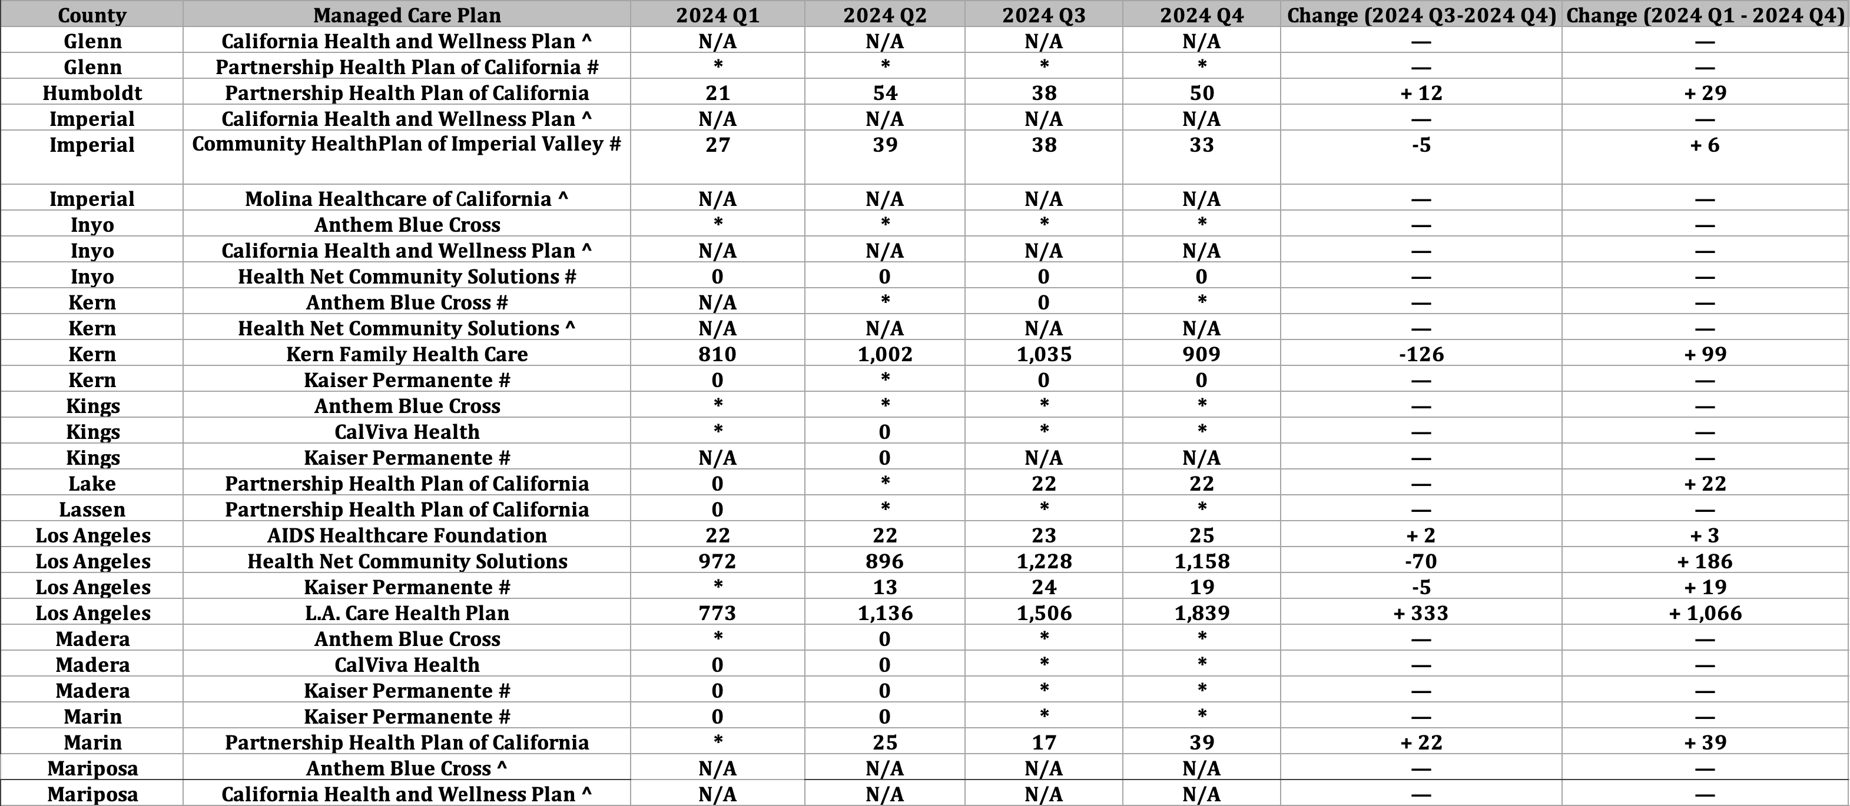
Adult Individuals At Risk of Long-Term Care Institutionalization: ECM Enrollment by County and Managed Care Plan (cont.)
Source: DHCS, “Total Number of Members Who Received ECM by MCP and County by Population of
Focus by Quarter,” https://geohub-cadhcs.hub.arcgis.com/datasets/CADHCS::ecm-community-support-data-tables-for-quarterly-implementation-report/explore?layer=26&showTable=true
California Health Policy Strategies, LLC
13

Slide 17
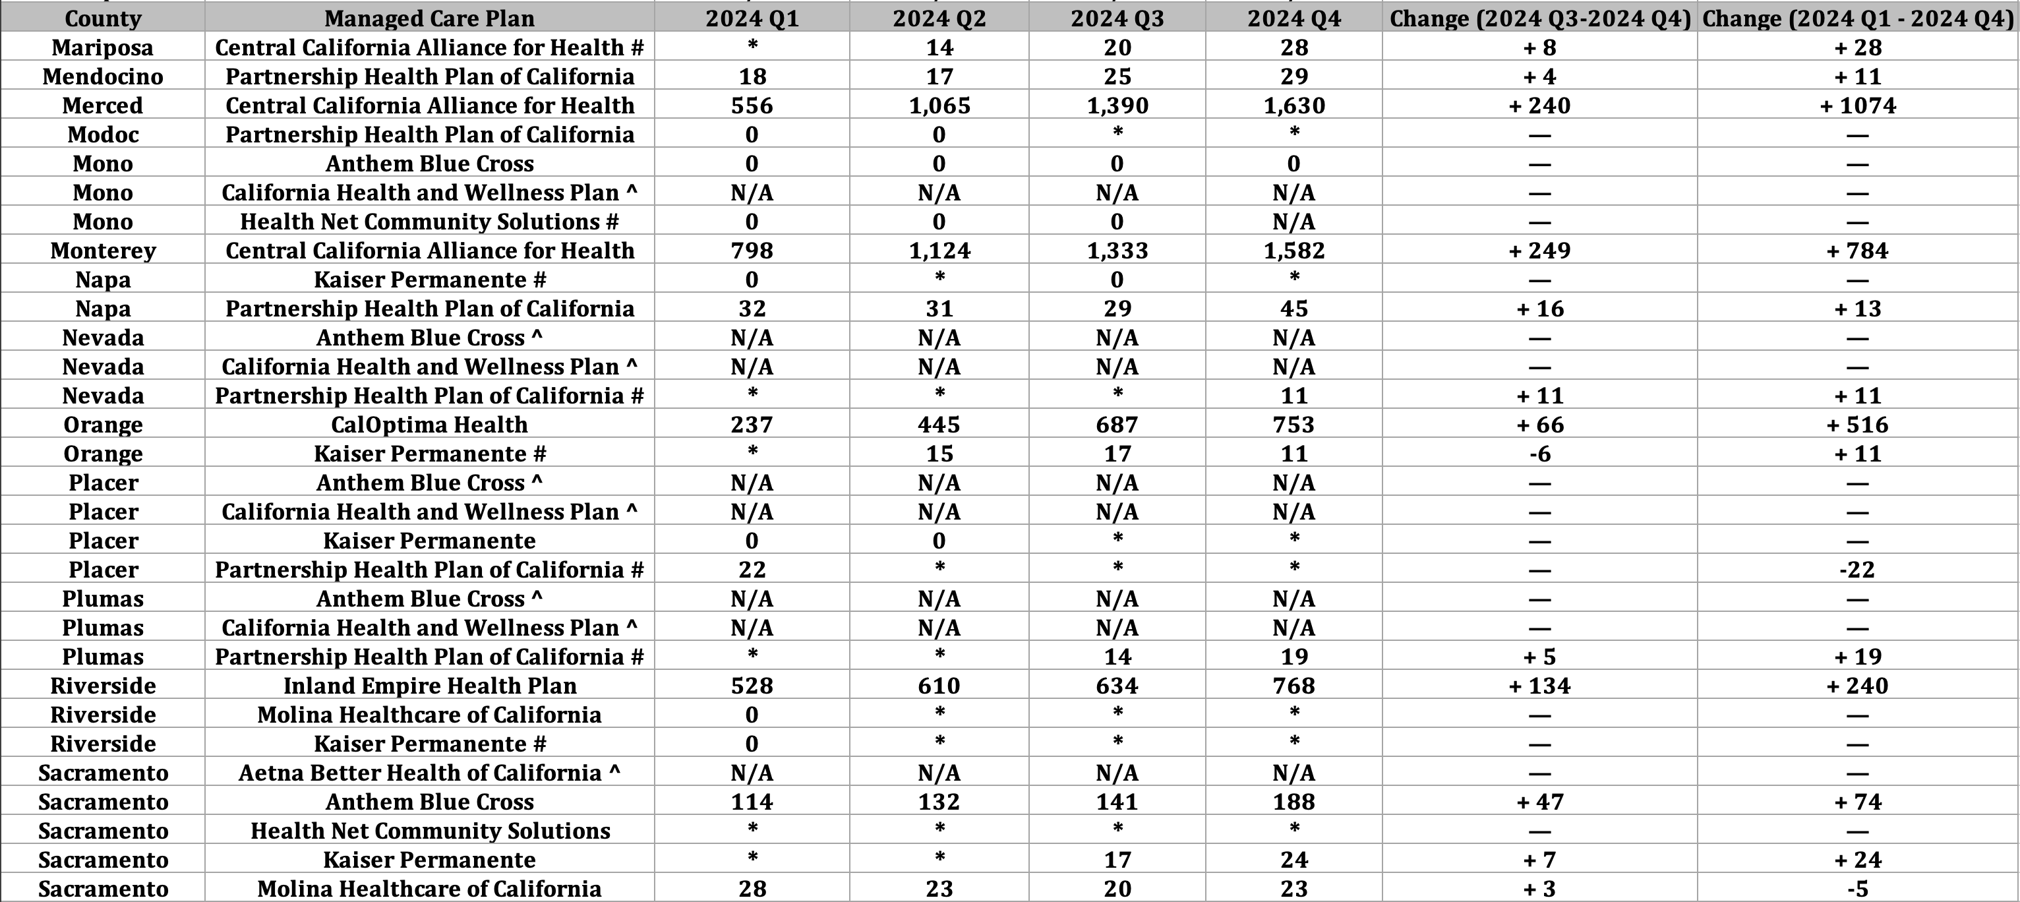
Adult Individuals At Risk of Long-Term Care Institutionalization: ECM Enrollment by County and Managed Care Plan (cont.)
Source: DHCS, “Total Number of Members Who Received ECM by MCP and County by Population of
Focus by Quarter,” https://geohub-cadhcs.hub.arcgis.com/datasets/CADHCS::ecm-community-support-data-tables-for-quarterly-implementation-report/explore?layer=26&showTable=true
California Health Policy Strategies, LLC
14

Slide 18
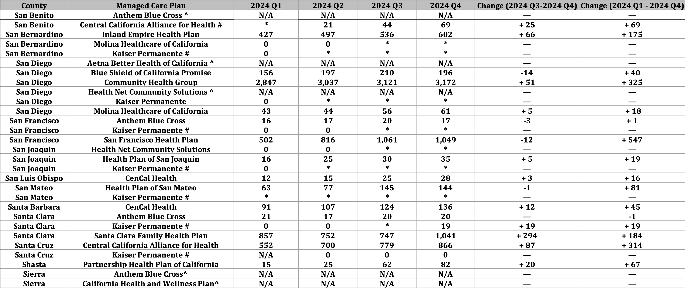
Adult Individuals At Risk of Long-Term Care Institutionalization: ECM Enrollment by County and Managed Care Plan (cont.)
Source: DHCS, “Total Number of Members Who Received ECM by MCP and County by Population of
Focus by Quarter,” https://geohub-cadhcs.hub.arcgis.com/datasets/CADHCS::ecm-community-support-data-tables-for-quarterly-implementation-report/explore?layer=26&showTable=true
California Health Policy Strategies, LLC
15

Slide 19
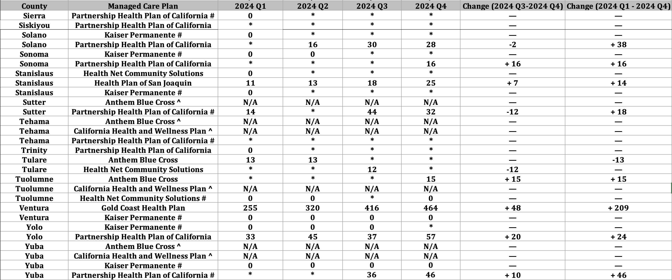
Adult Individuals At Risk of Long-Term Care Institutionalization: ECM Enrollment by County and Managed Care Plan (cont.)
Source: DHCS, “Total Number of Members Who Received ECM by MCP and County by Population of
Focus by Quarter,” https://geohub-cadhcs.hub.arcgis.com/datasets/CADHCS::ecm-community-support-data-tables-for-quarterly-implementation-report/explore?layer=26&showTable=true
California Health Policy Strategies, LLC
16

Slide 20
About the Author
Reese Murray is a 4th year undergraduate student at California Polytechnic State University, San Luis Obispo. She is majoring in Mathematics and hopes to use her degree to help marginalized communities through data analytics.
•
About California Health Policy Strategies (CalHPS), LLC
•
CalHPS is a mission-driven health policy consulting group in
Sacramento. For more information, visit www.calhps.com.
California Health Policy Strategies, LLC 17

Slide 21


Ending the Wait:
An Innovative Path to Faster Access and Better Outcomes in California's HCBA Waiver Program
Vanessa Moran, Sr. Director, HCBA
Dan Swayze, COO
Anwar Zoueihid, VP and CSO

Slide 22




Current HCBA Challenges
High Demand
2-to-4-year waitlist
Unreimbursed pre-enrollment work
Unfilled slots
Addressing these gaps can deliver faster access, better outcomes, and a replicable pathway for statewide scale
Notes:
Long waitlist times create avoidable risk and attrition for medically fragile individuals
Outreach, assessments, and DHCS coordination not funded under HCBA, shifting costs to providers
Members move, lose Medi-Cal, transition to facilities, or pass away during the wait

Slide 23




The Way Forward
Outreach to HCBA waitlisted individuals in ECM
Streamline the intake process for HCBA recipients
Stabilize members through ECM and CS supports
Seamless warm handoff to HCBA at slot release
The HCBA Access Accelerator leverages ECM and Community Supports to eliminate long waitlist delays, improve member outcomes, and create a replicable pathway for statewide scale.
Notes:
Proactively reach out to all waitlisted participants, excluding priority populations, to provide immediate support and care coordination
Streamline the intake process by making ECM the default entry point for waivers with waitlists, ensuring continuous care
Proactively prevent procedural disenrollment and leverage Community Supports to stabilize members at home during the wait period
Collect necessary documentation and complete care planning within ECM, allowing for a smooth transition to HCBA services when a slot becomes available

Slide 24
Key Achievements
Metric | Count
Cohort Engaged | 294
Left Message | 112
Deceased | 15
No Response | 12
Ineligible | 7
ACCEPTANCE RATE
(AMONG REACHED, ELIGIBLE MEMBERS)
83.7%
*Preliminary Key Achievements (as of August 7, 2025)

Slide 25




Challenges and Solutions
Established a dedicated ECM-HCBA Referral Process
Specially Trained ECM Staff
Stakeholder alignment
Documentation and redetermination safeguard
The HCBA Access Accelerator model addressed key challenges through cross-program coordination, specialized staffing, stakeholder engagement, and policy alignment, ensuring a seamless and sustainable solution.
Notes:
Built an ECM specialty unit trained on HCBA rules/forms to eliminate re-work at slot release.
Briefed DHCS and MCPs using early results, member stories, and a clear scale plan.
ECM teams actively manage Medi-Cal redetermination to prevent procedural disenrollment, a key risk during long waits.

Slide 26

Early Lessons
Default-to-ECM creates velocity
Scripted, empathic outreach drives high acceptance
Pre-collection of HCBA documentation in ECM
The HCBA Access Accelerator model leverages ECM to replace passive waitlisting with active care coordination, accelerating access to critical HCBA services.
Notes:
Do not hold referrals in a queue, move them directly to ECM for rapid assessment and service activation
Compassionate call scripts and plain-language member letters resulted in 84% acceptance among reached, eligible members
Collecting diagnoses, clinical documentation, and required forms in advance compresses time-to-enroll once HCBA slots are released

Slide 27
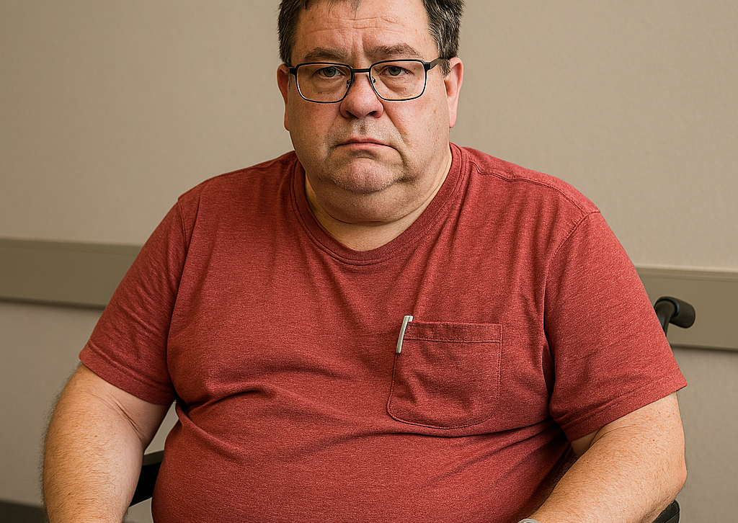
Member Story
M., a 52-year-old with diabetes and hypertension, had three ER visits in 60 days while waiting for HCBA.
Within two weeks of ECM enrollment, the care manager reconciled medications with the PCP, arranged a scale and BP cuff, and set up caregiver respite through Community Supports.
Over the next four months, M. had zero ER visits, no admissions, and transitioned to HCBA with a complete packet—no rework and no delay.

Slide 28




Impact and Benefits
Replaces passive waiting with active care
Funds pre-enrollment work via ECM
Accelerates time-to-enroll at slot release
Strengthens member experience and trust
Reduces ER visits and hospitalizations during waitlist period
Improves financial sustainability for HCBA providers
Pre-collects documentation and completes care planning
Provides consistent scripting and written confirmation
The HCBA Access Accelerator model leverages ECM to replace passive waitlisting with active care coordination, accelerating access to critical HCBA services.
The HCBA Access Accelerator delivers faster access, better outcomes, and a replicable pathway for statewide scale.

Slide 29
Ending the Wait: An Innovative Path to Faster Access and Better Outcomes in California's HCBA Waiver Program
Notes:
The HCBA Access Accelerator is an innovative model that leverages Enhanced Care Management (ECM) and Community Supports to eliminate long waitlist delays for California's Home and Community-Based Alternatives (HCBA) Waiver program. By proactively engaging waitlisted individuals, providing continuous care, and funding previously unreimbursed pre-enrollment work, this approach accelerates access to HCBA services and improves outcomes for medically fragile members.

Slide 30
Alameda Alliance for Health: Updates
August 13, 2025
Speaker:
Heather Wanket, BSN, RN, CCM, Gerontologist
Clinical Manager, Enhanced Care Management (ECM)

Slide 31
Announcements and Upcoming Meetings
Next Collaborative Meeting: Wednesday, October 8^{h}, 12:00 PM Zoom registration link for this and future meetings here.
Additional Upcoming Meetings
Wednesday, December 10th, 12:00 PM
Wednesday, February 11th, 12:00 PM
Wednesday, April 15th, 12:00 PM
Wednesday, June 10th, 12:00 PM
ECM Managers/Directors Ad-Hoc Meeting: Wednesday, August 14th, 2:00 PM
Requests to Jasmine for the Zoom link
California Health Policy Strategies, LLC
Notes:
Zoom link for H.R. 1 webinar: https://us02web.zoom.us/webinar/register/WN_Dw8CnQFzRy2N4WCzpX5DXA#/registration

Slide 32

Announcements and Upcoming Meetings
One Big Bill, Not So Beautiful: The Real Implications of H.R.1 for Older Adults: Thursday, September 25, 11:00AM-12:00PM
Zoom registration link here.
California Health Policy Strategies, LLC
Notes:
Zoom link for H.R. 1 webinar: https://us02web.zoom.us/webinar/register/WN_Dw8CnQFzRy2N4WCzpX5DXA#/registration

Slide 33
Agenda
Welcome and Introductions
ECM / Community Supports Q4 2024 Data
Partners in Care: ECM Enrollment Strategy
Alameda Alliance Updates
ECM / Community Supports and HR1 (aka OBBB)
Announcements and Upcoming Meetings
California Health Policy Strategies, LLC

