Slide 1


CalAIM Statewide Dementia Care
Learning Collaborative
June 11, 2025
California Health Policy Strategies, LLC
Notes:
David

Slide 2
Agenda
Welcome and Introductions
Community Update
Alameda County: ECM Case Study
Announcements and Upcoming Meetings
California Health Policy Strategies, LLC

Slide 3

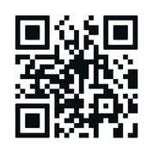


Dementia Assessment Quality Measure Webinar:
SCREENING TO ACHIEVE BETTER CARE
The California Depa ment of Health Care Services (DHCS) and Alzheimer’s Los Angeles are ho ing a webinar focused on
dementia screening for dual eligible members and the California-specific repo ing requirement for Dual Eligible Special Needs Plans (D-SNPs) on Cognitive Health Assessments (CHA). Local Medi-Cal MCP Medical Directors and relevant teams are encouraged to attend to learn more and pa icipate in the discussion.
THURSDAY, JUNE 12
•
1 – 1:45
TH
PM
To register, please scan QR code.

Slide 4

Alameda County: ECM Case Study
June 2025
Speaker Panel:
Preston Burnes, MBA
Vice President of Strategic Partnerships
Institute on Aging
Brenda Goldstein, MPH
Chief of Integrated Services
Lifelong Medical Care

Slide 5
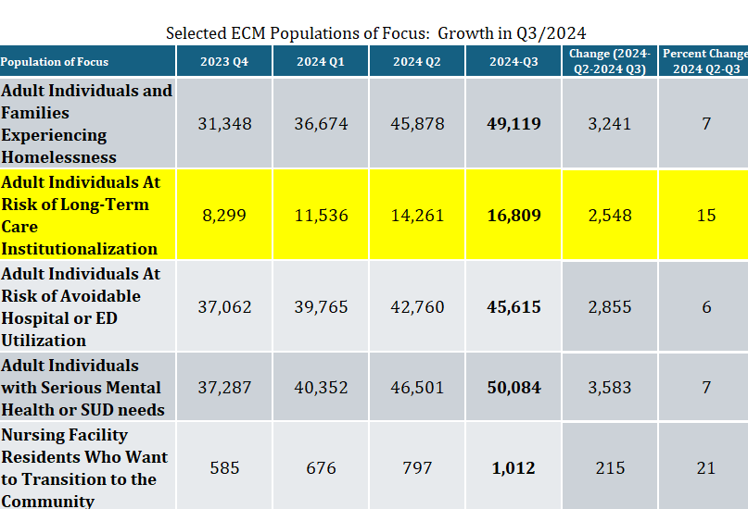
Statewide ECM Enrollment – Q3 2024
California Health Policy Strategies, LLC

Slide 6
Provider Survey
California Health Policy Strategies, LLC

Slide 7
Panel Discussion
What are the challenges that are slowing ECM enrollment in POF 5?
How have one-time infusion dollars (e.g. IPP and/or PATH) supported transition?
Is there anything the state and/or MCPs could do to increase enrollment within existing resources?

Slide 8
Announcements and Upcoming Meetings
Reminder: No Collaborative Meeting in July Next Meeting: August 13th, 12:00PM
ECM Managers/Directors Ad-Hoc Meeting: Wednesday, July 16th, 1:00 PM
California Health Policy Strategies, LLC
Notes:
Darren

