Slide 1


CalAIM Statewide Dementia Care
Learning Collaborative
March 12, 2025
California Health Policy Strategies, LLC
Notes:
David

Slide 2
Agenda
Welcome and Introductions
Updates
Dual Special Needs Plan – Policy Guide Overview with Anastasia Dodson
Panelist Discussion
Announcements and Upcoming Meetings
California Health Policy Strategies, LLC

Slide 3
Updates
Federal Budget 101 Webinar
Wednesday, March 26, 2025, at 1:00 PM
Cathy Senderling-McDonald
Registration link coming soon
Join us to learn the how’s and why’s of federal budgeting. Cathy Senderling-McDonald, who brings 28 years of experience in California and federal policy, along with Washington, DC based experts will demystify the process, providing details, definitions, and discussing how and when you can engage with policymakers in a meaningful way.
California Health Policy Strategies, LLC
Notes:
Darren

Slide 4
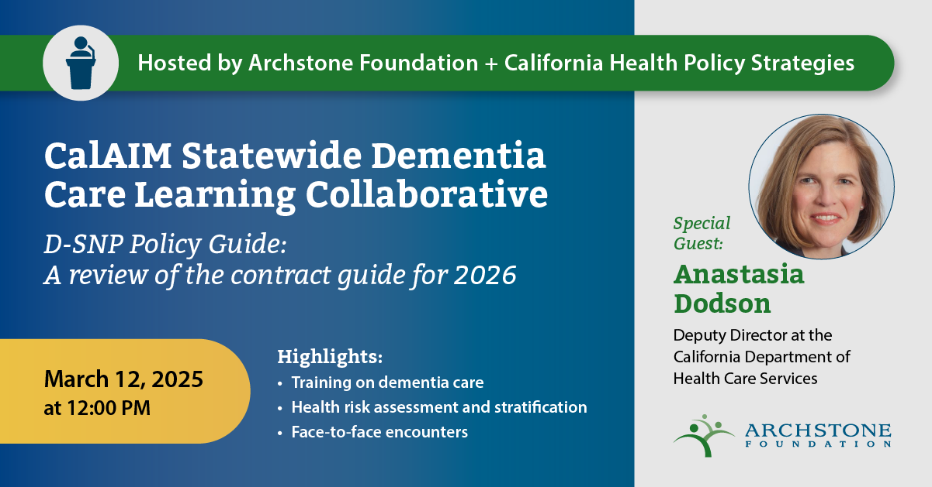
California Health Policy Strategies, LLC
Notes:
Darren

Slide 5
2026 D-SNP Policy Guide: Care Coordination
March 12, 2025

Slide 6
Agenda
Overview: Dual Eligible Members
D-SNPs in California
D-SNP Care Management Overview
CY 2026 Care Management Policy for D-SNPs
Overview: State-Specific Care Coordination Requirements
California Integrated Care Management

Slide 7
Overview: Dual Eligible Members

Slide 8
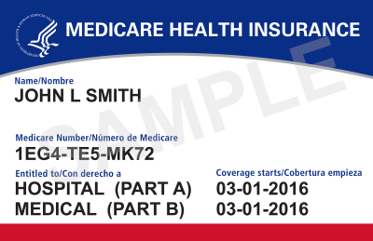
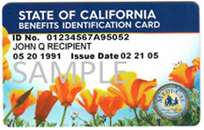
Medicare and Medi-Cal
Some people have both Medicare and Medi-Cal, known as dual eligibles (Medi-Medis).
Medicare covers doctor visits, hospital stays, labs, prescription drugs, and other benefits.
Medi-Cal covers Medicare Part B premiums, copays, adult day health care, skilled nursing facility care, dental, and In-Home Supportive Services (IHSS).

Slide 9
Dual Eligible Members with Dementia in California
As of March 2021, 18% of California’s dual eligible members in Medicare Fee-For-Service age 65 and older have Alzheimer’s or related dementias (DHCS data).
Alzheimer’s and related dementias are also more common among dual eligible members than Medicare-only beneficiaries.
In 2018, prevalence among California’s dual eligible members age 65 and older (20.7%) was more than twice as high as prevalence among California’s Medicare-only beneficiaries age 65 and older (8.7%) (CMS data).
Additional information can be found in:
Prevalence of Alzheimer's Disease and Related Dementias Among California Medi-Cal Beneficiaries Age 30 and Older, published August 2022
Chronic Conditions Experienced by Californians with Original Medicare in 2021, published December 2023

Slide 10
Dual Eligible Individuals in California
In California, almost a quarter of Medicare members also have Medi-Cal (1.7 million Californians).
About 52% of dual eligible individuals are enrolled in some type of MA plan, including integrated plans, and 48% are in Original (Fee-For-Service) Medicare.
As of February 2025, enrollment in Medi-Medi Plans (EAE D-SNP) is approximately 340,000.
All dual eligible members in California are enrolled in Medi-Cal managed care plans.

Slide 11
Medicare Delivery System Enrollment for Dual Eligibles in California (July 2024)
Notes:
[Christopher Tolbert]

Slide 12
D-SNPs in California
Notes:
[Cassidy]

Slide 13
D-SNPs in California
Dual Eligible Special Needs Plans (D-SNPs) are Medicare Advantage (MA) plans that provide specialized care and wrap-around services for dual eligible members (eligible for both Medicare and Medi-Cal).
D-SNPs must have a State Medicaid Agency Contract (SMAC) with DHCS and DHCS can choose whether to contract with D-SNPs. The D-SNP Policy Guide provides additional information for how D-SNPs must operate.
In California, dual eligible members can enroll in an exclusively aligned enrollment (EAE) D-SNP and matching Medi-Cal Managed Care Plan (MCP) that are operated by the same parent organization for better care coordination and integration. These are known as Medi-Medi Plans.
Non-EAE D-SNPs also exist in some counties. Non-EAE D-SNPs are plans that either have an affiliated Medi-Cal MCP but are not in counties that offer Medi-Medi Plans yet or do not have an affiliated Medi-Cal MCP.

Slide 14
D-SNP Care Management Overview

Slide 15
Care Management
Care management is a primary responsibility of D-SNPs.
Both federal and state requirements exist for care coordination.
D-SNPs manage many chronic and acute conditions for members, so they have robust federal care coordination requirements that include a clinical focus.
Additional information about federal care coordination requirements can be found on the NCQA Model of Care webpage.
D-SNPs are responsible for coordinating all Medicare and Medi-Cal benefits, including:
Medi-Cal benefits carved-out of MCPs: Medi-Cal Dental, In-Home Supportive Services, Regional Center Services, County Behavioral Health
Benefits with overlapping coverage: Transportation, Durable Medical Equipment, Community Supports
In some instances, there may be duplication across Medicare and Medi-Cal program requirements, such as the Medi-Cal Enhanced Care Management (ECM) program.

Slide 16
Care Management (cont.)
There is significant overlap across D-SNP care management and Medi-Cal ECM requirements.
This could result in duplication and confusion for members and care teams if a member receives care management from both programs.
D-SNPs, rather than Medi-Cal MCPs, are responsible for care management for D-SNP members that may otherwise qualify for Medi-Cal ECM. Dual eligible members in D-SNPs are not eligible for receiving Medi-Cal ECM through their MCP.
D-SNPs must provide sufficient care management to members to ensure that members who would otherwise qualify for Medi-Cal ECM are not adversely impacted by receiving care management exclusively through their D-SNP.
Note: Dual eligible members who are in Original Medicare or Medicare Advantage plans (not D-SNPs) receive Medi-Cal ECM through their MCP if they meet eligibility requirements.

Slide 17
CY 2026 D-SNP Policy Guide: Care Coordination Chapter

Slide 18
Overview: CY 2026 Care Coordination Chapter
The Care Coordination chapter of the CY 2026 D-SNP Policy Guide provides state-specific care coordination requirements to health plans operating EAE (Medi-Medi Plan) and non-EAE D-SNPs.
The chapter is available on the DHCS website.
Similar to previous years, topics in this chapter cover Risk Stratification, Health Risk Assessments (HRAs), Individualized Care Plans (ICPs), Interdisciplinary Care Teams (ICTs), and Care Transitions.
Guidance on Palliative Care and Dementia Care were carried over from 2025.
New for 2026: Transition from ECM-like care management to California Integrated Care Management (CICM).
D-SNPs will continue to provide “ECM-like” care management to eligible members throughout CY 2025.
D-SNPs will transition to providing CICM on January 1, 2026.

Slide 19
Overview: State-Specific Care Coordination Requirements

Slide 20
State-Specific Risk Stratification Requirements
All state-specific risk stratification requirements are in addition to federal risk stratification requirements for D-SNPs.
In California, a D-SNP’s risk stratification of members must account for any identified member needs covered by Medi-Cal.

Slide 21
State-Specific Risk Stratification Requirements (cont.)
At a minimum, a D-SNP’s risk stratification process must include a review of:
Any available utilization data, including Medicaid utilization data available through the aligned Medi-Cal managed care plan (including long-term care utilization)
Any other relevant and available data from delivery systems outside of the managed care plans such as:
In-Home Supportive Services (IHSS)
Multipurpose Senior Services Program (MSSP) and other 1915(c) and home-and community-based waiver programs
Behavioral health (both mental health and substance use disorder data, if available)
Pharmacy data
The results of previously administered Medicare or Medi-Cal Health Risk Assessments, if available
Any data and risk stratification available through the DHCS Population Health Management Platform (when it becomes available)

Slide 22
State-Specific Health Risk Assessment (HRA) Requirements
All state-specific HRA requirements are in addition to federal HRA requirements for D-SNPs.
D-SNPs must make best efforts to create a single, unified HRA to meet the requirements for both the D-SNP and Medi-Cal managed care plan.
HRAs must directly inform the development of a member’s Individualized Care Plan (ICP) and Interdisciplinary Care Team (ICT), per federal requirements.

Slide 23
State-Specific Health Risk Assessment (HRA) Requirements (cont.)
D-SNPs have flexibility in the design of their HRA tools but must ensure the HRA identifies the following elements:
Medi-Cal services a member currently uses.
Any Long-Term Services and Supports (LTSS) needs a member may have or potentially need.
Populations that may need additional screening or services specific to that population, such as those with dementia and Alzheimer’s disease.
At least one question on each of the following three domains: housing stability, food security, and access to transportation (consistent with federal requirements).
Identification of any caregivers.
If a member identifies a caregiver, then D-SNPs will conduct an assessment of caregiver support needs.

Slide 24
State-Specific Individualized Care Plan (ICP) and Interdisciplinary Care Team (ICT) Requirements
All state-specific ICP and ICT requirements are in addition to federal ICP and ICT requirements for D-SNPs.
ICPs are informed by a member’s HRA and past utilization of both Medicare and Medi-Cal services.
Members, primary care providers, and specialists are encouraged to participate in the development of the ICP and ICT activities.
If cognitive impairment is present, caregivers should also be involved.
The ICP should be person-centered and, when cognitive impairment is present, family-centered.
Both the ICP and ICT should include services and providers from the Medi-Cal managed care and carved-out delivery systems, as appropriate for a member and consistent with their preferences.
Additional information about ICPs and ICTs is included in the Care Coordination chapter of the CY2026 D-SNP Policy Guide.

Slide 25
Face-to-Face Encounters Requirements
Per federal requirements, all D-SNPs must provide face-to-face encounters with members for the delivery of health care or care management or care coordination services.
Face-to-face encounters must:
Be on at least an annual basis
Begin within the first 12 months of enrollment
Be with the member’s consent
Be between a member and an individual in the member’s ICT, or between a member and an individual from the D-SNP’s case management staff, or between a member and the member’s contracted health care provider
Be either in-person or through a visual, real-time, interactive telehealth encounter
Per state-specific requirements, D-SNPs must use alternate methods (including telehealth) when in-person communication is unavailable or does not meet the needs of a member, to provide culturally appropriate and accessible communication in accordance with member choice.

Slide 26
California Integrated Care Management

Slide 27
California Integrated Care Management (CICM)
CICM refers to the California-specific requirements for integrated care coordination for specific vulnerable populations covered by D-SNPs as determined by the state.
Per federal guidance, D-SNPs must provide robust care coordination to members. CICM layers state-specific requirements on top of federal D-SNP requirements.
CY 2026 CICM requirements replace the CY 2024 and CY 2025 “ECM-like care management” requirements for D-SNPs.
CICM policy applies to members who may have been eligible to receive Medi-Cal ECM from their MCP. However, D-SNP members are not eligible to receive Medi-Cal ECM from their MCP.
CICM requirements also address an additional vulnerable population: Adults with Documented Dementia Needs.

Slide 28
New CY 2026 D-SNP State-Specific Care Coordination Requirements
CICM Populations: D-SNPs must include all of the CICM populations as vulnerable members in their MOCs.
The CICM populations reflect Medi-Cal ECM with the addition of Adults with Documented Dementia Needs.
Note: CY 2025 care coordination requirements around dementia care and dementia care specialists have been incorporated into CICM.
CBO Contracting: DHCS is recommending that D-SNPs contract with community-based organizations (CBOs) to provide care management to specific CICM populations.
D-SNPs who contract with CBOs to provide care management to CICM populations are also encouraged to include the CBOs in a member’s ICT.
In-Person Engagement: In addition, DHCS is encouraging plans to provide care management to these CICM populations primarily through in-person interactions.
For the Adults Experiencing Homelessness CICM population, D-SNPs are required to provide in-person care.

Slide 29
CICM: CBO Contracting
DHCS recommends but does not require that D-SNPs contract with CBOs that serve CICM populations to augment D-SNP plan-based care management.
EAE D-SNPs are also encouraged to leverage the CBO contracts the plan has within their Medi-Cal line of business for ECM to support D-SNP members who qualify for CICM.

Slide 30
CICM: Working with CBO Care Managers
In situations where a CBO providing CICM assigns a care manager to a member, the D-SNP care manager must directly communicate with the CBO care manager to ensure the member receives coordinated care.

Slide 31
Additional Requirements for Specific CICM Populations
Adults with Documented Dementia Needs
D-SNPs must have trained dementia care specialists on ICTs for members living with dementia.
D-SNPs should leverage available training content from Alzheimer’s organizations when developing training content for dementia care specialists.
Dementia care specialists must be included in the development of the member’s ICP to the extent possible and as consistent with the member’s preference.
DHCS encourages plans to leverage Dementia Care Aware training and resources to support D-SNP providers when detecting cognitive impairment for D-SNP members.
Note: These requirements were also included in the CY 2025 Care Coordination chapter.

Slide 32
Questions?

Slide 33
Discussion panel
Jennifer Schlesinger, VP, Healthcare Services and Professional Training, Alzheimer’s Los Angeles Debbie Toth, President and CEO, Choice in Aging
California Health Policy Strategies, LLC
Notes:
Darren

Slide 34
Upcoming Meetings
Upcoming Collaborative Meetings
Register here for all 2025 meetings
Meeting #17: Wednesday, April 2, 12:00 – 1:00 PM Topic of Focus: Federally Qualified Health Center’s and their role in providing ECM
Meeting #18: Wednesday, May 14, 12:00 – 1:00 PM
Meeting #19: Wednesday, June 11, 12:00 – 1:00 PM
California Health Policy Strategies, LLC
Notes:
Brooke and/or Jasmine

Slide 35
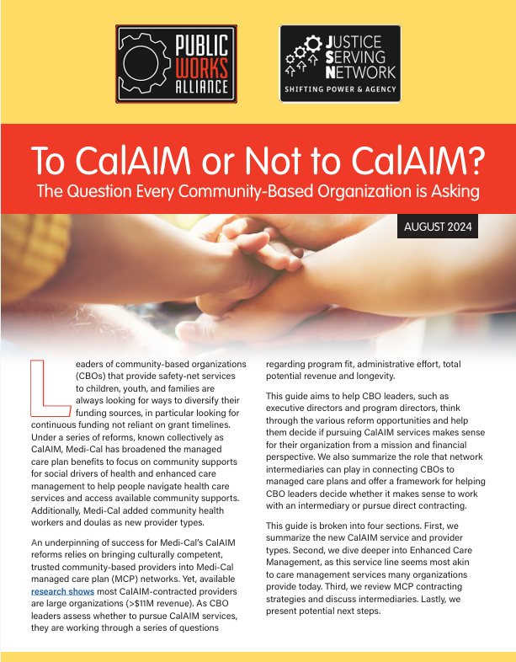
Resources
Link to document
Provides excellent overview of CalAIM, Enhanced Care Management, Community Supports, CBO considerations, Administrative needs, contracting, technical assistance.
California Health Policy Strategies, LLC
Notes:
Brooke and/or Jasmine

Slide 36

Resources
Managerial Training Series
Hosted by Training Development Unit
In-person training program for CalAIM ECM or CS managers
In Alameda and Central Valley
More information: Alameda County Central Valley
California Health Policy Strategies, LLC

