Slide 1


CalAIM Statewide Dementia Care
Learning Collaborative
February 12, 2025
California Health Policy Strategies, LLC
Notes:
David

Slide 2
Agenda
Welcome and Introductions
Updates
ECM Enrollment Data Overview
Skilled Nursing Facility Transitions Discussion
Announcements and Upcoming Meetings
California Health Policy Strategies, LLC

Slide 3
Updates
ECM Managers/Directors Ad-Hoc Meeting
TUESDAY, March 4th @ 2:00 PM
  Topics for discussion: TBA
  Meeting for ECM Managers/Directors only – email Jasmine at jlacsamana@archstone.org for link to register
California Health Policy Strategies, LLC
Notes:
Darren

Slide 4

Enhanced Care Management (ECM) Populations of Focus: Enrollment Data by County and Managed Care Plan
January 2025
Arun Dixit
California Health Policy Strategies, LLC

Slide 5

Statewide ECM Enrollment Growth
Population of Focus | 2023 Q1 | 2023 Q2 | 2023 Q3 | 2023 Q4 | 2024 Q1 | 2024 Q2 | Change (2024- Q1-2024 Q2) | Change (2023 Q1-2024 Q2)
Adult Individuals and Families Experiencing Homelessness | 21,092 | 25,506 | 29,338 | 31,348 | 36,674 | 45,879 | + 9,205 | + 24,787
Adult Individuals Transitioning from Incarceration | 1,942 | 2,139 | 1,795 | 1,543 | 1,570 | 1,811 | + 241 | - 131
Adult Individuals At Risk of Long- Term Care Institutionalization | 3,690 | 5,644 | 6,602 | 8,299 | 11,536 | 14,261 | + 2,725 | + 10,761
Adult Individuals At Risk of Avoidable Hospital or ED Utilization | 36,062 | 37,630 | 38,250 | 37,062 | 39,765 | 42,760 | + 2,995 | + 6,958
Adult Individuals with Serious Mental Health or SUD needs | 30,205 | 34,313 | 35,412 | 37,287 | 40,352 | 46,501 | + 6,149 | + 16,296
Nursing Facility Residents Who Want to Transition to the Community | 277 | 352 | 465 | 585 | 676 | 797 | + 121 | + 520
Youth Involved in Child Welfare | 0 | 0 | 204 | 1,104 | 1,742 | 1,615 | - 127 | + 1,615
Youth Transitioning from Incarceration | 0 | 0 | 0 | 17 | 87 | 149 | + 62 | + 149
Youth with Serious Mental Health or SUD Needs | 196 | 235 | 2,440 | 4,494 | 6,952 | 8,990 | + 2,08 | + 8,794
Youth at Risk of Avoidable Hospital or ED Utilization | 988 | 921 | 2,197 | 4,436 | 6,770 | 9,343 | + 2,573 | + 8,355
Youth Individuals Experiencing Homelessness | 690 | 1,177 | 1,647 | 2,856 | 4,665 | 6,919 | + 2,254 | + 6,229
Youth Enrolled in CA’s Children’s Services with Additional Needs | 59 | 69 | 452 | 1,165 | 2,170 | 3,284 | + 1,114 | + 3,225
Total | 95,201 | 107,986 | 118,802 | 130,196 | 152,959 | 182,309 | + 29,350 | + 87,198
4

Slide 6

Adults Living in the Community and At Risk of Long-Term Care Institutionalization: Eligibility Criteria
launched Jan. 2023
Are living in the community who meet the SNF Level of Care (LOC) criteria; or who require lower —acuity skilled nursing, such as time-limited and/or intermittent medical and nursing services, support, and/or equipment for prevention, diagnosis, or treatment of acute illness or injury;
AND
Are actively experiencing at least one complex or environmental factor influencing their health including but not limited to:
  Needing assistance with activities of daily living
  Communication difficulties
  Access to food
  Access to stable housing
  Living alone
  The need for conservatorship or guided decision-making
  Poor or adequate caregiving which may appear as a lack of safety monitoring
AND
3) Are able to reside continuously in the community with wraparound supports.
Source: DHCS, Enhanced Care Management Implementation Timeline & Updated Populations of Focus, https://www.dhcs.ca.gov/Documents/MCQMD/ECM-Implementation-Timeline-Updated-POFs.pdf
11

Slide 7
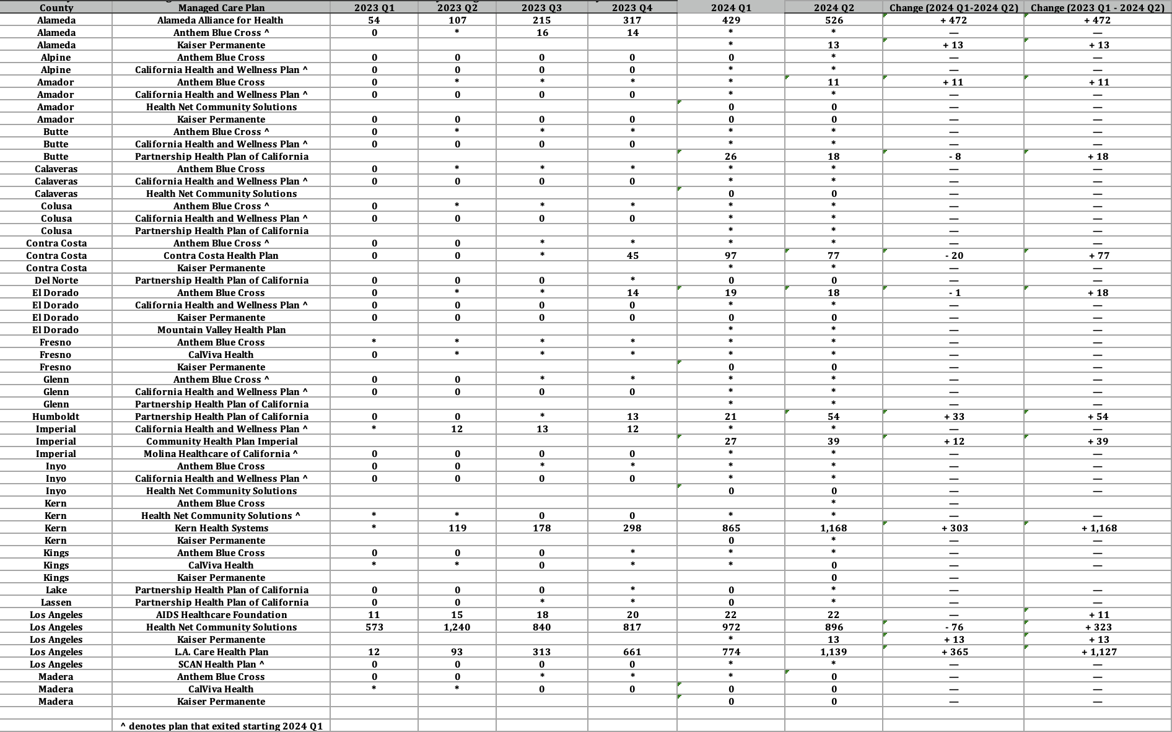
Adult Individuals At Risk of Long-Term Care Institutionalization: ECM Enrollment by County and Managed Care Plan
Source: DHCS, Total Number of Members Who Received ECM by MCP and County by Population of
Focus by Quarter, https://geohub-cadhcs.hub.arcgis.com/datasets/CADHCS::ecm-community-support-data-tables-for- quarterly-implementation-report/explore?layer=26&showTable=true

Slide 8
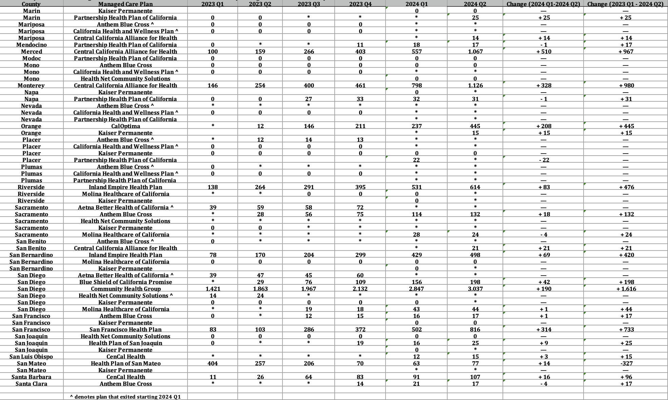
Adult Individuals At Risk of Long-Term Care Institutionalization: ECM Enrollment by County and Managed Care Plan (continued)
Source: DHCS, Total Number of Members Who Received ECM by MCP and County by Population of
Focus by Quarter, https://geohub-cadhcs.hub.arcgis.com/datasets/CADHCS::ecm-community-support-data-tables-for
-quarterly-implementation-report/explore?layer=26&showTable=true

Slide 9
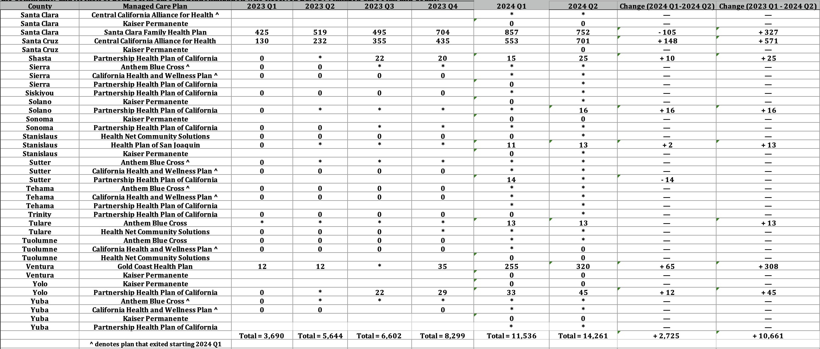
Adult Individuals At Risk of Long-Term Care Institutionalization: ECM Enrollment by County and Managed Care Plan (continued)
Source: DHCS, Total Number of Members Who Received ECM by MCP and County by Population of
Focus by Quarter, https://geohub-cadhcs.hub.arcgis.com/datasets/CADHCS::ecm-community-support-data-tables-for-
quarterly-implementation-report/explore?layer=26&showTable=true
California Health Policy Strategies, LLC
13

Slide 10
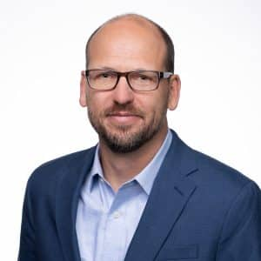
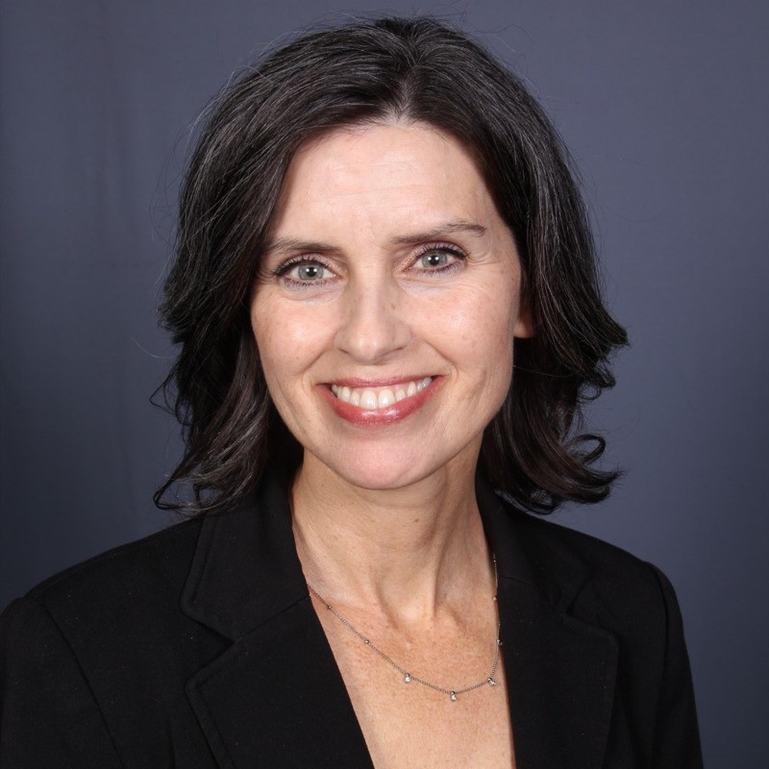
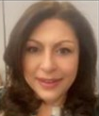
Skilled Nursing Facility Transitions discussion
  Dustin Harper
  Chief Strategy Officer
  Institute on Aging
  DeAnn Walters
  Director of Clinical Affairs &
  Quality Improvement;
  California Association of Health Facilities
  Aurelia Zamarripa
  Manager,
  Practice Coach – ECM
  Inland Empire Health Plan
California Health Policy Strategies, LLC
Notes:
Darren

Slide 11
Upcoming Meetings
Upcoming Collaborative Meetings
Register here for all 2025 meetings
Meeting #16: Wednesday, March 12, 12:00 – 1:00 PM
Topic of Focus: D-SNP Policy Guide Overview
Adults with Documented Dementia Needs
Meeting #17: Wednesday, April 2, 12:00 – 1:00 PM
Meeting #18: Wednesday, May 14, 12:00 – 1:00 PM
Meeting #19: Wednesday, June 11, 12:00 – 1:00 PM
California Health Policy Strategies, LLC
Notes:
Brooke and/or Jasmine

Slide 12

Resources
DHCS: All Comer Webinar on Closed-Loop Referral Implementation Guidance
Thursday, February 13, 2025, from 10:00-11:00am PST
The CLR Implementation Guidance outlines requirements for MCPs in implementing Closed-Loop Referrals under managed care; including tracking, supporting and monitoring CLRs.
new requirements will ensure more MCP members are connected to the care they need by identifying and addressing gaps in referral paths.
Register here
California Health Policy Strategies, LLC
Notes:
Brooke and/or Jasmine

Slide 13

Resources
Link to document
Provides excellent overview of CalAIM, Enhanced Care Management, Community Supports, CBO considerations, Administrative needs, contracting, technical assistance.
California Health Policy Strategies, LLC
Notes:
Brooke and/or Jasmine

Slide 14

Resources
Managerial Training Series
Hosted by Training Development Unit
In-person training program for CalAIM ECM or CS managers
In Alameda and Central Valley
More information:
Alameda County
Central Valley
California Health Policy Strategies, LLC
Notes:
Brooke and/or Jasmine

