Slide 1


CalAIM Statewide Dementia Care
Learning Collaborative
January 15, 2025
California Health Policy Strategies, LLC
Notes:
David

Slide 2
Agenda
Welcome and Introductions
Updates
IHSS program referrals
Announcements and Upcoming meetings
California Health Policy Strategies, LLC

Slide 3
Updates
ECM Managers/Directors Ad-Hoc Meeting Wednesday, January 22 at 2:00 PM
Topics for discussion: ECM Referral Forms, Transitional Benefits, and IHSS linkages Meeting for ECM Managers/Directors only – email Jasmine at jlacsamana@archstone.org for link to register
California Health Policy Strategies, LLC
Notes:
Darren

Slide 4
Managed Care Plans
ECM Managers/Directors Ad-Hoc Meeting Wednesday, January 22 at 2:00 PM
Topics for discussion: ECM Referral Forms, Transitional Benefits, and IHSS linkages Meeting for ECM Managers/Directors only – email Jasmine at jlacsamana@archstone.org for link to register
California Health Policy Strategies, LLC
Notes:
Jane

Slide 5

IHSS and CalAIM: Opportunities for Collaboration
January 15, 2025
Presented by Cathy Senderling-McDonald CalAIM Dementia Collaborative

Slide 6

Goals of This Presentation
Refresher on IHSS Program and CalAIM ECM Benefit
IHSS Clients and CalAIM Populations of Focus Overlaps
Snapshot of Current IHSS Caseloads and ECM Uptake
Project Overview: Increasing Referrals in IHSS
Discussion / Feedback

Slide 7
IHSS & CalAIM ECM
Structure | Overlaps & Referral Processes

Slide 8
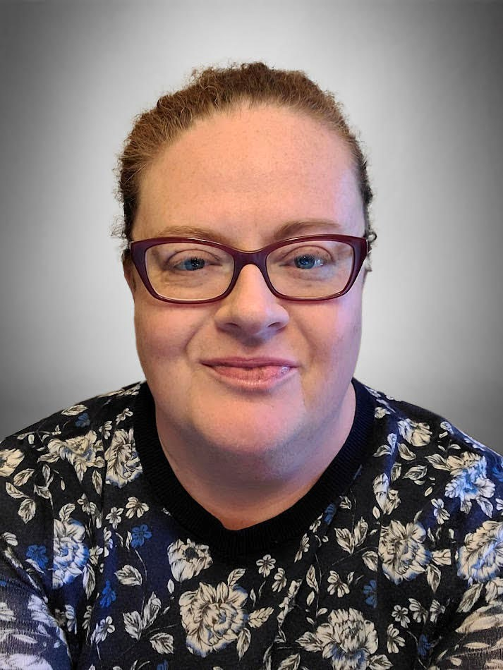
Catbird Strategies
Cathy Senderling-McDonald, CEO
28 years experience in health & human services policy and practice
23 years with County Welfare Directors Association of CA
Staffed Senate Budget Committee, Legislative Analyst’s Office
Budget, Legislative Processes and Administrative Advocacy

Slide 9
In-Home Supportive Services (IHSS)
IHSS provides in-home assistance to eligible elder adults and adults
or children who are sight impaired or have disabilities. IHSS is an
alternative to out of home care and enables recipients to remain
safely in their own homes.
IHSS have been assessed as having a need for services offered by the
program. A Medi-Cal eligibility determination is required, as is an in-
home assessment by a county IHSS social worker to identify and document service needs.
Those found eligible for IHSS receive a monthly authorization for a
certain number and type of service hours to help with activities of
daily living.
Providers are hired, supervised and fired by the IHSS recipient and are
paid according to an hourly wage negotiated in each county. Some
counties also offer contracted staff or homemaker employees.

Slide 10
IHSS Roles and Responsibilities
The Department of Health Care Services (DHCS) maintains the State Plan
authority under Medicaid to draw down federal funding for eligible recipients.
The Department of Social Services (CDSS) administers the day-to-day
aspects of the program at the state level and operates the information technology system, CMIPS.
County Human Services Agencies administer the program locally, including assessing eligibility and authorizing hours and types of service.
Public Authorities in each county oversee IHSS provider enrollment and
training, conduct background checks, make referrals, maintain registries of providers, and negotiate wages and benefits.
IHSS providers care for recipients according to authorized hours and types
of service.
IHSS recipients hire, fire, and supervise their own providers.

Slide 11
IHSS Services (all must be approved)
Domestic services
Meal preparation and cleanup
Laundry
Shopping for groceries, other shopping or errands
Nonmedical personal care services, such as bathing, grooming, dressing, bowel and bladder care
Accompaniment to medical appointments
Paramedical services (e.g., wound care, help with medicine, feeding
tubes, home therapy treatments)
Protective supervision (authorized only for individuals with mental impairments such as impaired cognition, judgement or memory)
Heavy cleaning, yard hazard abatement (generally one time or time
limited benefits when needed under special circumstances)

Slide 12
CalAIM Enhanced Case Management
A whole-person, interdisciplinary approach to care that addresses clinical and non-clinical needs of MCP members with the most complex medical and social needs.
ECM provides systematic coordination of services and comprehensive care management that is community based, interdisciplinary, high touch and person centered.
DHCS envisions ECM coordinating all care for MCP members who receive it, including across physical and behavioral health delivery systems.
ECM is a statewide Medi-Cal benefit.

Slide 13
Adult ECM Populations of Focus
Adults Living in the Community & At Risk for LTC Institutionalization
Adults who:
Are living in the community who meet the SNF Level of Care criteria, OR who require lower-acuity skilled nursing such as time-limited and/or intermittent medical and nursing services, support, and/or equipment for prevention, diagnosis, or treatment of acute illness or injury.
AND
Are actively experiencing at least one complex social or environmental factor influencing their health (including, but not limited to, needing assistance with activities of daily living, communication difficulties, access to food, access to stable housing, living alone, the need for conservatorship or guided decision- making, poor or inadequate caregiving which may appear as a lack of safety monitoring);
AND
Are able to reside continuously in the community with wraparound supports (i.e., some individuals may not be eligible because they have high-acuity needs or conditions that are not suitable for home- based care due to safety or other concerns).

Slide 14
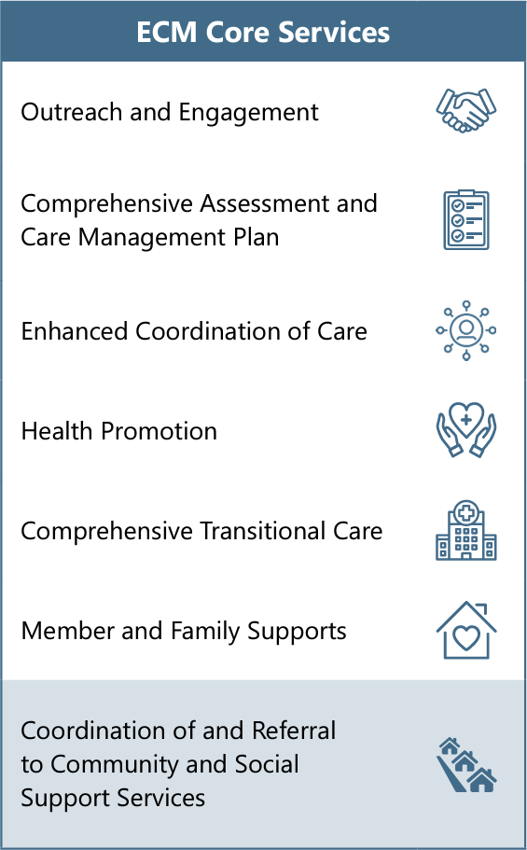
ECM Core Services
ECM Providers are required to offer all seven of these core services.
ECM Lead Care Managers are strongly encouraged to screen MCP members receiving ECM for community support needs. Community supports are services provided by MCPs as cost-effective alternatives to traditional medical services or settings.
All MCPs are encouraged to offer as many of the 14 Community Supports as possible, but not all plans may offer the entire suite of services. Examples of Community Supports include:
Asthma Remediation
Medically Supportive Food/Medically Tailored Meals
Respite Services
Short-Term Post-Hospitalization Housing
Housing Transition Navigation Services
Housing Deposits
Housing Tenancy and Sustaining Services
Sobering Centers
Home Modifications
Personal Care Services
Day Habilitation Programs
Nursing Facility Transition
Community Transition
Recuperative Care

Slide 15
IHSS and ECM Overlaps
IHSS recipients can also receive ECM services if they are enrolled in a managed care plan, meet ECM population of focus criteria.
IHSS adults should generally meet the criteria given the underlying requirements of the IHSS program (i.e., the SOC 873).
Both children and adults may receive both IHSS and ECM if they meet criteria for both sets of services.
It is crucial to avoid service duplication across IHSS and ECM.
Data collected to date suggest that the vast majority of IHSS recipients are not receiving ECM, despite likely eligibility for many.

Slide 16
Referring IHSS Recipients to ECM
Referrals can be made from multiple sources, most likely:
County IHSS Social Worker
Public Authority Staff
IHSS Provider
DHCS produced template referral forms that MCPs can customize
If individual meets the POF definition, they are eligible for ECM
MCPs cannot add requirements or narrow the POF definition

Slide 17
Snapshot: Program Data
IHSS Caseload | ECM Receipt | Connecting the Dots

Slide 18
IHSS Data: Caseload and Gender
November 2024
809,972 Recipients served by 719,614 providers
36.7% considered “Severely Impaired” | Average 159.9 hours/mo
62.9% considered “Non-Severely Impaired” | Average 92.9 hours/mo
62.9% considered Disabled
36.0% considered Aged
1.1% considered Blind
57.4% female (468,753) | 42.6% male (348,127)

Slide 19
IHSS Data: Age Breakdown
November 2024: IHSS Recipients, Percent by Age
25
21.0%
20.5%
20
19.6%
15
14.3%
14.2%
10.4%
10
5
0
0-17 years
18-44 years
45-64 years
65 to 74 years 75 to 84 years
85+ years

Slide 20
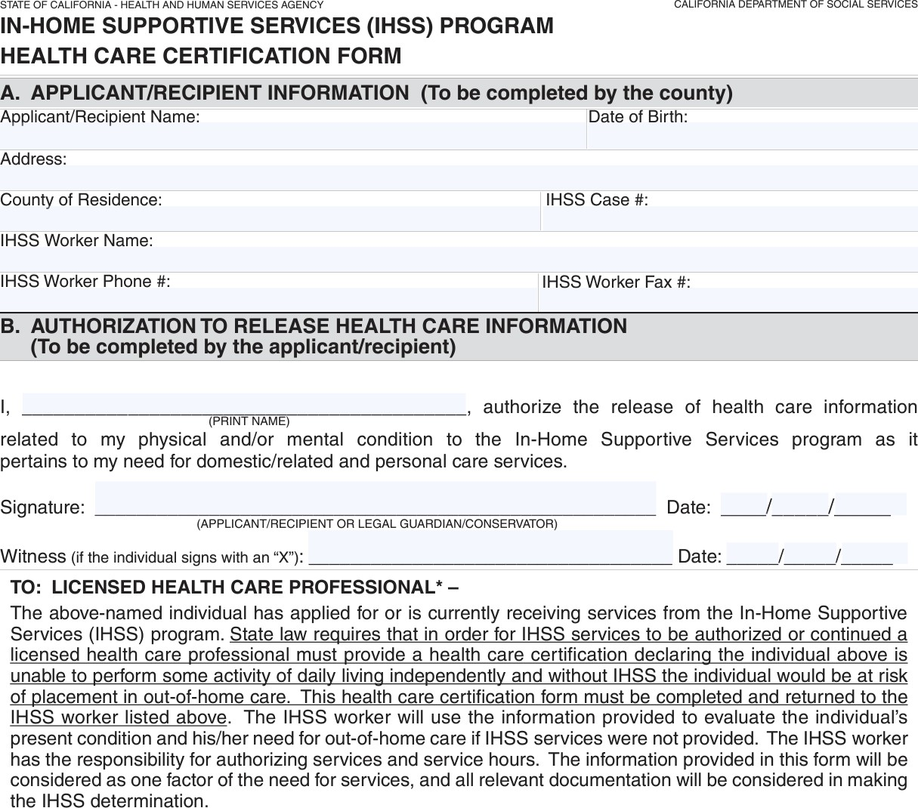
SOC 873: “Health Care Certification Form”
“State law requires that in order for IHSS services to be authorized or continued a licensed health care professional must provide a
… certification declaring the individual above is unable to
without IHSS the individual
perform some activity of daily
living independently | and
would be
at risk of placement in
out-of-home care
.”
Download at: https://www.cdss.ca.gov/cdssweb/entres/forms/english/soc873.pdf
11

Slide 21
ECM Data: Receipt of ECM
244,800 unique members received some kind of ECM benefit since ECM launched in January 2022
176,000 unique members received ECM during the most recent 12 months, from July 1, 2023 through June 30, 2024.
The recent trend has been towards continued growth, with 127,000 unique members receiving ECM during the most recent reporting period of April 1 through June 30, 2024.
Source: DHCS, accessed at: https://storymaps.arcgis.com/collections/a07f998dfefa497fbd7613981e4f6117?item=4
17

Slide 22
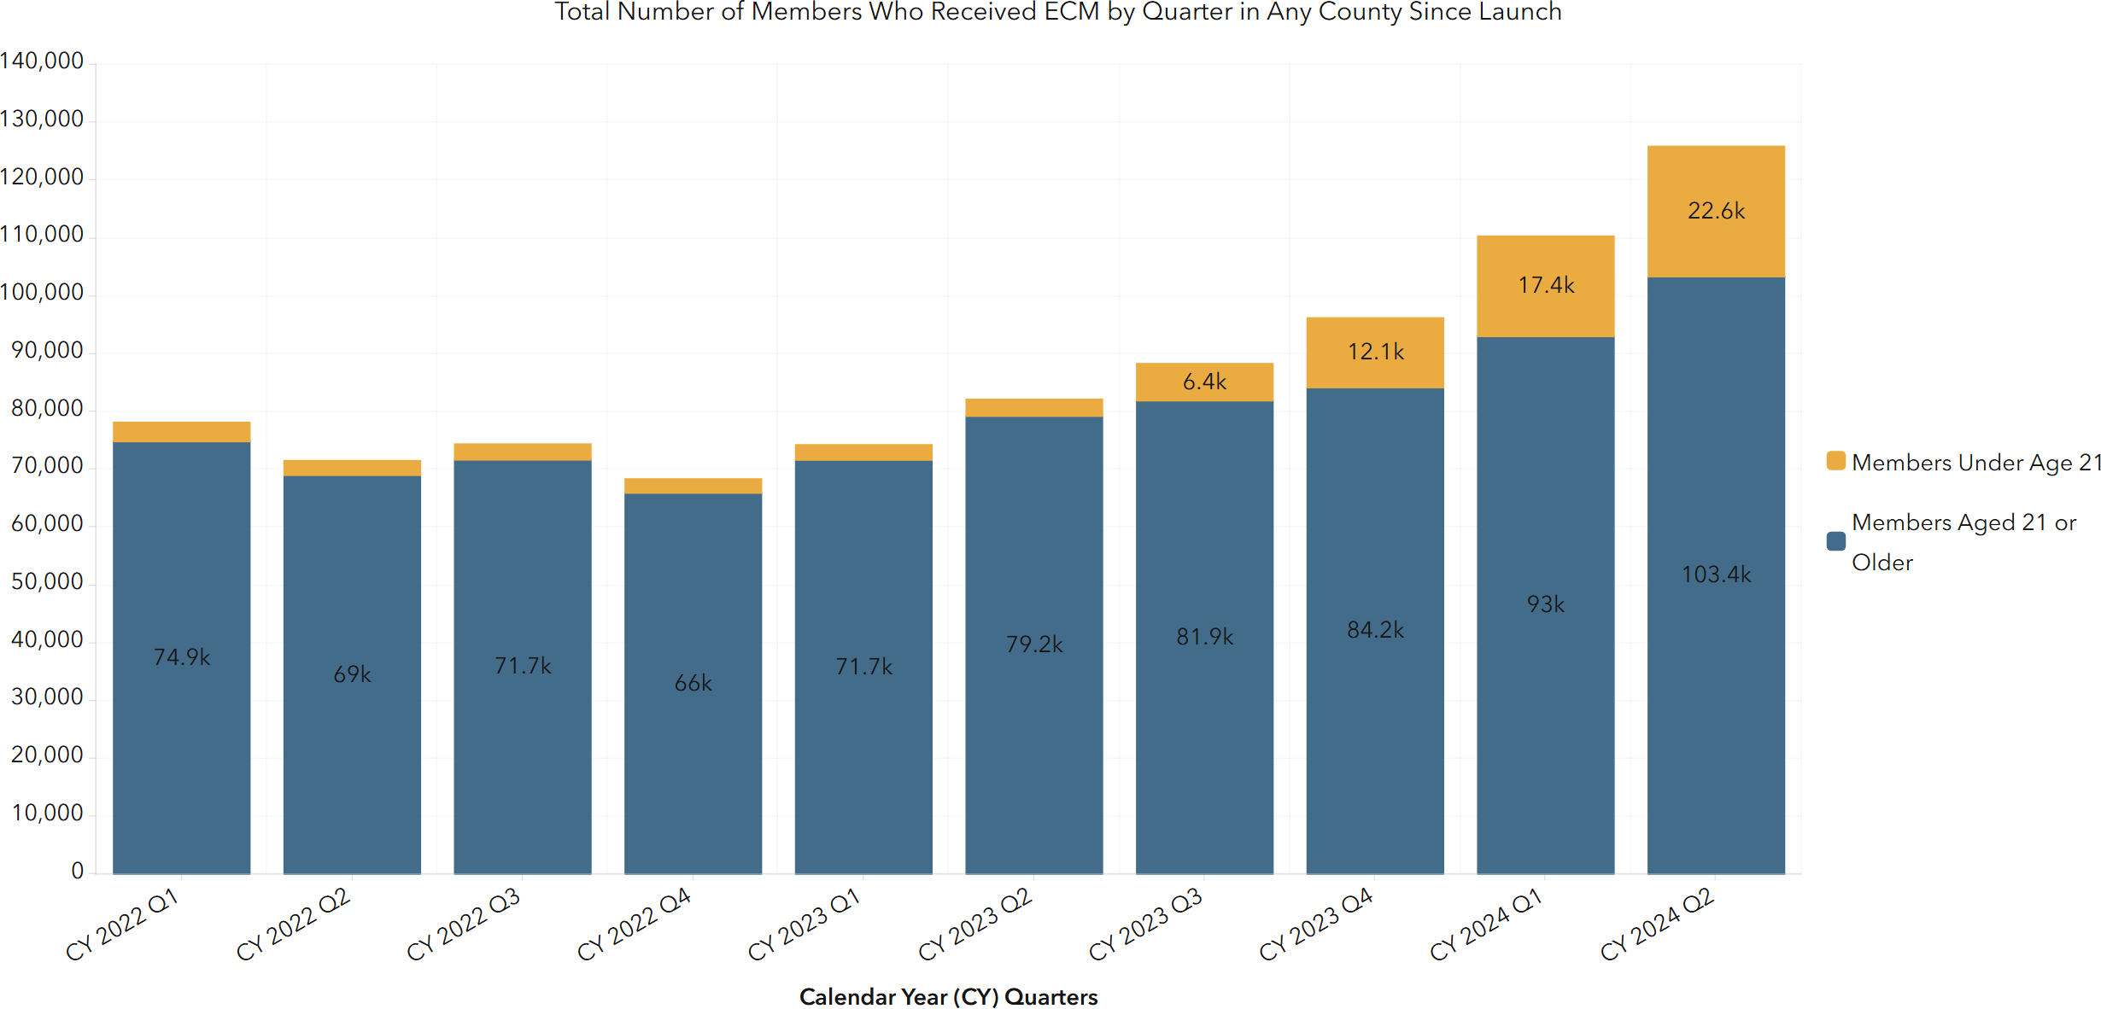
ECM Data: Receipt by Age, Quarterly
Source: DHCS, accessed at https://cadhcs.maps.arcgis.com/apps/dashboards/a622d2397ff6457eb13d65db9f301d61
18

Slide 23
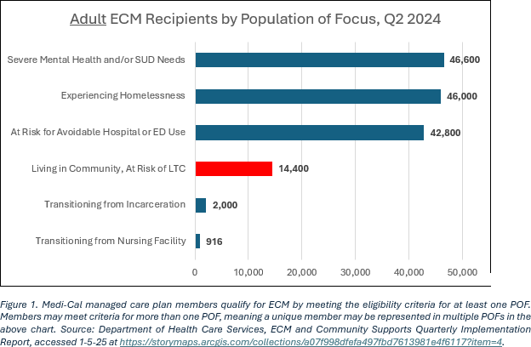
ECM Data: Populations of Focus
19

Slide 24
Increasing IHSS ECM Uptake
Key Assumptions | Data | Toolkit

Slide 25
Where We Are
Assumptions About IHSS Referrals to ECM…
Lack of training about how to make a referral and why/when to do so
Lack of materials targeted towards key IHSS constituencies
Greater focus should lead to more referrals and greater uptake
Need for regular data sharing across programs
State Engagement
Data reports – develop and/or restart for MCPs to utilize
Toolkit development and maintenance
Monitor uptake specifically in IHSS population
Timing is good (2025 goals)

Slide 26
3 Major Project Components
Review and Analysis
Program Data, Reporting, and Data Sharing Across DHCS/MCPs
Training and Outreach Materials
Referral Tools and Processes
Development of Focused IHSS/ECM Toolkit
Targeted Training and Outreach Materials
Potential Enhancements to Referral Tools and Processes
Test, Refine and Disseminate Materials
Refine Based on Feedback from Pilot Testing
Disseminate to MCPs, Counties, Public Authorities, Unions/Providers

Slide 27
Seeking Feedback & Partnership
Are we on the right track?
Are we diagnosing the situation correctly?
What are we missing?
Do you want to help? Need plans, counties, PA’s, union support!
Email csm@catbirdstrategies.com or drop info in chat
***Huge thanks to Archstone Foundation for funding project & to CalHPS for the opportunity to be involved***

Slide 28
Thank You!
Cathy Senderling-McDonald, CEO csm@catbirdstrategies.com

Slide 29
Resource Links
DHCS: Enhanced Care Management Policy Guide - https://www.dhcs.ca.gov/CalAIM/ECM/Documents/ECM-Policy-Guide.pdf
DHCS: Enhanced Care Management for Children and Youth: A Population of Focus Spotlight – https://www.dhcs.ca.gov/CalAIM/ECM/Documents/ECM- Children-And-Youth-POFs-Spotlight.pdf
Justice In Aging Issue Brief: Breaking Down Barriers to Personal Care Services: Unlocking Vital Services for Those Who Need Them Most - https://www.capaihss.org/wp-content/uploads/2024/11/Breaking-Down- Barriers-to-Personal-Care-JIA-Oct-24.pdf
California Health Care Foundation Fact Sheet: In-Home Supportive Services 101: Opportunities and Challenges Under CalAIM (Prepared by Chapman Consulting) - https://www.chcf.org/publication/in-home- supportive-services-101-opportunities-and-challenges-under-calaim/

Slide 30
Relevant Populations of Focus
Children and Youth Populations of Focus
Children and Youth Experiencing Homelessness
Children and Youth at Risk for Avoidable Hospital or Emergency Department Utilization
Children and Youth With Serious Mental Health and/or Substance Use Disorder Needs
Children and Youth Enrolled in California Children’s Services (CCS) or CCS Whole Child Model with Additional Needs Beyond the CCS Condition
Children and Youth Involved in Child Welfare
Birth Equity
Individuals Transitioning from Incarceration

Slide 31
Upcoming Meetings
Upcoming Collaborative Meetings
Register here for all 2025 meetings
Meeting #15: Wednesday, February 12, 12:00 – 1:00 PM
Meeting #16: Wednesday, March 12, 12:00 – 1:00 PM
Meeting #17: Wednesday, April 2, 12:00 – 1:00 PM
Meeting #18: Wednesday, May 14, 12:00 – 1:00 PM
Meeting #19: Wednesday, June 11, 12:00 – 1:00 PM
Next Collaborative Meeting – Wednesday, February 12th at 12:00 PM Topic of Focus: Transitions to Community from Skilled Nursing Facilities
DHCS All Comer Webinar on Closed-Loop Referral Implementation Guidance February 13, 10:00 AM Register at: https://manatt.zoom.us/webinar/register/WN_M4BRoACsQpSfB7zjZ2E1lQ#/registration
California Health Policy Strategies, LLC
Notes:
Brooke and/or Jasmine

